Slide 1
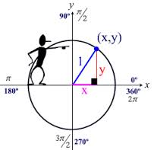
Unit Circle lesson 13-6
(an introduction)
Learning Targets:
I can solve special right triangles on the coordinate plane.
I can find exact values of trigonometric functions.

Slide 2
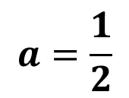
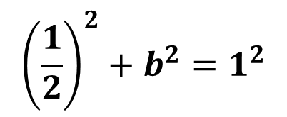
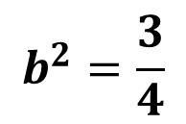
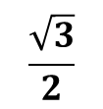
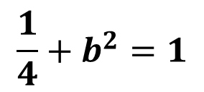
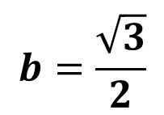
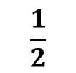
30º-60º-90º Right Triangles
With Hypotenuse of 1:
Think about it as half of an equilateral triangle.
30º
30º
1
1
Now, what is a?
b
60º
60º
a
Use the Pythagorean Theorem to solve for b.
30º
1
60º

Slide 3
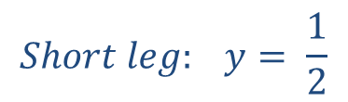
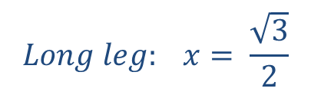
Special Right Triangles.
Triangles:
$$Short leg: y= \frac{1}{2}$$
1
y
$$Long leg: x= \frac{\sqrt{3}}{2}$$
x

Slide 4


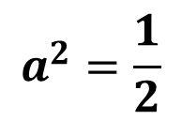
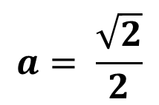
Isosceles Right Triangles
With Hypotenuse of 1:
Use the Pythagorean Theorem
45º
1
a
45º
a

Slide 5
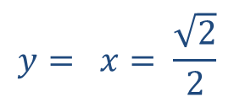
Special Right Triangles.
Triangles:
1 y
x
$$y= x= \frac{\sqrt{2}}{2}$$
y
x

Slide 6
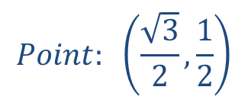

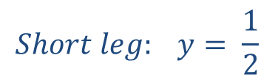
Example 1: Find the exact value of x and y on the
coordinate plane.
y
( , )
.
1
y
x
x
$$Short leg: y= \frac{1}{2}$$
$$Point: \left(\frac{\sqrt{3}}{2},\frac{1}{2}\right)$$
$$Long leg: x= \frac{\sqrt{3}}{2}$$

Slide 7
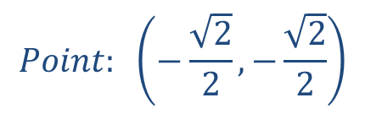
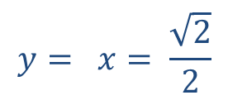
Example 1: Find the exact value of x and y on the
coordinate plane.
y
$$y= x= \frac{\sqrt{2}}{2}$$
Think about the location!
x
x
y
1
$$Point: \left(−\frac{\sqrt{2}}{2},−\frac{\sqrt{2}}{2}\right)$$
.
( , )

Slide 8
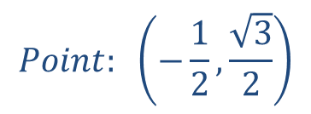
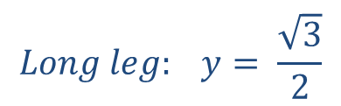
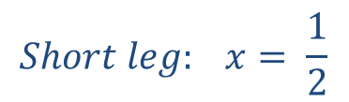
Example 2: Find the exact value of x and y on the
coordinate plane.
( , )
.
y
$$Point: \left(−\frac{1}{2},\frac{\sqrt{3}}{2}\right)$$
Think about the location!
1
y
x
x
$$Short leg: x= \frac{1}{2}$$
$$Long leg: y= \frac{\sqrt{3}}{2}$$

Slide 9
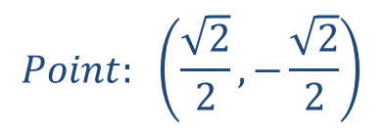
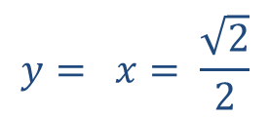
Example 2: Find the exact value of x and y on the
coordinate plane.
y
$$y= x= \frac{\sqrt{2}}{2}$$
Think about the location!
x
x
y
1
.
( , )
$$Point: \left(\frac{\sqrt{2}}{2},−\frac{\sqrt{2}}{2}\right)$$

Slide 10
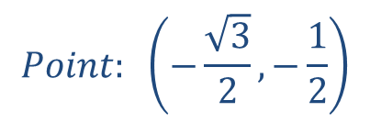
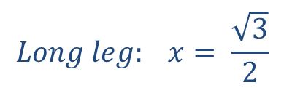
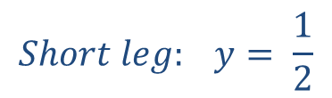
Your Turn 1: Find the exact value of x and y on the
coordinate plane.
y
$$Short leg: y= \frac{1}{2}$$
$$Long leg: x= \frac{\sqrt{3}}{2}$$
x
x
y
1
.
( , )
$$Point: \left(−\frac{\sqrt{3}}{2},−\frac{1}{2}\right)$$

Slide 11
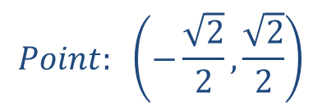
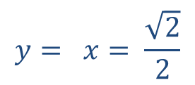
Your Turn 1: Find the exact value of x and y on the
coordinate plane.
y
( , )
.
$$y= x= \frac{\sqrt{2}}{2}$$
1
y
$$Point: \left(−\frac{\sqrt{2}}{2},\frac{\sqrt{2}}{2}\right)$$
x
x

Slide 12
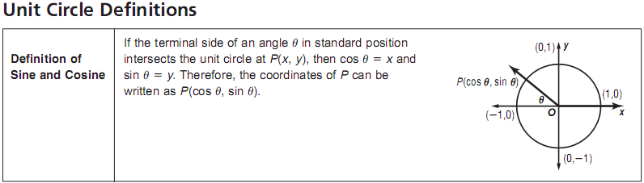
Remember:
=
where
and
Find all the coordinates of the unit circle.
(Hint: One LEG of the triangle must be on the x-axis)

Slide 13
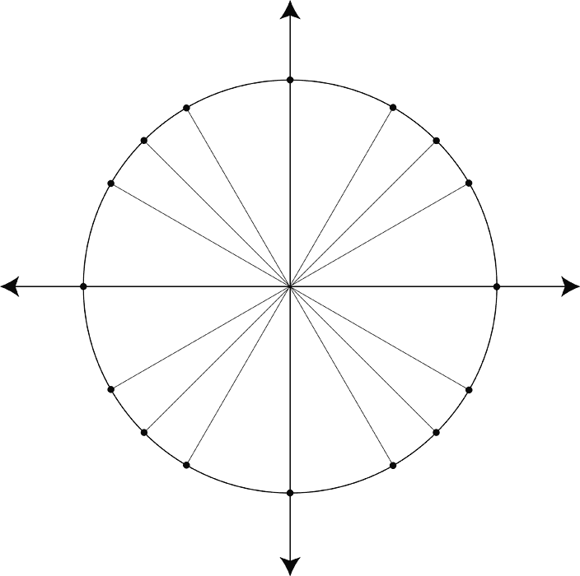
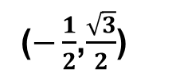
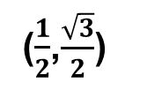
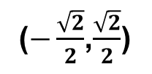
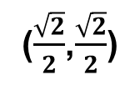
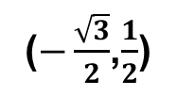
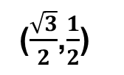
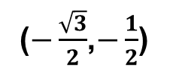
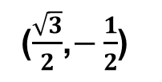
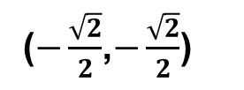
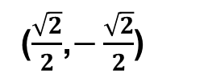
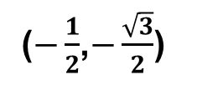
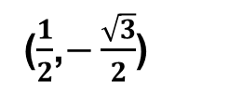
















The Unit Circle: r = 1
1
$$\frac{\sqrt{2}}{2}$$
(0,1)
$$\frac{\sqrt{2}}{2}$$
Q – II
( - , + )
Q – I
( +, + )
90°
120°
60°
$$\frac{π}{2}$$
$$\frac{2π}{6}=\frac{π}{3}$$
45°
135°
$$\frac{2π}{3}$$
150°
$$\frac{3π}{4}$$
$$\frac{π}{4}$$
30°
$$\frac{5π}{6}$$
$$\frac{π}{6}$$
(-1,0)
180°
π
0
0°
360°
(1,0)
2π
$$\frac{7π}{6}$$
$$\frac{11π}{6}$$
30º
210°
$$\frac{7π}{4}$$
330°
1
$$\frac{5π}{4}$$
$$\frac{4π}{3}$$
$$\frac{5π}{3}$$
225°
$$\frac{3π}{2}$$
315°
240°
300°
Q – III
( - , - )
270°
Q – IV
( + , - )
60º
(0,-1)

Slide 14







































Divide by 12
$$\frac{6π}{12}$$
(0,1)
$$\frac{5π}{12}$$
$$\frac{7π}{12}$$
$$\frac{8π}{12}$$
$$\frac{4π}{12}$$
$$\frac{9π}{12}$$
$$\frac{π}{2}$$
$$\frac{3π}{12}$$
$$\frac{2π}{3}$$
$$\frac{π}{3}$$
$$\frac{10π}{12}$$
$$\frac{3π}{4}$$
$$\frac{π}{4}$$
$$\frac{2π}{12}$$
$$\frac{11π}{12}$$
$$\frac{5π}{6}$$
$$\frac{π}{6}$$
$$\frac{1π}{12}$$
$$\frac{12π}{12}$$
(-1,0)
π
0
(1,0)
$$\frac{0π}{12}$$
$$\frac{24π}{12}$$
2π
$$\frac{13π}{12}$$
$$\frac{23π}{12}$$
$$\frac{7π}{6}$$
$$\frac{11π}{6}$$
$$\frac{14π}{12}$$
$$\frac{5π}{4}$$
$$\frac{7π}{4}$$
$$\frac{22π}{12}$$
$$\frac{4π}{3}$$
$$\frac{5π}{3}$$
$$\frac{15π}{12}$$
$$\frac{3π}{2}$$
$$\frac{21π}{12}$$
$$\frac{16π}{12}$$
$$\frac{20π}{12}$$
$$\frac{17π}{12}$$
$$\frac{19π}{12}$$
(0,-1)
$$\frac{18π}{12}$$
Notes:
Animation order: axes, then four unit points, then dividing lines that break pi into twelfths, after the appearance of 24pi/12, have students recognize that we now just simplify fractions and we don’t use the red lines any more. Then show the simplified fractions. Then, look for patterns to help you remember: Q1 from the top, denominators are 2, 3, 4, 6; QII, from the top, denominators are 2, 3, 4,6 and numerators are one less than the denominator; QIII, from the bottom, denominators are 2, 3, 4, 6 and numerators are one more than denoms; QIV, from the bottom, denominators are 2, 3, 4, 6 and numerators are double the denom less 1.

Slide 15
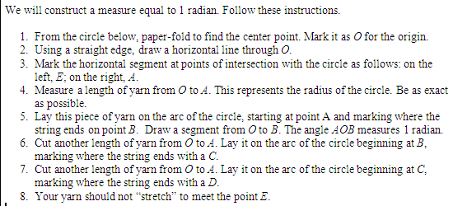
What is a Radian?

Slide 16

What is a Radian?

Slide 17
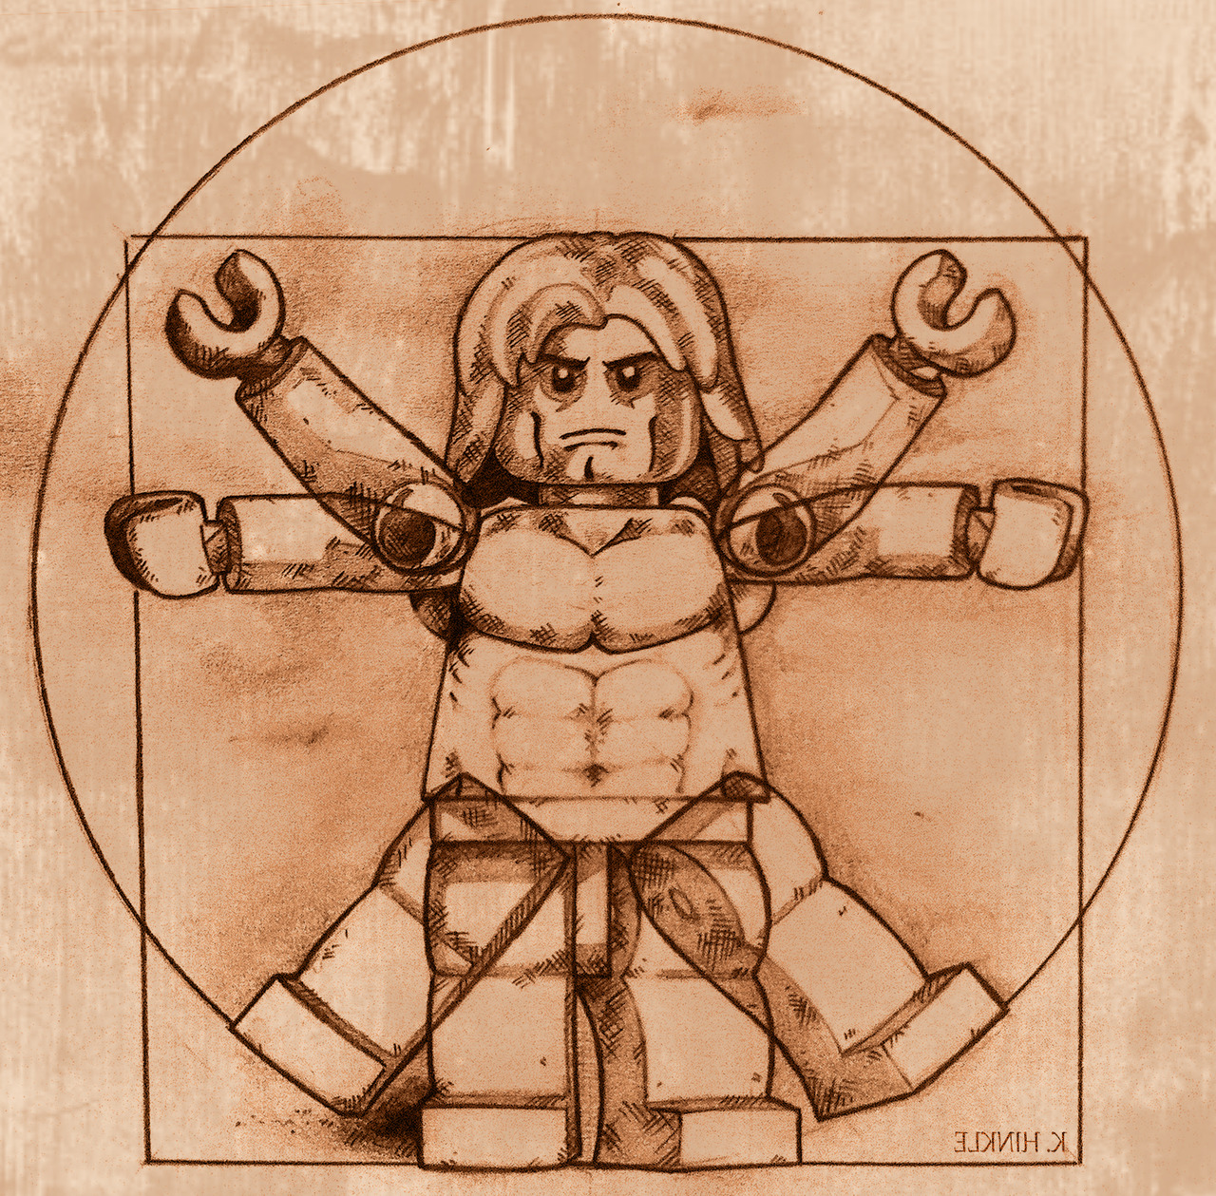
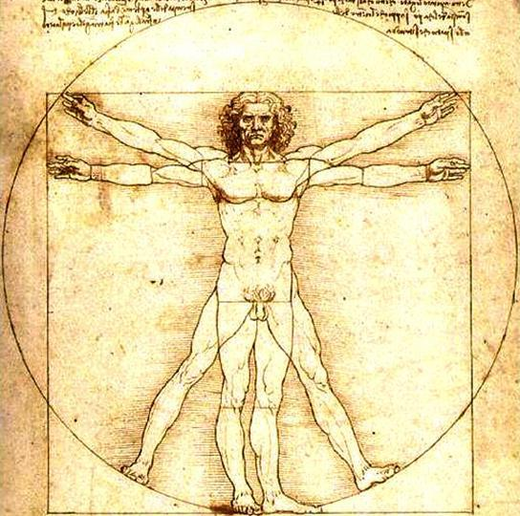
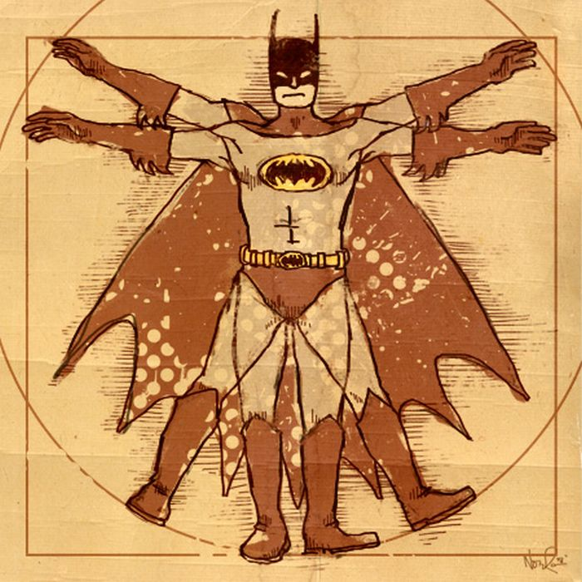
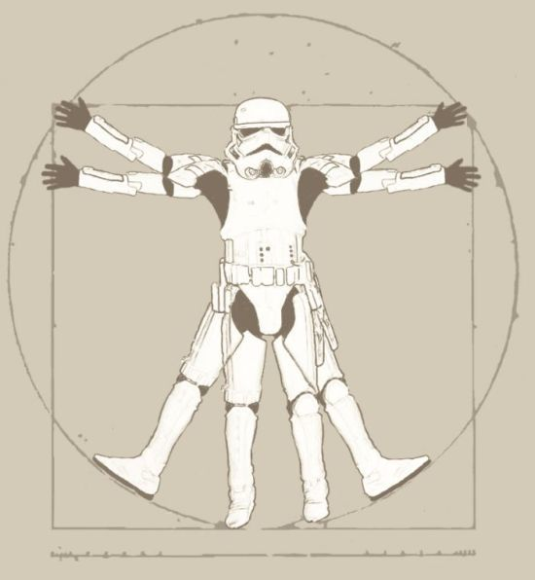
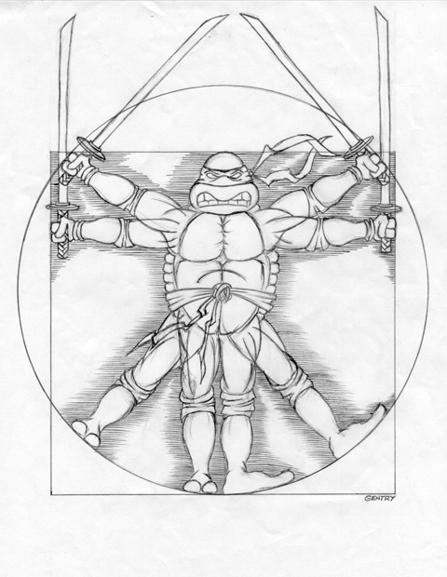
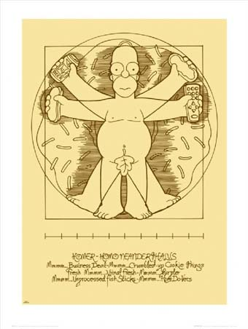
Da Vinci: Vitruvian Man

Slide 18
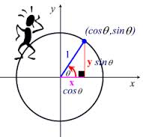




Big Idea: Lesson 13-6
1
The unit circle has a radius of ________.
P(x, y) = P( , )
where x =
y =
$$\cos{θ}$$
$$\sin{θ}$$
$$\cos{θ}$$
$$\sin{θ}$$
Learning Targets:
Can you solve special right triangles on the coordinate plane?
Can you find exact values of trigonometric functions?

Slide 19
Angles and Angle Measure lesson 13-2
Learning Targets:
I can change radian measure to degree measure and vice versa.
I can identify co-terminal angles.

Slide 20
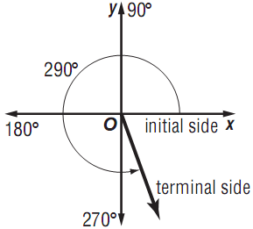
Angle Measurement: An angle is determined by two rays.
The degree measure of an angle is described by the
amount and direction of rotation from the initial side
along the positive x-axis to the terminal side.
Positive angle:
Negative angle:
______ degrees = _____ radians
180°
π

Slide 21
















Example 1: Rewrite each degree measure in radians
and each radian measure in degrees.
degrees → radians (multiply by )
radians → degrees (multiply by )
$$\frac{90°}{1}∙\frac{π}{180°}$$
$$= \frac{π}{2}$$
$$= \frac{2π}{2}= π$$
$$−\frac{3π}{2}∙\frac{180°}{π}$$
$$=−270°$$
$$\frac{180°}{1}∙\frac{π}{180°}$$
$$\frac{270°}{1}∙\frac{π}{180°}$$
$$= \frac{3π}{2}$$
$$\frac{5π}{3}∙\frac{180°}{π}$$
$$=300°$$
$$\frac{360°}{1}∙\frac{π}{180°}$$
$$= \frac{4π}{2}=2π$$
$$\frac{45°}{1}∙\frac{π}{180°}$$
$$= \frac{π}{4}$$
$$\frac{60°}{1}∙\frac{π}{180°}$$
$$= \frac{π}{3}$$

Slide 22












Your Turn 1: Rewrite each degree measure in radians
and each radian measure in degrees.
a.
$$\frac{140°}{1}∙\frac{π}{180°}$$
$$= \frac{7π}{9}$$
$$\frac{−860°}{1}∙\frac{π}{180°}$$
$$= \frac{43π}{9}$$
b.
c.
$$−\frac{3π}{5}∙\frac{180°}{π}$$
$$=−108°$$
d.
$$\frac{11π}{3}∙\frac{180°}{π}$$
$$=660°$$

Slide 23

Example 2: Draw the following angles measures in
standard notation.
a.
b.

Slide 24


Your Turn 2: Draw the following angles measures in
standard notation.
a.
b.

Slide 25









Coterminal Angles: Two angles in standard position that
have the same terminal side. You can find a coterminal
angle by adding or subtracting
________degrees or ________ radian.
Example 3: Find one positive and negative angle measure
coterminal with each angle.
a.
360°
2π
$$2π$$
b.
c.
690° - 360°= 330°
-130° - 360°= -490°
$$\frac{3π}{8} + \frac{16π}{8}$$
$$=\frac{19π}{8}$$
330° - 360°= -30°
-130° + 360°= 230°
$$\frac{3π}{8} − \frac{16π}{8}$$
$$=\frac{−13π}{8}$$
$$2π$$

Slide 26











Your Turn 3: Find one positive and negative angle measure
coterminal with each angle.
a. b. c.
-75° - 360°= -435°
$$\frac{−13π}{6} + \frac{12π}{6}$$
$$=\frac{−1π}{6}$$
$$\frac{17π}{5} − \frac{10π}{5}$$
$$=\frac{7π}{5}$$
-75° + 360°= 285°
$$\frac{−1π}{6} + \frac{12π}{6}$$
$$=\frac{11π}{6}$$
$$\frac{7π}{5} − \frac{10π}{5}$$
$$=\frac{−3π}{5}$$

Slide 27
Big Idea: Lesson 13-2
Learning Targets:
Can you change radian measure to degree measure and vice versa?
Can you identify co-terminal angles.

Slide 28
Warm-up:
On scrap paper… or… the back of your HW

Slide 29

Warm-up:

Slide 30





Warm-up:
y
1) Find the exact value of x and y on the coordinate
plane for a 60⁰ in Quadrant III.
Think about the location!
$$Short leg: x= \frac{1}{2}$$
x
x
$$Long leg: y= \frac{\sqrt{3}}{2}$$
y
1
$$Point: \left(−\frac{1}{2},−\frac{\sqrt{3}}{2}\right)$$
( , )
y
2) Find the exact value of x and y on the coordinate
plane for a 45⁰ in Quadrant IV.
Think about the location!
$$y= x= \frac{\sqrt{2}}{2}$$
x
x
$$Point: \left(\frac{\sqrt{2}}{2},−\frac{\sqrt{2}}{2}\right)$$
1
y
( , )

Slide 32
Trigonometric Functions of General Angles lesson 13-3
Learning Targets:
I can find values of trigonometric functions for general angles.
I can use reference angles to find values of trigonometric
functions.

Slide 33





Slide 34








Trigonometric Values
$$\frac{opp}{hyp}= \frac{y}{r}$$
$$\frac{hyp}{opp}= \frac{r}{y}$$
r
$$\frac{adj}{hyp}= \frac{x}{r}$$
$$\frac{hyp}{adj}= \frac{r}{x}$$
y
x
$$\frac{opp}{adj}= \frac{y}{x}$$
$$\frac{adj}{opp}= \frac{x}{y}$$

Slide 35


























Your Turn 1: Find the exact values of the six trigonometric
functions of
if the terminal side of contains the following points.
y
Find r:
Use a² + b² = c²
$${\left(8\right)}^{2}+{\left(4\right)}^{2}= r^{2}$$
So, we have:
$$4\sqrt{5}$$
a.
y
$$4$$
$$80= r^{2}$$
$$x=8$$
x
x
$$8$$
$$r=\sqrt{80}= \sqrt{2∙2∙2∙2∙5}$$
$$y=4$$
$$r=4\sqrt{5}$$
$$r=4\sqrt{5}$$
$$sin θ= \frac{4}{4\sqrt{5}}$$
$$= \frac{1}{\sqrt{5}}$$
$$∙\frac{\sqrt{5}}{\sqrt{5}}$$
$$= \frac{\sqrt{5}}{5}$$
$$csc θ= \frac{\sqrt{5}}{1}$$
$$=\sqrt{5}$$
$$cos θ= \frac{8}{4\sqrt{5}}$$
$$= \frac{2}{\sqrt{5}}$$
$$∙\frac{\sqrt{5}}{\sqrt{5}}$$
$$= \frac{2\sqrt{5}}{5}$$
$$sec θ= \frac{\sqrt{5}}{2}$$
$$= \frac{\sqrt{5}}{2}$$
$$tan θ= \frac{4}{8}$$
$$= \frac{1}{2}$$
$$cot θ= \frac{8}{4}= \frac{2}{1}=2$$

Slide 36




Example 2: Sketch an angle of measure
Then find its reference angle.
$$θ^{′}=205° −180°$$
$$θ^{′}=25°$$

Slide 37





Your Turn 2: Sketch each angle. Then find its reference angle.
a.
b.
$$θ^{′}=360° −315°$$
$$θ^{′}= π − \frac{3π}{4}$$
$$θ^{′}=45°$$
$$θ^{′}= \frac{π}{4}$$

Slide 38


































Example 3: Use a reference angle to find the
exact value of the following.
a.
Draw the triangle first!:
$$\frac{2π}{4}$$
Remember the Unit Circle:
$$\frac{3π}{4}$$
$$\frac{π}{4}$$
$$=\frac{\frac{−\sqrt{2}}{2}}{1}$$
$$\frac{\sqrt{2}}{2}$$
$$1$$
$$\frac{adj}{hyp}= \frac{x}{r}$$
$$=\frac{−\sqrt{2}}{2}$$
$$45°$$
$$\frac{−\sqrt{2}}{2}$$
$$=\frac{\frac{\sqrt{3}}{2}}{\frac{1}{2}}$$
$$∙\frac{\frac{2}{1}}{\frac{2}{1}}$$
$$\frac{adj}{opp}= \frac{x}{y}$$
$$30°$$
$$1$$
$$\frac{1}{2}$$
b.
$$30°$$
$$=\sqrt{3}$$
$$\frac{\sqrt{3}}{2}$$
$$\frac{11π}{4}$$
$$\frac{10π}{4}$$
$$\frac{hyp}{opp}= \frac{r}{y}$$
$$=\frac{1}{\frac{\sqrt{2}}{2}}$$
$$\frac{9π}{4}$$
$$\frac{\sqrt{2}}{2}$$
$$1$$
c.
$$45°$$
$$\frac{8π}{4}$$
$$=\frac{2}{\sqrt{2}}$$
$$∙\frac{\sqrt{2}}{\sqrt{2}}$$
$$=\frac{2\sqrt{2}}{2}$$
$$\frac{−\sqrt{2}}{2}$$
$$=\sqrt{2}$$

Slide 39



























Your Turn 3: Use a reference angle to find the
exact value of the following.
a.
$$−\frac{\sqrt{3}}{2}$$
e.
$$−\frac{1}{2}$$
$$1$$
$$\frac{opp}{adj}= \frac{y}{x}$$
$$=\frac{\sqrt{3}}{3}$$
$$\frac{opp}{hyp}= \frac{y}{r}$$
=$\frac{−1}{1}=−1$
$$270°$$
b.
$$\frac{−\sqrt{2}}{2}$$
$$180°$$
f.
$$\frac{−\sqrt{2}}{2}$$
$$\frac{adj}{hyp}= \frac{x}{r}$$
$$\frac{opp}{hyp}= \frac{y}{r}$$
$$1$$
=$\frac{−\sqrt{2}}{2}$
=$\frac{−1}{1}=−1$
$$90°$$
c.
$$π$$
g.
$$\frac{opp}{adj}= \frac{y}{x}$$
=$\frac{0}{1}=0$
$$\frac{adj}{opp}= \frac{x}{y}$$
=$\frac{0}{1}=0$
d.
$$\frac{π}{2}$$
2$π$
h.
$$\frac{opp}{adj}= \frac{y}{x}$$
=$\frac{1}{0}=?$
$$\frac{hyp}{adj}= \frac{r}{x}$$
=$\frac{1}{1}=1$
undefined

Slide 40







Example 4:
Now you have:
x=-3, y=4, and r=5
$$\frac{adj}{hyp}= \frac{x}{r}= \frac{−3}{5}$$
Draw the triangle first!:
$$\frac{opp}{hyp}= \frac{y}{r}$$
$$\frac{opp}{adj}= \frac{y}{x}= \frac{4}{−3}$$
So, y=4 and r=5
5
Use a² + b² = c² to
find the missing side.
$$\frac{hyp}{opp}= \frac{r}{y}= \frac{5}{4}$$
4
-3
a² + (4)² = (5)²
$$\frac{hyp}{adj}= \frac{r}{x}= \frac{5}{−3}$$
Make sure you put the 3
in the negative direction!
a² + 16 = 25
a² = 9
$$\frac{adj}{opp}= \frac{x}{y}= \frac{−3}{4}$$
a = 3

Slide 41







Your Turn 4:
Draw the triangle first!:
Now you have:
x=5, y=-12, and r=13
$$\frac{opp}{hyp}= \frac{y}{r}= \frac{−12}{13}$$
$$\frac{opp}{adj}= \frac{y}{x}= \frac{−12}{5}$$
$$\frac{adj}{hyp}= \frac{x}{r}= \frac{5}{13}$$
5
(5)² + (-12)² = c²
$$\frac{hyp}{opp}= \frac{r}{y}= \frac{13}{−12}$$
169 = c²
-12
13
13 = c
$$\frac{hyp}{adj}= \frac{r}{x}= \frac{13}{5}$$
Use a² + b² = c² to
find the missing side.
$$\frac{adj}{opp}= \frac{x}{y}= \frac{5}{−12}$$

Slide 42
Big Idea: Lesson 13-3
Learning Targets:
Can you find values of trigonometric functions for general angles?
Can you use reference angles to find values of trigonometric
functions?

Slide 43
Circular Functions lesson 13-6
Learning Targets:
I can determine the period of a periodic function when given its graph.

Slide 44
Vocabulary
Example 1: Determine the period
Period: 4

Slide 45


Period: 10
Example 3:
Period: $2\frac{1}{2}π or \frac{5}{2}π$

Slide 46

Example 4: Determine the period of the function
Period: 4
Example 5: Determine the period of the function
Period: $2π$

Slide 47

Your Turn 1:
Period: 4
Period: 2
Period: $2π$

Slide 48
Big Idea: Lesson 13-6
Learning Targets:
Can you determine the period of a periodic function when given its graph?

Slide 49

Warm-up:
Draw two periodic functions with the following periods:
Period = $2π$
Period = 3

Slide 50




1)
5)
Period: 4
Period: 4
2)
6)
Period: 2
Period: $2π$
3)
7)
Period: $2π$
4)
$$\frac{60 sec}{2.5 rev}=24s$$
Period: $2\frac{1}{2}π or \frac{5}{2}π$

Slide 51








Properties of the sine function:
1. Period:
2. Domain:
3. Range:
4. x-intercepts:
5. y-intercept:
6. maximum values:
7. minimum values:
2π

Slide 52
Back to your note packet,
pick up your writing utensils.
-
-
-
-
 | -360⁰ | -330⁰ | -315⁰ | -300⁰ | -270⁰ | -240⁰ | -225⁰ | -210⁰ | -180⁰
 | -150⁰ | -135⁰ | -120⁰ | -90⁰ | -60⁰ | -45⁰ | -30⁰ | 0⁰
1
.866
.707
.5
0
-.5
-.707
-.866
-1
-.866
-.707
-.5
0
.5
.707
.866
1

Slide 53

-
-
-
-
 |  | - | - | - | 0
0
undefined
0
undefined
0

Slide 54
1)
5)
Period: 4
Period: 4
2)
6)
Period: 2
Period: $2π$
3)
7)
Period: $2π$
4)
$$\frac{60 sec}{2.5 rev}=24s$$
Period: $2\frac{1}{2}π or \frac{5}{2}π$

Slide 55


$$a= \frac{8}{2}=4$$
$$a= \frac{16}{2}=8$$

