Slide 1
Matrices Unit
Section M.1 Introduction to
Matrices

Slide 2
Learning Targets
- I can organize data in matrices.
- I can solve equations involving matrices.

Slide 3
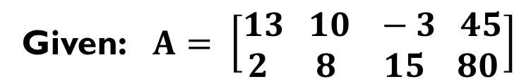
Matrix: a rectangular array of variables or constants in horizontal rows and vertical columns, usually enclosed in brackets
Given: $A= \left[\begin{aligned}13 10 −3 45 \\ 2 8 15 80\end{aligned}\right]$
Elements(s): each value in the matrix.
Dimensions: given by rows and columns in the form 2 X 4,
read as “2 by 4”

Slide 4
Special matrices:
Row matrix: a matrix with only one row.
Column matrix: a matrix with only one column.
Square matrix: a matrix with the same number of rows
as columns.
Zero matrix: a matrix with every element being 0.

Slide 5

Example 1: State the dimensions of each matrix.
1.
2.
4 X 4
1 X 3

Slide 6


Your turn 1: State the dimensions of each matrix.
1.
2.
5 X 2
2 X 4

Slide 7

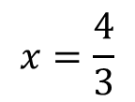







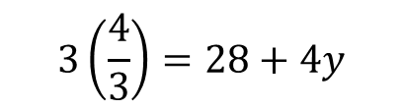


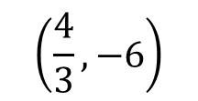
Equations Involving Matrices
Equal matrices: Two matrices are equal if they have the same
dimensions and each element of one matrix is
equal to the corresponding element of the
other matrix.
Now solve:
Example 2: Solve for x and y.
$$3x=28+4(−3x −2)$$
$$3x=28 −12x −8$$
$$+12x +12x$$
a)
$$15x=20$$
Rewrite as a system of equations:
$$x=\frac{4}{3}$$
$$3x=28+4y$$
$$3\left(\frac{4}{3}\right)=28+4y$$
$$y=−3x −2$$
$$4=28+4y$$
$$−24=4y$$
$$\left(\frac{4}{3}, −6\right)$$
$$−6=y$$

Slide 8


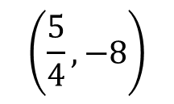


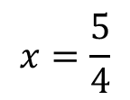



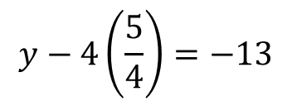

Example 2: Solve for x and y.
b)
Rewrite as a system of equations:
$$8x−y=18$$
$$16x=20$$
$$12=12$$
$$y−4x=−13$$
Now solve:
$$y−5=−13$$
$$16x=20$$
$$x=\frac{5}{4}$$
$$y=−8$$
$$\left(\frac{5}{4}, −8\right)$$
$$y−4\left(\frac{5}{4}\right)=−13$$

Slide 9










Your Turn 2: Solve for x and y.
a)
Rewrite as a system of equations:
$$−2y=4−5x$$
$$x=y+5$$
Now solve:
$$−2y=4−5(y+5)$$
$$−2y=4−5y−25$$
$$3y=−21$$
$$y=−7$$
$$\left(−2, −7\right)$$
$$x=−7+5$$
$$x=−2$$

Slide 10





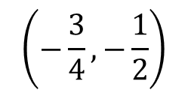


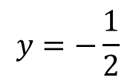
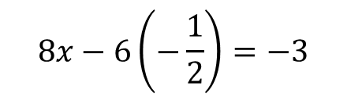


Your Turn 2: Solve for x and y.
b)
Rewrite as a system of equations:
$$8x−6y=−3$$
$$12x+4y=−11$$
Now solve:
$$24x−18y=−9$$
$$8x−6\left(−\frac{1}{2}\right)=−3$$
$$−24x−8y = 22$$
$$−26y=13$$
$$8x+3=−3$$
$$y=−\frac{1}{2}$$
$$8x=−6$$
$$x=−\frac{3}{4}$$
$$\left(−\frac{3}{4}, −\frac{1}{2}\right)$$

Slide 11
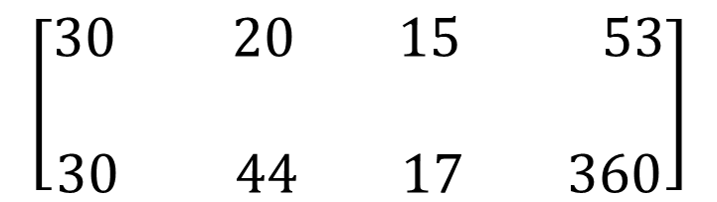
Example 3: Owls’ eggs incubate for 30 days and their fledgling period is also 30 days. Swifts’ eggs incubate for 20 days and their fledgling period is 44 days. Pigeon eggs incubate for 15 days and their fledgling period is 17 days. Eggs of the king penguin incubate for 53 days, and the fledgling time for a king penguin is 360 days.
Write a 2 x 4 matrix to organize this information. Source: The Cambridge Factfinder.
Owl Swift Pigeon King Penguin
Incubation
Fledgling
$$\left[\begin{aligned}30 20 15 53 \\ \\ 30 44 17 360\end{aligned}\right]$$

Slide 12
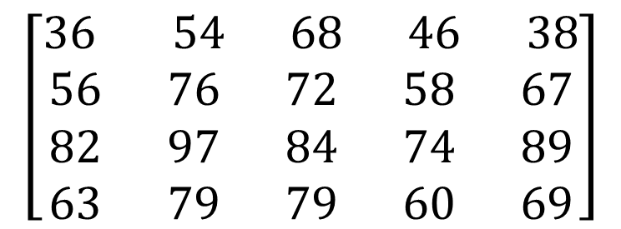
Your Turn 3: A travel agent provides for potential travelers the normal high temperatures for the months of January, April, July, and October for various cities. In Boston these figures are 36°, 56°, 82°, and 63°. In Dallas they are 54°, 76°, 97°, and 79°. In Los Angeles they are 68°, 72°, 84°, and 79°. In Seattle they are 46°, 58°, 74°, and 60°, and in St. Louis they are 38°, 67°, 89°, and 69°.
Organize this information in a 4 x 5 matrix. Source: The New York Times Almanac.
Boston
Dallas
Seattle
St. Louis
L.A.
January
$$\left[\begin{aligned}36 54 68 46 38 \\ 56 76 72 58 67 \\ 82 97 84 74 89 \\ 63 79 79 60 69\end{aligned}\right]$$
April
July
October

Slide 13
Big Idea:
Homework:
M.1 Worksheet

Slide 14
Matrices Unit
Section M.2 Operations with
Matrices

Slide 15
Learning Targets
- I can add and subtract matrices.
- I can understand the role of the zero
matrix in matrix addition, similar to the
role of 0 with real numbers.
- I can multiply a matrix by a scalar.

Slide 16


To Add Matrices: Add corresponding elements
To Subtract Matrices: Subtract corresponding elements
When is it NOT POSSIBLE to add or subtract matrices?
It is NOT POSSIBLE to add or subtract matrices if the dimensions of the matrices are not the same!!
Multiply each element by the scalar.

Slide 17

Example 1:
$$\left[\begin{aligned}6+4 −7+2 \\ 2+−5 −12+−6\end{aligned}\right]$$
$$\left[\begin{aligned}10 −5 \\ −3 −18\end{aligned}\right]$$

Slide 18

Example 2:
$$\left[\begin{aligned}−2−4 8−−3 \\ 3−−2 −4−1 \\ 10−−6 7−8\end{aligned}\right]$$
$$\left[\begin{aligned}−6 11 \\ 5 −5 \\ 16 −1\end{aligned}\right]$$

Slide 19

Your Turn 1:
1.
$$\left[\begin{aligned}6+−4 −5+3 9+2 \\ −3+6 4+9 5+−4 \end{aligned}\right]$$
$$\left[\begin{aligned}2 −2 11 \\ 3 13 1\end{aligned}\right]$$

Slide 20

2.
$$\left[\begin{aligned}8−−4 7−3 \\ −10−2 −6−−12\end{aligned}\right]$$
$$\left[\begin{aligned}12 4 \\ −12 6\end{aligned}\right]$$

Slide 21

3.
Not Possible

Slide 22

Example 3: Multiplying by a scalar.
$$\left[\begin{aligned}3\left(−4\right) 3(5) \\ 3\left(2\right) 3(3)\end{aligned}\right]$$
$$\left[\begin{aligned}−12 15 \\ 6 9\end{aligned}\right]$$

Slide 23


Example 4:
$$3\left[\begin{aligned}−1 5 \\ 7 8\end{aligned}\right] −2\left[\begin{aligned}4 0 \\ −6 3\end{aligned}\right]$$
$$\left[\begin{aligned}−3 15 \\ 21 24\end{aligned}\right] −\left[\begin{aligned}8 0 \\ −12 6\end{aligned}\right]$$
or
$$\left[\begin{aligned}−3 15 \\ 21 24\end{aligned}\right]+\left[\begin{aligned}−8 0 \\ 12 −6\end{aligned}\right]$$
$$\left[\begin{aligned}−11 15 \\ 33 18\end{aligned}\right]$$

Slide 24



Your Turn 2:
$$\left[\begin{aligned}12 −30 18 \\ 0 42 −6 \\ −24 36 54\end{aligned}\right]$$
1.
$$\left[\begin{aligned}−2 −5 −3 \\ −17 11 −8 \\ 6 −1 −15\end{aligned}\right]$$
2.
3.
$$\left[\begin{aligned}−12 15 \\ 6 9\end{aligned}\right]+\left[\begin{aligned}2 −4 \\ 6 −10\end{aligned}\right]= \left[\begin{aligned}−10 11 \\ 12 −1\end{aligned}\right]$$

Slide 25
Big Idea:
Homework:
M.2 Worksheet

Slide 26
Matrices Unit
Section M.3 Multiplying
Matrices

Slide 27
Learning Targets
- I can determine whether matrix multiplication is possible or not.
- I can predict the dimensions of the matrix product.
- I can multiply matrices with the appropriate dimensions.
- I can show that multiplication of square matrices is not commutative.
- I can show that multiplication of square matrices satisfies the associative and distributive properties.

Slide 28
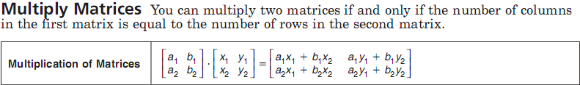
Multiply each Row from the first matrix
by each Column in the second matrix!
The inner dimensions MUST be the same!
The product matrix’s dimensions are the
outer dimensions.
Example: 3 X 2 times a 2 X 4
These MUST be the same!
The product’s dimensions are: 3 X 4

Slide 29

Example 1: Find AB and the dimension of the product
3 X 2
2 X 2
Product is 3 X 2:
$$\left[\begin{aligned}−4\left(5\right)+3\left(−1\right) −4\left(−2\right)+3(3) \\ 2\left(5\right)+−2\left(−1\right) 2\left(−2\right)+−2(3) \\ 1\left(5\right)+7\left(−1\right) 1\left(−2\right)+7(3)\end{aligned}\right]$$
$$\left[\begin{aligned}−23 17 \\ 12 −10 \\ −2 19\end{aligned}\right]$$

Slide 30

Example 2: Find the product, if possible.
If it is not possible, write undefined.
a)
2 X 2 2 X 2
Product is 2 X 2:
$$\left[\begin{aligned}−1\left(3\right)+0\left(−1\right) −1\left(2\right)+0(4) \\ 3\left(3\right)+7\left(−1\right) 3\left(2\right)+7(4)\end{aligned}\right]$$
$$\left[\begin{aligned}−3 −2 \\ 2 34\end{aligned}\right]$$

Slide 31

Example 2: Find the product, if possible.
If it is not possible, write undefined.
b)
2 X 2 2 X 3
Product is 2 X 3:
$$\left[\begin{aligned}−3\left(4\right)+1\left(−3\right) −3\left(0\right)+1\left(1\right) −3\left(−2\right)+1(1) \\ 5\left(4\right)+−2\left(−3\right) 5\left(0\right)+−2\left(1\right) 5\left(−2\right)+−2(1)\end{aligned}\right]$$
$$\left[\begin{aligned}−15 1 7 \\ 26 −2 −12\end{aligned}\right]$$

Slide 32

Your Turn 1: Find the product, if possible.
If it is not possible, write undefined.
a)
3 X 2 2 X 2
Product is 3 X 2:
$$\left[\begin{aligned}3\left(1\right)+−2\left(2\right) 3\left(2\right)+−2(1) \\ 0\left(1\right)+4\left(2\right) 0\left(2\right)+4(1) \\ −5\left(1\right)+1\left(2\right) −5\left(2\right)+1(1)\end{aligned}\right]$$
$$\left[\begin{aligned}−1 4 \\ 8 4 \\ −3 −9\end{aligned}\right]$$

Slide 33

Your Turn 1: Find the product, if possible.
If it is not possible, write undefined.
b)
3 X 2 1 X 3
Product is: Undefined

Slide 34

Your Turn 1: Find the product, if possible.
If it is not possible, write undefined.
c)
2 X 2 2 X 2
Product is 2 X 2:
$$\left[\begin{aligned}7\left(1\right)+−2\left(−2\right) 7\left(−3\right)+−2(0) \\ 5\left(1\right)+−4\left(−2\right) 5\left(−3\right)+−4(0)\end{aligned}\right]$$
$$\left[\begin{aligned}11 −21 \\ 13 −15\end{aligned}\right]$$

Slide 35
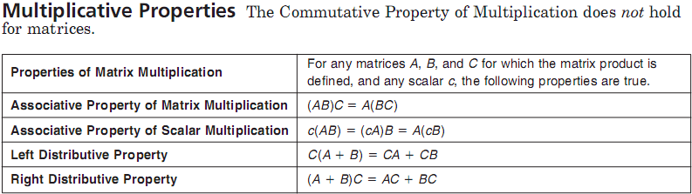
Where c is a scalar (or a constant). A, B, and C is a matrix.

Slide 36

Example 3: Find (A+B)C
1)
$$\left(\left[\begin{aligned}4 −3 \\ 2 1\end{aligned}\right]+\left[\begin{aligned}2 0 \\ 5 −3\end{aligned}\right]\right)\left[\begin{aligned}1 −2 \\ 6 3\end{aligned}\right]$$
Make sure matrix C is in
the correct position.
$$\left(\left[\begin{aligned}6 −3 \\ 7 −2\end{aligned}\right]\right)\left[\begin{aligned}1 −2 \\ 6 3\end{aligned}\right]$$
$$\left[\begin{aligned}6−18 −12−9 \\ 7−12 −14−6\end{aligned}\right]$$
$$\left[\begin{aligned}−12 −21 \\ −5 −20\end{aligned}\right]$$

Slide 37
Example 3: Find AC+BC
1)
$$\left(\left[\begin{aligned}4 −3 \\ 2 1\end{aligned}\right]\left[\begin{aligned}1 −2 \\ 6 3\end{aligned}\right]+\left[\begin{aligned}2 0 \\ 5 −3\end{aligned}\right]\left[\begin{aligned}1 −2 \\ 6 3\end{aligned}\right]\right)$$
Make sure matrix C is in
the correct position.
$$\left[\begin{aligned}−14 −17 \\ 8 −1\end{aligned}\right]+\left[\begin{aligned}2 −4 \\ −13 −19\end{aligned}\right]$$
$$\left[\begin{aligned}−12 −21 \\ −5 −20\end{aligned}\right]$$
Does (A+B)C = AC + BC?
Yes, but make sure when you are
doing these types of problems you
put the matrices in the correct order.

Slide 38

Your Turn 2:
to determine whether each of the following is true for the given matrices.
1)
c(AB) = (cA)B
$−4\left(\left[\begin{aligned}3 2 \\ 5 −2\end{aligned}\right]\left[\begin{aligned}6 4 \\ 2 1\end{aligned}\right]\right)= \left(−4\left[\begin{aligned}3 2 \\ 5 −2\end{aligned}\right]\right)\left[\begin{aligned}6 4 \\ 2 1\end{aligned}\right]$
$−4\left(\left[\begin{aligned}22 14 \\ 26 18\end{aligned}\right]\right)= \left(\left[\begin{aligned}−12 −8 \\ −20 8\end{aligned}\right]\right)\left[\begin{aligned}6 4 \\ 2 1\end{aligned}\right]$
$$\left[\begin{aligned}−88 −56 \\ −104 −72\end{aligned}\right]= \left[\begin{aligned}−88 −56 \\ −104 −72\end{aligned}\right]$$
c(AB) = (cA)B is true for matrices!

Slide 39
Your Turn 2:
to determine whether each of the following is true for the given matrices.
2)
C(A+B) = AC+BC
$\left[\begin{aligned}−\frac{1}{2} −2 \\ 1 −3\end{aligned}\right]\left(\left[\begin{aligned}3 2 \\ 5 −2\end{aligned}\right]+\left[\begin{aligned}6 4 \\ 2 1\end{aligned}\right]\right)= \left[\begin{aligned}3 2 \\ 5 −2\end{aligned}\right]\left[\begin{aligned}−\frac{1}{2} −2 \\ 1 −3\end{aligned}\right]+\left[\begin{aligned}6 4 \\ 2 1\end{aligned}\right]\left[\begin{aligned}−\frac{1}{2} −2 \\ 1 −3\end{aligned}\right]$
$\left[\begin{aligned}−\frac{1}{2} −2 \\ 1 −3\end{aligned}\right]\left(\left[\begin{aligned}9 6 \\ 7 −1\end{aligned}\right]\right)= \left[\begin{aligned}\frac{1}{2} −12 \\ −\frac{9}{2} −4\end{aligned}\right]+\left[\begin{aligned}1 −24 \\ 0 −7\end{aligned}\right]$
$$\left[\begin{aligned}−\frac{37}{2} −1 \\ −12 9\end{aligned}\right]= \left[\begin{aligned}\frac{3}{2} −36 \\ −\frac{9}{2} −11\end{aligned}\right]$$
C(A+B) = AC+BC is NOT true for matrices!
Notice matrix C is NOT in the correct position.

Slide 40
Big Idea:
Homework:
M.3 Worksheet

Slide 41
Matrices Unit
Section M.4 Transformations
with Matrices
The Making of a Math Manipulative
(Crafty Math)

Slide 42
Learning Targets
- I can make and use a mathematic manipulative to find the correct rotation or reflection matrix.
- I can incorporate this process into other situations.

Slide 43
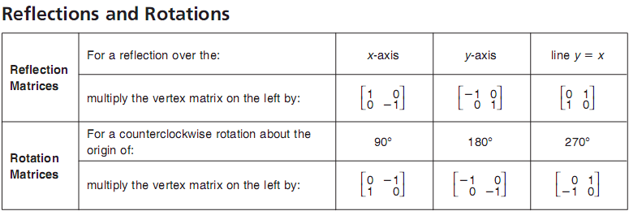
Make your math manipulative!
Starting Position
Transformation Matrix
$$\left[\begin{aligned}R B \\ E L \\ D U \\ E\end{aligned}\right]$$
Red to the right, Blue towards the sky

Slide 44
Finding the Transformation Matrix:
Step 1: Put tool into starting position.
Step 2: Perform the transform desired
with your manipulative.
Step 3: Write the position of the red tip in the matrix’s first column and the position of the blue tip in the second column.
$$\left[\begin{aligned}R B \\ E L \\ D U \\ E\end{aligned}\right]$$
Example: 180°

Slide 45
Finding the Transformation Matrix:
Step 1: Put tool into starting position.
Step 2: Perform the transform desired
with your manipulative.
Step 3: Write the position of the red tip in the matrix’s first column and the position of the blue tip in the second column.
$$\left[\begin{aligned}R B \\ E L \\ D U \\ E\end{aligned}\right]$$
Example: 180°
$$\left[\begin{aligned}−1 0 \\ 0 −1\end{aligned}\right]$$

Slide 46
Matrices Unit
Section M.4 Transformations
with Matrices

Slide 47
Learning Targets
- I can use matrices to determine the coordinates of a translated or dilated figure.
- I can use matrix multiplication to find the coordinates of a reflected or rotated figure.

Slide 48

The figure keeps the same orientation.
(Doesn’t spin or flip)
Translation is similar to sliding a figure.
Example 1: Given a triangle with vertices at coordinates (-5,4), (-1,5), and
(-3,-1) translate the figure 6 units to the right and 4 units down.
A B C
Fist: Construct the vertex matrix:
X
Y
$$\left[\begin{aligned}−5 −1 −3 \\ 4 5 −1\end{aligned}\right]$$
Second: Construct the Translation matrix:
X
Y
$$\left[\begin{aligned}6 6 6 \\ −4 −4 −4\end{aligned}\right]$$
Third: Add the matrices together to get the Image matrix:
$$\left[\begin{aligned}−5 −1 −3 \\ 4 5 −1\end{aligned}\right]$$
+ $\left[\begin{aligned}6 6 6 \\ −4 −4 −4\end{aligned}\right]$ =
A’ B’ C’
X
Y
$$\left[\begin{aligned}1 5 3 \\ 0 1 −5\end{aligned}\right]$$
Image coordinates of: A’(1,0), B’(5,1), C’(3,-5)

Slide 49
The figure keeps the same orientation.
(Doesn’t spin or flip)
Example 2: Given a triangle with vertices at coordinates (-5,4), (-1,5), and
(-3,-1), dilate the figure so the perimeter is 2 times the original perimeter.
A B C
Fist: Construct the vertex matrix:
X
Y
$$\left[\begin{aligned}−5 −1 −3 \\ 4 5 −1\end{aligned}\right]$$
Second: Calculate the scalar being used In the dilation:
2 times means my scalar is 2
$$2\left[\begin{aligned}−5 −1 −3 \\ 4 5 −1\end{aligned}\right]$$
Third: Perform the scalar multiplication:
A’ B’ C’
X
Y
$$\left[\begin{aligned}−10 −2 −6 \\ 8 10 −2\end{aligned}\right]$$
Image coordinates of: A’(-10,8), B’(-2,10), C’(-6,-2)

Slide 50
Your Turn 1:
1. Write the translation matrix. Write the vertex matrix
Q U A D
$$\left[\begin{aligned}−3 −3 −3 −3 \\ 2 2 2 2\end{aligned}\right]$$
X
Y
$$\left[\begin{aligned}−1 0 5 2 \\ −3 0 −1 −5\end{aligned}\right]$$
2. Find the coordinates of the vertices of Q’U’A’D’.
Q U A D
X
Y
$$\left[\begin{aligned}−4 −3 2 −1 \\ −1 2 1 −3\end{aligned}\right]$$
Image coordinates of: Q’(-4,-1), U’(-3,2), A’(2,1), and D’(-1,-3)

Slide 51
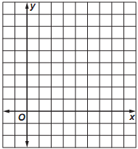
Example 4:
3. Write the coordinates of the vertices of ∆ABC in a vertex matrix.
A B C
X
Y
$$\left[\begin{aligned}4 2 8 \\ −2 8 2\end{aligned}\right]$$
4. Find the coordinates of the vertices of image ∆A’B’C’.
$$\left[\begin{aligned}1 \frac{1}{2} 2 \\ −\frac{1}{2} 2 \frac{1}{2}\end{aligned}\right]$$
$$\frac{1}{4}\left[\begin{aligned}4 2 8 \\ −2 8 2\end{aligned}\right]=$$
B
5. Graph the preimage and the image.
A’ B’ C’
$$\left[\begin{aligned}1 \frac{1}{2} 2 \\ −\frac{1}{2} 2 \frac{1}{2}\end{aligned}\right]$$
B’
C
X
Y
C’
A’
A

Slide 52
Example 5:
A B C
Vertex
Matrix
$$\left[\begin{aligned}3 −2 1 \\ 5 4 −1\end{aligned}\right]$$
Reflection
Matrix
$$\left[\begin{aligned}0 1 \\ 1 0\end{aligned}\right]$$
X
Y
Always put the
Reflection or
Rotation Matrix
First
A’ B’ C’
$$\left[\begin{aligned}0 1 \\ 1 0\end{aligned}\right]$$
$$\left[\begin{aligned}3 −2 1 \\ 5 4 −1\end{aligned}\right]$$
$$=\left[\begin{aligned}5 4 −1 \\ 3 −2 1\end{aligned}\right]$$

Slide 53
Your Turn 2:
A B C D
Vertex
Matrix
$$\left[\begin{aligned}−2 −1 2 2 \\ 1 3 2 −1\end{aligned}\right]$$
Reflection
Matrix
$$\left[\begin{aligned}−1 0 \\ 0 1\end{aligned}\right]$$
A’ B’ C’ D’
$$\left[\begin{aligned}−1 0 \\ 0 1\end{aligned}\right]$$
$$\left[\begin{aligned}−2 −1 2 2 \\ 1 3 2 −1\end{aligned}\right]$$
$$= \left[\begin{aligned}2 1 −2 −2 \\ 1 3 2 −1\end{aligned}\right]$$

Slide 54
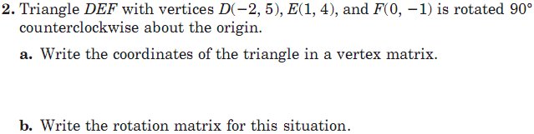
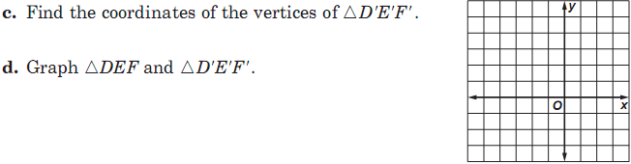
Your Turn 3:
D E F
X
Y
$$\left[\begin{aligned}−2 1 0 \\ 5 4 −1\end{aligned}\right]$$
$$\left[\begin{aligned}0 −1 \\ 1 0\end{aligned}\right]$$
D
E
E’
F’
D’ E’ F’
$$\left[\begin{aligned}0 −1 \\ 1 0\end{aligned}\right]$$
$$\left[\begin{aligned}−2 1 0 \\ 5 4 −1\end{aligned}\right]$$
$$=\left[\begin{aligned}−5 −4 1 \\ −2 1 0\end{aligned}\right]$$
F
D’

Slide 55
Big Idea:
Homework:
M.4 Worksheet

Slide 56
Matrices Unit
Section M.5 Determinants
of Matrices

Slide 57
Learning Targets
- I can evaluate the determinant of a 2X2 matrix without a calculator.
- I can evaluate the determinant of a 3X3 matrix with a calculator.

Slide 58

Determinants of a matrix can be written two ways:
Given matrix A as:
$$\left[\begin{aligned}a b \\ c d\end{aligned}\right]$$
$$det\left[\begin{aligned}a b \\ c d\end{aligned}\right]$$
The determinant of matrix A is written as:
$$\left|\begin{aligned}a b \\ c d\end{aligned}\right|$$
Notice the parallel lines and not brackets!!

Slide 59
The value of determinant of matrix A (2X2)
is written and calculated as:
$$det\left[\begin{aligned}a b \\ c d\end{aligned}\right]=ad −bc$$
$$\left|\begin{aligned}a b \\ c d\end{aligned}\right|=ad −bc$$

Slide 60

Example 1: Find the value of the determinant.
Remember:
$$\left|\begin{aligned}a b \\ c d\end{aligned}\right|=ad −bc$$
$$=6\left(5\right)−3(−8)$$
$$=30+24$$
$$=54$$

Slide 61


Your Turn 1: Find the value of each determinant.
Remember:
a.
b.
$$\left|\begin{aligned}a b \\ c d\end{aligned}\right|=ad −bc$$
$$=11\left(3\right)−\left(−5\right)9$$
$$=5\left(−4\right)−12(−7)$$
$$=33+45$$
$$=−20+84$$
$$=78$$
$$=64$$

Slide 62
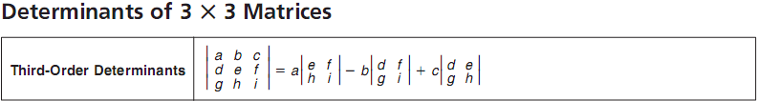

We will use our calculators for all 3X3 or bigger determinants.
Example 2: Evaluate the determinant using your calculator:
Edit matrix A as the 3X3 matrix to the left.
Quit to get to a blank screen.
Go to MATRIX: MATH: 1:det( and hit enter.
Now put matrix A in det([A] and hit enter.
Your determinant value should be: 60

Slide 63

We will use our calculators for all 3X3 or bigger determinants.
Your Turn 2 Evaluate the determinant using your calculator:
Edit matrix A as the 3X3 matrix to the left.
Quit to get to a blank screen.
Go to MATRIX: MATH: 1:det( and hit enter.
Now put matrix A in det([A] and hit enter.
Your determinant value should be: 28

Slide 64

We will use our calculators for all 3X3 or bigger determinants.
Example 3 Evaluate the determinant using your calculator:
But I will show Expansion by Minors:
Rewrite the chosen row and alternate the signs.
= +5 -(-2) +2
Now construct the leftover 2X2 determinants.
= $5\left|\begin{aligned}0 −2 \\ 4 −3\end{aligned}\right|−\left(−2\right)\left|\begin{aligned}3 −2 \\ 2 −3\end{aligned}\right|+2\left|\begin{aligned}3 0 \\ 2 4\end{aligned}\right|$
Now evaluate the leftover 2X2 determinants and simplify.
= $5\left(8\right)+2(−5)+2(12)$
= $40−10+24$
Your determinant value should be: 54

Slide 65

We will use our calculators for all 3X3 or bigger determinants.
Your Turn 3 Evaluate the determinant using your calculator:
Your determinant value should be: 80

Slide 66
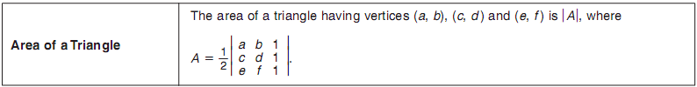
Notice: It is the absolute value of this amount!
$$A= \frac{1}{2}\left|\begin{aligned}2 −3 1 \\ 7 4 1 \\ −5 5 1 \end{aligned}\right|$$
Edit matrix A as the 3X3 matrix to the left.
Quit to get to a blank screen.
Go to MATRIX: MATH: 1:det( and hit enter.
Now put matrix A in det([A] and hit enter.
Remember: this value is of the determinant,
you still have to take half of its absolute value.
$$A= \frac{1}{2}(89)$$
$$A=44.5 {units}^{2}$$

Slide 67
Big Idea:
Homework:
M.5 Worksheet

Slide 68
Matrices Unit
Section M.6 Identity and Inverse
Matrices

Slide 69
Learning Targets
- I can determine whether two matrices are inverses.
- I can find the inverse of a 2 X 2 matrix.

Slide 70
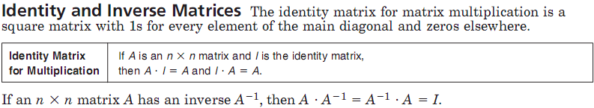
$$\left[\begin{aligned}1 0 \\ 0 1\end{aligned}\right]$$
2 X 2 Identity matrix:
$$\left[\begin{aligned}1 0 0 \\ 0 1 0 \\ 0 0 1\end{aligned}\right]$$
3 X 3 Identity matrix:
$$\left[\begin{aligned}1 0 0 0 \\ 0 1 0 0 \\ 0 0 1 0 \\ 0 0 0 1\end{aligned}\right]$$
4 X 4 Identity matrix:

Slide 71
X · Y
Y · X
$$\left[\begin{aligned}7 4 \\ 10 6\end{aligned}\right]∙\left[\begin{aligned}3 −2 \\ −5 \frac{7}{2}\end{aligned}\right]$$
$$\left[\begin{aligned}3 −2 \\ −5 \frac{7}{2}\end{aligned}\right]∙\left[\begin{aligned}7 4 \\ 10 6\end{aligned}\right]$$
$$=\left[\begin{aligned}1 0 \\ 0 1\end{aligned}\right]$$
$$=\left[\begin{aligned}1 0 \\ 0 1\end{aligned}\right]$$
Because both X · Y and Y · X equal the identity matrix they are inverses.

Slide 72
X · Y
Y · X
$$\left[\begin{aligned}8 11 \\ 3 4\end{aligned}\right]∙\left[\begin{aligned}−4 11 \\ 3 −8\end{aligned}\right]$$
$$=\left[\begin{aligned}1 0 \\ 0 1\end{aligned}\right]$$
$$\left[\begin{aligned}−4 11 \\ 3 −8\end{aligned}\right]∙\left[\begin{aligned}8 11 \\ 3 4\end{aligned}\right]$$
$$=\left[\begin{aligned}1 0 \\ 0 1\end{aligned}\right]$$
Because both X · Y and Y · X equal the identity matrix they are inverses.

Slide 73
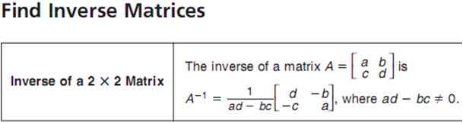


Example 2:
ad – bc = (7)(1)-(2)(2) = 3
$$=\left[\begin{aligned}\frac{1}{3} −\frac{2}{3} \\ −\frac{2}{3} \frac{7}{3}\end{aligned}\right]$$
$$\frac{1}{3}\left[\begin{aligned}1 −2 \\ −2 7\end{aligned}\right]$$
Check it using your calculator: ${\left[A\right]}^{−1}$, then use your MATH: FRAC button

Slide 74

Your Turn 2: Find the inverse of each matrix, if it exists.
a.
ad – bc = (24)(4)-(12)(8) = 0
Because the determinant is zero, this matrix has no inverse.

Slide 75

Your Turn 2: Find the inverse of each matrix, if it exists.
b.
ad – bc = (3)(8)-(4)(6) = 0
Because the determinant is zero, this matrix has no inverse.

Slide 76
Your Turn 2: Find the inverse of each matrix, if it exists.
$$\left[\begin{aligned}4 −1 \\ −2 1 \end{aligned}\right]$$
c.
ad – bc = (4)(1)-(-1)(-2) = 4-2 = 2
Put the determinant in the denominator (under 1) on the outside of the
newly organized matrix to get your inverse.
$$\frac{1}{2}\left[\begin{aligned}1 1 \\ 2 4\end{aligned}\right] = \left[\begin{aligned}\frac{1}{2} \frac{1}{2} \\ 1 2\end{aligned}\right]$$
Check this using your calculator…${\left[A\right]}^{−1}$

Slide 77
$$\left[A\right]=\left[\begin{aligned}16 30 \\ 44 72 \\ 27 36 \\ 19 38 \\ 48 66 \\ 51 78\end{aligned}\right]$$
$$\left[\begin{aligned}13 1 \\ 20 8 \\ 0 9 \\ 19 0 \\ 3 15 \\ 15 12\end{aligned}\right]$$
$$\left[B\right]=\left[\begin{aligned}1 2 \\ 3 4\end{aligned}\right]$$
$$\left[A\right]∙{\left[B\right]}^{−1}=$$
MATH IS COOL

Slide 79
Big Idea:
Homework:
M.6 Worksheet

Slide 80
Matrices Unit
Section M.7 Using Matrices to
Solve Systems of
Equations

Slide 81
Learning Targets
- I can write matrix equations for systems of equations.
- I can solve systems of equations using matrix equations.

Slide 82

Example 1: Write a matrix equation for the system of equations.
a.
Coefficient
Matrix
Variable
Matrix
Constant
Matrix
$$\left[\begin{aligned}3 −7 \\ 1 5\end{aligned}\right]$$
$$∙ \left[\begin{aligned}x \\ y\end{aligned}\right]=$$
$$\left[\begin{aligned}12 \\ −8\end{aligned}\right]$$

Slide 83

Example 1: Write a matrix equation for the system of equations.
b.
Coefficient
Matrix
Variable
Matrix
Constant
Matrix
$$\left[\begin{aligned}2 −1 3 \\ 1 3 −4 \\ 7 2 1\end{aligned}\right]$$
$$∙ \left[\begin{aligned}x \\ y \\ z\end{aligned}\right]=$$
$$\left[\begin{aligned}−7 \\ 15 \\ −28\end{aligned}\right]$$

Slide 84

Your Turn 1: Write a matrix equation for the system of equations.
a.
Coefficient
Matrix
Variable
Matrix
Constant
Matrix
$$\left[\begin{aligned}2 1 \\ 5 −3\end{aligned}\right]$$
$$∙ \left[\begin{aligned}x \\ y\end{aligned}\right]=$$
$$\left[\begin{aligned}8 \\ −12\end{aligned}\right]$$

Slide 85

Your Turn 1: Write a matrix equation for the system of equations.
b.
Coefficient
Matrix
Variable
Matrix
Constant
Matrix
$$\left[\begin{aligned}1 −1 1 \\ 3 2 −1 \\ 2 3 0\end{aligned}\right]$$
$$∙ \left[\begin{aligned}a \\ b \\ c\end{aligned}\right]=$$
$$\left[\begin{aligned}5 \\ 0 \\ 8\end{aligned}\right]$$

Slide 86
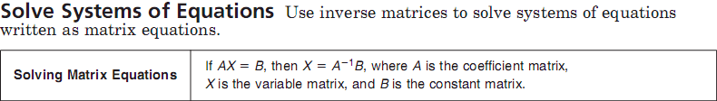

$$\left[A\right]∙\left[X\right]=\left[B\right]$$
$${\left[A\right]}^{−1}∙\left[A\right]∙\left[X\right]={\left[A\right]}^{−1}∙\left[B\right]$$
$$\left[X\right]={\left[A\right]}^{−1}\left[B\right]$$
The inverse matrix
must be placed first!!
Example 2:
$$\left[\begin{aligned}x \\ y\end{aligned}\right]={\left[\begin{aligned}5 2 \\ 6 4\end{aligned}\right]}^{−1}∙\left[\begin{aligned}6 \\ 4\end{aligned}\right]$$
$$\left[\begin{aligned}x \\ y\end{aligned}\right]=\left[\begin{aligned}2 \\ −2\end{aligned}\right]$$

Slide 87

$$\left[A\right]∙\left[X\right]=\left[B\right]$$
$$\left[X\right]={\left[A\right]}^{−1}\left[B\right]$$
The inverse matrix
must be placed first!!
Your Turn 2: Solve each matrix equation or system of equations by using inverse matrices.
a.
$$\left[\begin{aligned}x \\ y\end{aligned}\right]={\left[\begin{aligned}2 4 \\ 3 −1\end{aligned}\right]}^{−1}∙\left[\begin{aligned}−2 \\ 18\end{aligned}\right]$$
$$\left[\begin{aligned}x \\ y\end{aligned}\right]=\left[\begin{aligned}5 \\ −3\end{aligned}\right]$$

Slide 88

$$\left[A\right]∙\left[X\right]=\left[B\right]$$
$$\left[X\right]={\left[A\right]}^{−1}\left[B\right]$$
The inverse matrix
must be placed first!!
Your Turn 2: Solve each matrix equation or system of equations by using inverse matrices.
b.
$$\left[\begin{aligned}3 4 \\ 5 8\end{aligned}\right]∙\left[\begin{aligned}x \\ y\end{aligned}\right]=\left[\begin{aligned}12 \\ −8\end{aligned}\right]$$
$$\left[\begin{aligned}x \\ y\end{aligned}\right]={\left[\begin{aligned}3 4 \\ 5 8\end{aligned}\right]}^{−1}∙\left[\begin{aligned}12 \\ −8\end{aligned}\right]$$
$$\left[\begin{aligned}x \\ y\end{aligned}\right]=\left[\begin{aligned}32 \\ −21\end{aligned}\right]$$

Slide 89
$$\left[A\right]∙\left[X\right]=\left[B\right]$$
$$\left[X\right]={\left[A\right]}^{−1}\left[B\right]$$
The inverse matrix
must be placed first!!
Your Turn 2: Solve each matrix equation or system of equations by using inverse matrices.
c.
$$2w+3x−2y+2z=15$$
$$3w−x+2y−z=−15$$
$$w+2x−y+3z=17$$
$$4w+3x−2y+z=7$$
W = -2
X = 3
Y = -1
Z = 4

Slide 90
Big Idea:
Homework:
M.7 Worksheet

