Slide 1
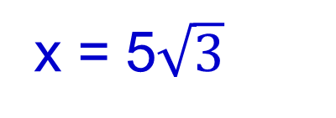
Warm-up:
Find the missing measurement in each triangle.
1. 2.
10
60°
10
6
x = 8
x = 5$\sqrt{3}$
x
x
3. 4.
x°
54°
10
x
6
x = 59°
x = 17.0
10

Slide 2
Change in hw policy
No work = no credit (unless vocab or problems where work not needed)
Any homework turned in on test day is worth half credit

Slide 3
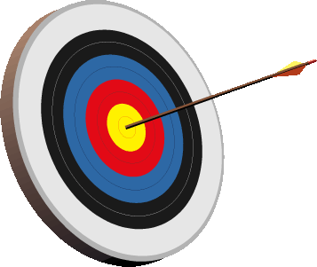
Lesson 10-1
I can find perimeters and areas of triangles and parallelograms
I can find perimeters and areas of triangles and parallelograms on the coordinate plane

Slide 4
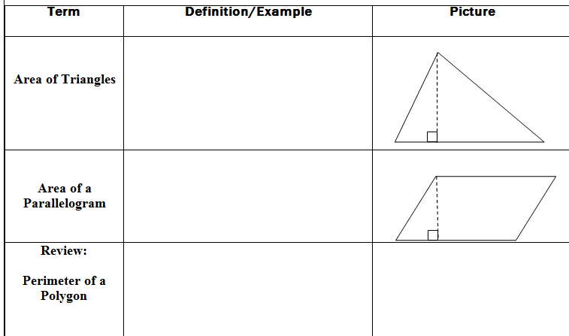
1
A =
bh
2
h
b
A = bh
h
b
Sum of all the sides

Slide 5
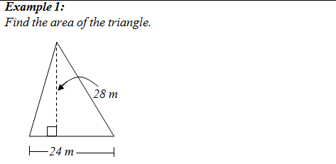
1
A =
bh
2
1
A =
(24)(28)
2
A = 336 m²

Slide 6
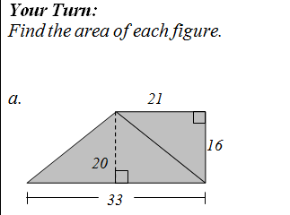
1
1
A =
(33)(20)
A =
(21)(16)
2
2
= 330
= 168
Total = 330 + 168
= 498 un²

Slide 7
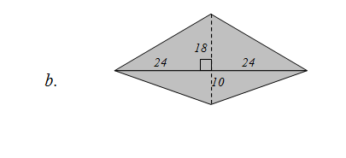
= 672 un²

Slide 8
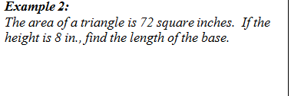
1
A =
bh
2
1
72 =
(b)(8)
2
72 = 4b
18 in = b

Slide 9
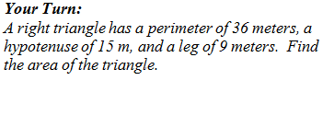
1
A =
(12)(9)
2
15 m
9 m
= 54 m²
12 m

Slide 10
Warm-up:
Find the area of each triangle.
1. 2.
10
60°
10
6
5
24
21.65
8.66
8
3. 4.
59°
54°
10
17
6
30
68.75
13.75
10

Slide 11
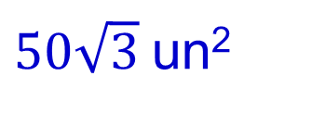
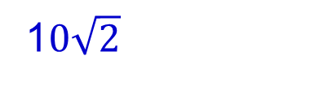


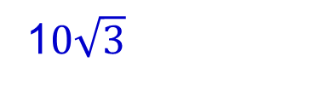
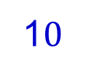

Warm-up:
Find the exact area of each triangle.
1. 2.
45°
20
20
1$0\sqrt{2}$
1$0$
30°
1$0\sqrt{2}$
1$0\sqrt{3}$
1
1
A =
bh
A =
bh
2
2
1
1
=
$$(10\sqrt{3})(10)$$
=
$$(10\sqrt{2})(10\sqrt{2})$$
2
2
=
$50\sqrt{3}$un²
= 100 un²

Slide 12
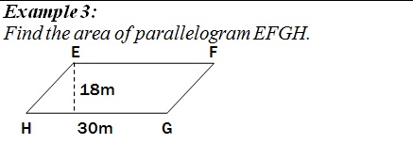
A = bh
A = 30(18)
A = 540 m²

Slide 13
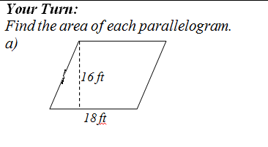
A = bh
A = 18(16)
A = 288 ft²

Slide 14
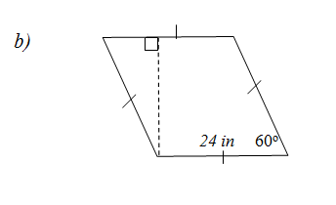
60°
60°
h
20.78
h
24
24
h
sin 60 =
24
h = 20.78
A = bh
A = 24(20.78)
A = 498.72 in²

Slide 15
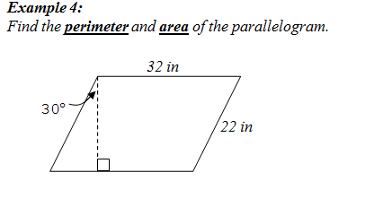
h
cos 30 =
22
22
h
h = 19.05
32
P = 32 + 22 + 32 + 22 = 108 in
A = 32(19.05)
= 609.6 in²

Slide 16

A = bh
A = 6(3)
A = 18 un²
3
6

Slide 17

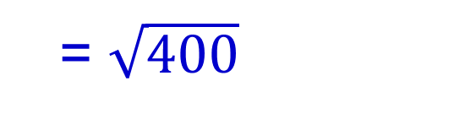
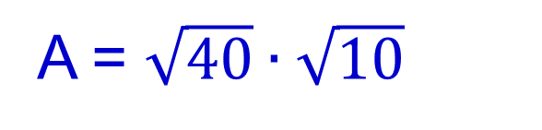
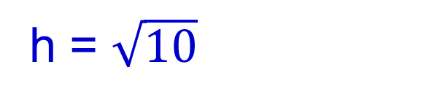
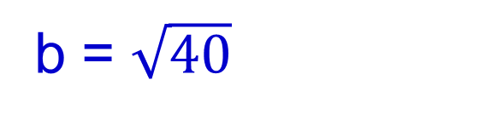
b = $\sqrt{40}$
h = $\sqrt{10}$
A = $\sqrt{40}∙\sqrt{10}$
h
= $\sqrt{400}$
b
= 20 un²

Slide 18
ASSIGNMENT
10-1 worksheet

Slide 19
Warm-up:
Find the area of each figure.
5
20
1. 2.
16
8
12
25
A = 360 un²
A = 82 un²

Slide 20
Lesson 10-2
I can find perimeters and areas of kites, trapezoids and rhombi
I can determine whether points on a coordinate plane define a kite, trapezoid or rhombus

Slide 21
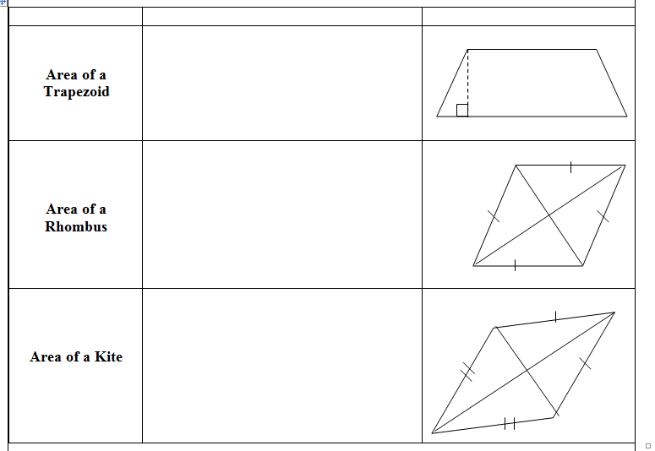
b₁
A = ¹/₂h(b₁+b₂)
h
b₂
A = ¹/₂•d₁•d₂
d₁
d₂
A = ¹/₂•d₁•d₂

Slide 22
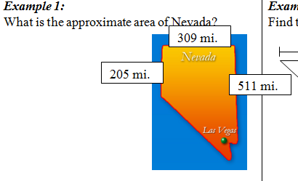
h
b₁
A = ¹/₂h(b₁+b₂)
b₂
A = ½(309)(205+511)
A = 110,622 mi²

Slide 23
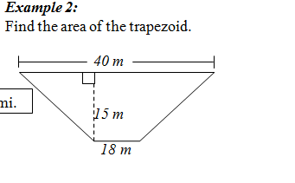
A = ¹/₂h(b₁+b₂)
A = ¹/₂(15)(40+18)
A = ¹/₂(15)(58)
A = 435 m²

Slide 24



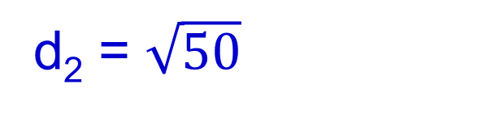
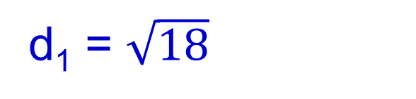
d₁ = $\sqrt{18}$
d₂ = $\sqrt{50}$
1
A =
d₁d₂
2
N
M
1
=
$$(\sqrt{50})(\sqrt{18})$$
2
P
1
R
=
$$(\sqrt{900})$$
2
= 15 un²

Slide 25

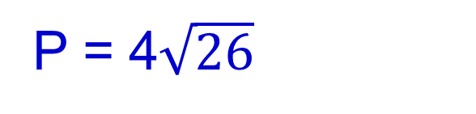
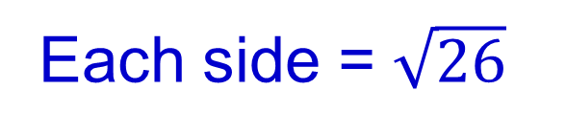
Each side = $\sqrt{26}$
P = 4$\sqrt{26}$
or 20.4 un²

Slide 26

b₂
A = ¹/₂h(b₁+b₂)
12 in
144 = ¹/₂12(6+b₂)
6 in
144 = 6(6+b₂)
6 6
24 = 6+b₂
-6 -6
18 in = b₂

Slide 27
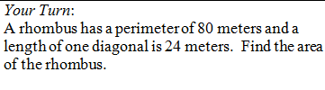
d₁ = 24
d₂ = 32
20
16
12
A = ¹/₂•24•32
A = 384 m²

Slide 28
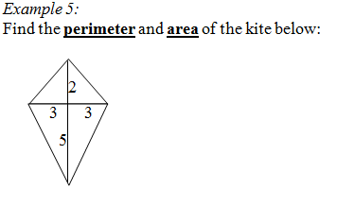




$$3.6$$
$$3.6$$
P = 18.8 un
$$5.8$$
$$5.8$$
A = ¹/₂• 7• 6
A = 21 un²

Slide 29
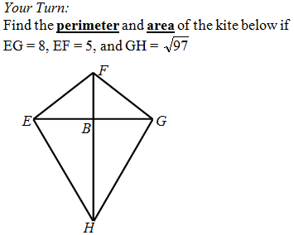

Slide 30
ASSIGNMENT
10-2 worksheet

Slide 31
Warm-up
Find x in each figure. (Assume all angles in each figure are congruent.
1. 2.
90°
72°
x°
x°
3. 4.
x°
x°
72°
60°

Slide 32
Lesson 10-3
I can find areas of regular polygons

Slide 33
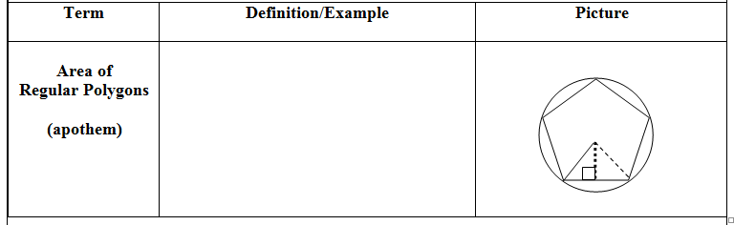
1
A =
Pa
2
a
P = perimeter

Slide 34
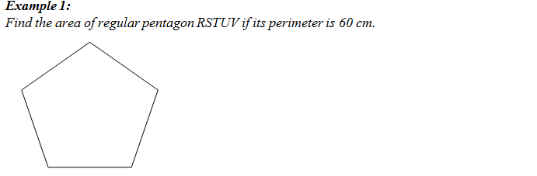
36°
a
6
tan 36 =
a
12
a
6
a = 8.26
1
A =
Pa
2
1
=
(60)(8.26)
= 247.8 cm²
2

Slide 35
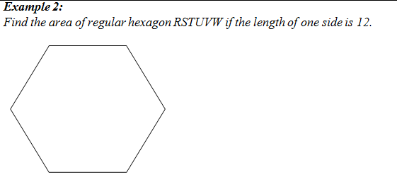
30°
a
6
tan 30 =
a
a
12
6
a = 10.39
1
A =
Pa
2
1
=
(72)(10.39)
= 374.04 un²
2

Slide 36
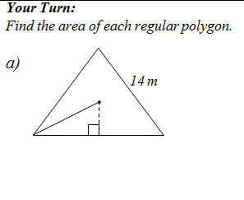
14
h
h
h = 12.12
7
1
A =
bh
2
1
=
(14)(12.12)
= 84.84 m²
2

Slide 37
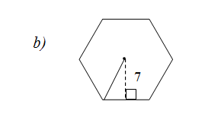
30°
x
7
tan 30 =
7
x
x = 4.04
8.08
1
A =
Pa
2
1
=
(48.48)(7)
= 169.68 un²
2

Slide 38
ASSIGNMENT
10-3 worksheet

Slide 39
Lesson 10-4
I can find the area of circles
I can find the area of a sector of a circle

Slide 40
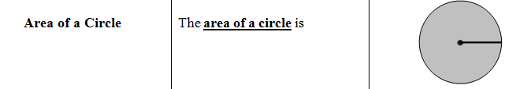
A = π r²

Slide 41
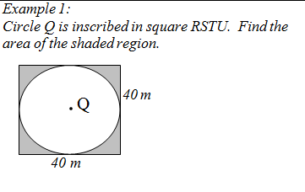
20
Square – circle
bh
– π r²
40(40)
– π (20)²
1600
– 1256.64
= 343.36 m²

Slide 42
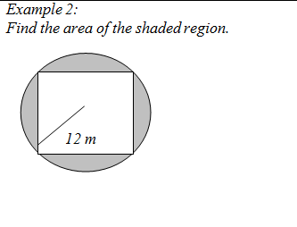
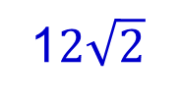
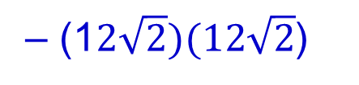

Circle – Square
π r²
– bh
π (12)²
– (1$2\sqrt{2})(12\sqrt{2}$)
452.39
– 288
24
1$2\sqrt{2}$
= 164.39 m²
1$2\sqrt{2}$

Slide 43
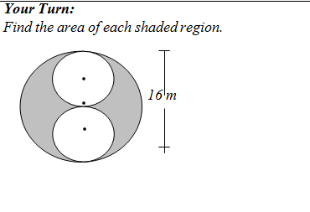
4
Big circle – 2( small circles)
8
π(8)²
– 2π(4)²
201.06
– 100.53
= 100.53 m²

Slide 44
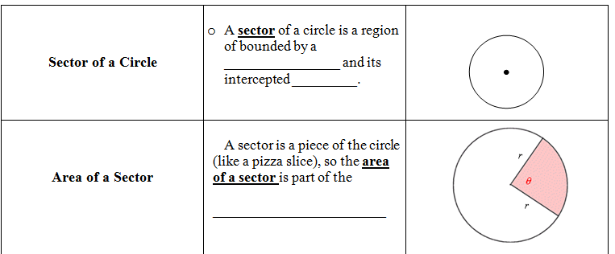
pair of radii
arc
area of the circle
θ
A =
• π r²
360

Slide 45
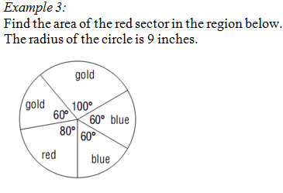
θ
A =
• π r²
360
80
A =
• π (9)²
360
= 56.55 in²

Slide 46
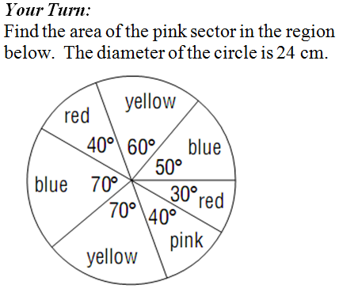
40
A =
• π (12)²
360
= 50.27 cm²

Slide 47
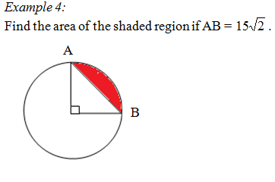
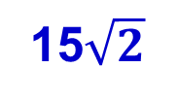
15$\sqrt{2}$
15
Sector – triangle
15
90
1
(15)(15)
–
• π (15)²
360
2
176.71
– 112.5
= 64.21 un²

Slide 48
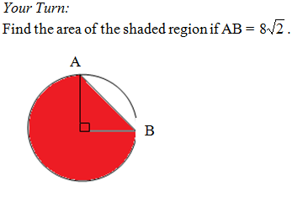
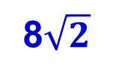
8
8$\sqrt{2}$
Sector + triangle
8
270
1
(8)(8)
+
• π (8)²
360
2
150.80
+ 32
= 182.80 un²

Slide 49
ASSIGNMENT
10-4 worksheet
Quiz tomorrow!

Slide 50
Warm-up:
Find the area of each figure.
5
20
1. 2.
16
8
12
25
A = 360 un²
A = 82 un²

Slide 51
Lesson 10-5
I can find the area of circles
I can find the area of a sector of a circle

Slide 52
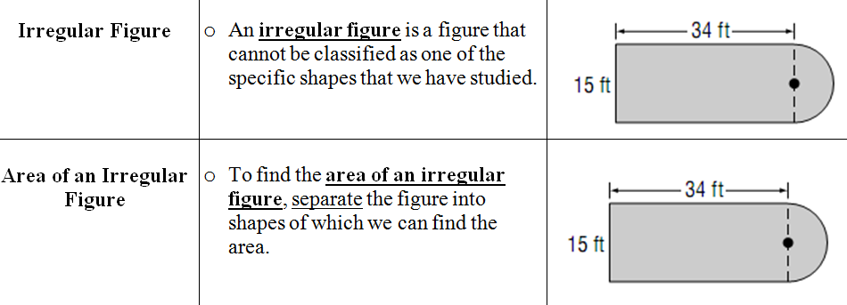

Slide 53
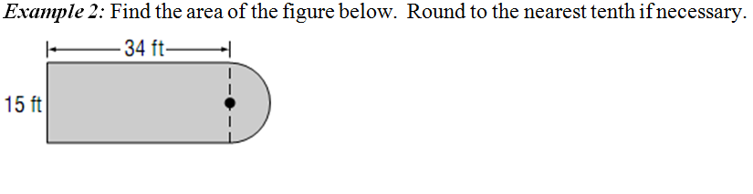
Half circle
7.5
(0.5) π (7.5)²
= 88.36
34(15) = 510
Total = 598.36 ft²

Slide 54

20
22(22) = 484
22(20)
= 220
2
Total = 704 cm²

Slide 55

7(4)
= 14
2
7(2)
= 7
2
Total = 21 un²

Slide 56

Total = 40 un²

Slide 57

Big rectangle – small rectangle
32(16)
– 12(5)
512
– 60
= 452 cm²

Slide 58

3(3) = 9
6(3) = 18
6
12(2) = 24
Total = 9 + 18 + 24
= 51 ft²

Slide 59
ASSIGNMENT
10-5 worksheet

Slide 60
Lesson 10-6
I can use similarity and proportions to find perimeters and areas of similar figures

Slide 61

shape
size
a:b
a²:b²

Slide 62


a:b
9:6
9:6
9² : 6²
81:36
81x = 2160
81
60
x = 26.67 in²
=
36
x

Slide 63

a:b
12:18
12:18
12² : 18²
144:324
144
x
324x = 12960
=
324
90
x = 40 cm²

Slide 64


50 cm²
98 cm²
a²:b²
50:98
a:b
$\sqrt{50}:\sqrt{98}$

Slide 65

2.5²
(13)
= 81.25 bushels

Slide 66


a²:b²
1875:135
a:b
$\sqrt{1875}:\sqrt{135}$

Slide 67

Price is determined by in² (area)
3²
$2.50
=
5²
x
9x = $62.50
x = $6.94

Slide 68
ASSIGNMENT
10-6 worksheet

Slide 72
What’s the area?
Work with your group to come up with some strategies
Decide on one strategy that everyone thinks will work
Use any or all of the provided tools
Calculate the area using your chosen tools and strategy!

Slide 73


