Slide 1
Statistics
Algebra 2B
Unit 11

Slide 2
Statistics lesson 11.1: Variance and Standard Deviation
Learning Targets:
I can calculate measures of center and spread for data sets.
I can use statistics to describe data sets or to
compare or contrast data sets.

Slide 3
Mrs. Smith has two Algebra 2 classes. Each class takes a test, and the scores of each class are shown below:
Calculate the mean score for each class:
1st hour: 2nd hour:
85
85
Can she say that her classes performed equally well on the test? Why or why not?
No, the scores in 2nd hour vary more (they are more spread out).

Slide 4
Mrs. Smith has two Algebra 2 classes. Each class takes a test, and the scores of each class are shown below:
Make a side-by-side dot plot showing the scores from each class:
70
75
80
85
90
95
100
55
70
75
80
85
90
95
100
What do the dotplots show about the distributions of scores?
1st hour scores are more consistent (closer to 85).

Slide 5
a score and the mean.
Deviation can be positive or negative.
Deviation: the difference between
Variance: roughly, the average of
Standard Deviation: square root of
Two data sets can have the same mean but a different standard deviation. This means:
the squared difference from the mean.
the variance. (always positive)
they have the same “center” but a different amount of variability or “spread”.

Slide 6
Steps for finding standard deviation:
1.
2.
3.
4.
5.
6.
Find the mean, x
Subtract the mean from each score, x
Square each difference
Add up all squares
Divide by n-1 (the result is the variance)
Square root (the result is the standard deviation)

Slide 7
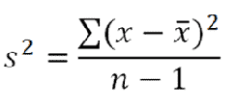
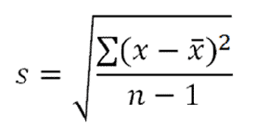
In summation notation:
variance standard deviation

Slide 8
Example 1: Finding Standard Deviation by Hand (no calculator) 4, 9, 11, 13, 18
11
x
Mean:
Variance:
Standard deviation:
4
4–11 = -7
2
(-7) = 49
9
-2
4
106
5-1
= 26.5
11
0
0
13
2
4
18
7
49
___
Sum:
106
V
26.5
= 5.15

Slide 9
Your Turn 1: Finding Standard Deviation (no calculator) 8, 9, 10, 11, 12
10
x
Mean:
Variance:
Standard deviation:
8
8–10 = -2
2
(-2) = 4
9
-1
1
10
5-1
= 2.5
10
0
0
11
1
1
12
2
4
__
Sum:
10
V
2.5
= 1.58

Slide 10
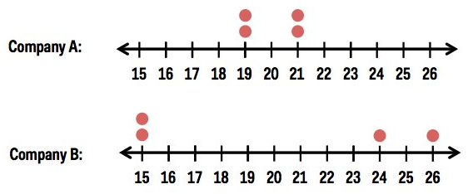
Example:
Two companies sell used cars. Each keeps track of how many cars they sell during the months of November, December, January and February. The data is shown on the dotplots below.
Using your calculator, find the mean and standard deviation of the used car sales for each company.
Company A: mean: standard deviation:
Company B: mean: standard deviation:
STAT
Calc
1-Var Stats L1
20
1.15
20
5.83

Slide 11
Your turn:
Using your calculator, find the standard deviation for each of Mrs. Smith’s Algebra 2 classes test scores.
1st hour: Standard deviation: 2nd hour: Standard deviation:
1st hour | 80 | 90 | 82 | 88 | 85 | 79 | 91 | 84 | 86 | 87 | 83
2nd hour | 100 | 81 | 100 | 85 | 85 | 70 | 89 | 85 | 100 | 55 | 85
3.87
13.54
Larger, since scores are more spread out.

Slide 12
Assignment
11.1 Worksheet

Slide 13
Statistics lesson 11.2: Distributions of data
Learning Targets:
- I can determine the shape of a distribution.
- I can solve problems involving normally
distributed data.

Slide 14
Common shapes for distributions of data:
Uniform
Bell-shaped
Skewed left
Skewed right

Slide 15
Example 1: Identify the most likely shape for the distribution of each data set:
a. Number of absences Mr. Kelly has in his first hour for one week:
Skewed left
The test scores for a very easy social studies test.
The SAT scores for 1000 randomly selected high school juniors
Skewed left
Bell-shaped

Slide 16
Your turn: Identify the most likely shape for the distribution of each data set:
a. The heights for all the students in your Algebra 2 class
b. The number of siblings for all the students at WOHS
Let’s line up and check.
Skewed right

Slide 17
Percentiles
Percentiles are a measure of the _______________ of a data value, compared to others in the data set.
p-th percentile: the pth percentile of a set of numbers is a value in the set such that p percent of the numbers are less than or equal to that value.
In other words, A percentile tells what percent of the values in the data set are less than or equal to the value you are considering.
position

Slide 18
Example 2: Johnny scored at the 87th percentile on his SAT. What does this mean?
Johnny answered 87% of the questions on the SAT.
b. Johnny answered 87% of the questions correctly on the SAT
c. 87% of students who took the SAT scored better than Johnny
Johnny scored better than 87% of the students who took the SAT
Your turn: Samantha’s doctor measured her height, and told her that she is at the 60th percentile. Write a sentence explaining what this means.
Samantha is taller than 60% of girls her age.

Slide 19
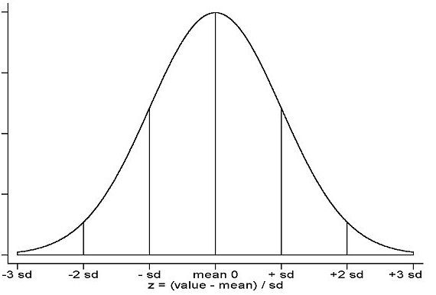
The standard Normal distribution:
single peak
Facts: ______________________________
______________________________
______________________________
______________________________
______________________________
uniform
~
~
mean median mode
~
~
total area under the curve is 1 (100%)

Slide 20
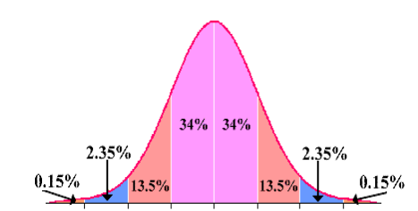
Empirical Rule: In a normal distribution,
68
1
_____% of the data lie within ____ standard deviation of the mean
_____% of the data lie within ____ standard deviation of the mean
_____% of the data lie within ____ standard deviation of the mean
95
2
99.7
3

Slide 21
Example 1:
Students counted the number of candies in 150 small packages. They found that the number of candies per package was normally distributed with a mean of 23 candies per package and a standard deviation of 1 piece of candy.
a. Draw a sketch of the distribution of number of candies per package. Label the mean, as well as the points 1, 2 and 3 standard deviations from the mean.
b. What percent of the packages had between 22 and 24 candies?
c. What percent of the packages had more than 25 candies?
20
21
22
23
24
25
26
68%
2.5%

Slide 22
20
21
22
23
24
25
26
d. What percent of the packages had no more than 22 candies?
e. Out of the 150 bags, how many of them would have fewer than 21
candies?
f. Between what two values does the middle 95% of candy bags lie?
g. How many candies would have to be in a bag for it to be at the 84th
percentile?
16%
2.5% of 150 = 3.75 so approximately 4 bags
21 and 25 candies
24 candies

Slide 23
Your Turn:
A fisherman counted the number of worms in 60 containers of bait. He found that the number of worms per container was normally distributed with a mean of 15 worms per container and a standard deviation of 2 worms.
a. Draw a sketch of the distribution of number of worms in the container.
Label the mean, as well as the points 1, 2 and 3 standard deviations from
the mean.
b. What percent of the containers had between 13 to 17 worms?
c. What percent of the containers had between 11 and 15 worms?
9
11
13
15
17
19
21
68%
47.5%

Slide 24
9
11
13
15
17
19
21
d. What percent of the containers had at least 17 worms?
e. What percent of the containers had at most 15 worms?
f. About how many containers had less than 11 worms or more than 19
worms?
g. How many worms would a container have to have for it to be at the 16th
percentile?
16%
50%
5% of 60 = 3 containers
13 worms

Slide 25
Assignment
11.2 Worksheet

Slide 26
Statistics lesson 11.3: Bivariate Data and Scatterplots
Learning Targets:
- I can construct a scatter plot for two quantitative
variables.
- I can identify the explanatory and response variable in
a bivariate data set.
- By looking at a scatter plot of a data set, I can identify
the direction of the relationship between the variables
and interpret the meaning of that direction in context.

Slide 27
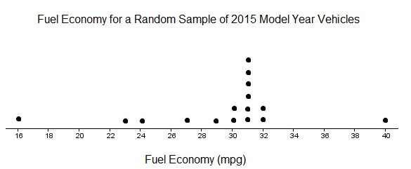
When examining univariate data (one variable), we can use displays like dotplots, stemplots, box and whisker plots, etc.. to look for patterns in the data.
Example 1: Use the dotplot below to answer the questions.
Fuel Economy
What is the variable being measured?
How many vehicles were in the sample?
What is the median value in this data? What is the mean?
What is the mode? What is the range?
16
31
29.31
31
24

Slide 28
two
When working with bivariate data (____________ variables),
we will concern ourselves with questions like:
1. Are the two variables related?
2. What type of relationship exists?
3. If so, what is the strength of the relationship?
4. What kind of predictions can be made from the relationship?

Slide 29
Two types of variables:
Categorical (Qualitative):
Examples:
Numerical (Quantitative):
Examples:
Variables whose values can be placed into categories.
gender, eye color, student ID #
Variables whose values are numbers that we can do math on (average, etc…)
height, weight, age, number of siblings

Slide 30
Bivariate Data Where Both Variables are Quantitative
Explanatory variable
(also called ________________ or ___________________)
Response variable
(also called _______________ or ___________________)
x
independent input
y
dependent output

Slide 31
Example 2: In each of the following situations, identify the explanatory variable and the response variable.
a. The length of your bungee cord and the total distance you drop while bungee jumping
explanatory variable:
response variable:
b. The number of calories in a candy bar and the amount of sugar in the candy bar
explanatory variable:
response variable:
c. The number of miles a vehicle has been driven and its price when sold.
explanatory variable:
response variable:
length of bungee
drop distance
amount of sugar
calories
miles
price

Slide 32
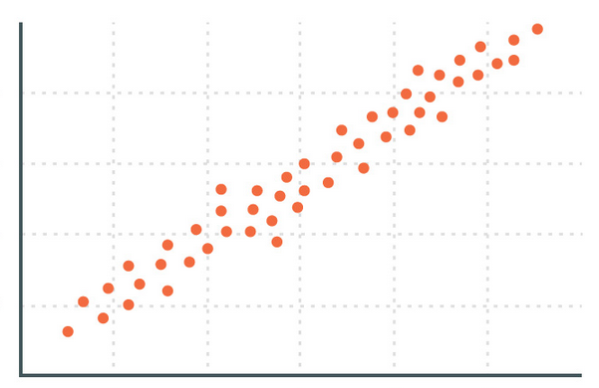
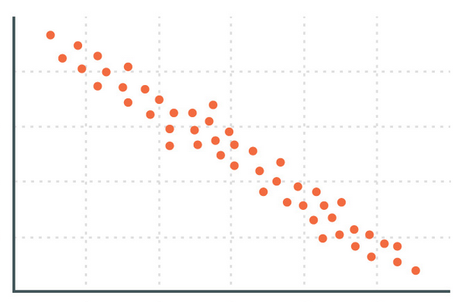
Scatter plot
graph of 2 quantitative variables as ordered pairs (x, y) where x is the explanatory variable and y is the response variable
Direction of the Relationship Between the 2 Variables
Positive relationship (positive association)
Negative relationship (negative association)
as x increases, y increases
or as x decreases, y decreases
as x increases, y decreases
or as x decreases, y increases

Slide 33
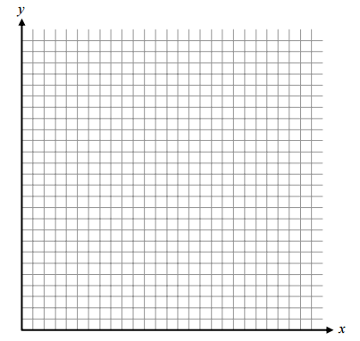
Example 3:
Below is some data about the number of grams of sugar in some popular candy bars, along with the number of calories in each candy bar.
a. What is the explanatory (independent) variable?
b. What is the response (dependent) variable?
sugar
calories
c. Construct a scatter plot of the data.
d. Describe the direction of the relationship.
Are the variables positively or negatively
associated?
e. What does this mean in the context of the situation?
positive
Candy bars with more sugar tend to have more calories.

Slide 34
Constructing a scatter plot on the graphing calculator:
Construct a scatter plot of the final grade vs. number of absences data set on your calculator. To do so, enter the number of absences in L₁, and the final grade in L₂. Remember: to enter data in a list, press STAT EDIT.
2. Access the STAT PLOT menu. To get to this feature, press 2nd Y=.
3. If any plots other than Plot1 indicate that they’re on, select that Plot and turn it off.
4. Select Plot 1 by pressing ENTER. Turn Plot1 On by having On highlighted.
5. For graph Type, select the 1st graph in the upper left corner. The graph looks like several scattered points.
6. Next to Xlist, type L₁. Next to Ylist, type L₂.
7. Select which Mark you wish to use for your points. It’s your decision.
8. Press the ZOOM key. Scroll down to option 9, ZoomStat. Using this, the calculator will resize your window automatically to best fit your data. With ZoomStat highlighted, press ENTER. You will now see the scatter plot on the screen.

Slide 35
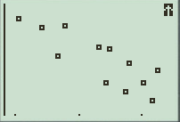
Example 4: Each member of an Algebra 2 class ran a 40-yard sprint and then did a long jump (with a running start). The table below shows the sprint times (in seconds) and the long-jump distance (in inches).
Sprint time (Sec) | Long Jump Distance (in)
5.41 | 171
5.05 | 184
7.01 | 90
7.17 | 65
6.73 | 78
5.68 | 130
5.78 | 173
6.31 | 143
6.44 | 92
6.50 | 139
6.80 | 120
7.25 | 110
a. What is the explanatory (independent) variable?
b. What is the response (dependent) variable?
c. Construct a scatter plot of the data on your calculator. Sketch here:
sprint time
long jump distance
d. Describe the direction of the relationship. Are the variables positively or negatively associated?
negative
e. What does this mean in the context of the situation?
Kids that run faster are also good jumpers.
(time goes up = slower)

Slide 36
Assignment
11.3 Worksheet

Slide 37
Statistics lesson 11.4 Correlation
Learning Targets:
- I can compute the correlation coefficient (r)
for a set of quantitative data.
- I can describe what the correlation coefficient
(r) measures.

Slide 38
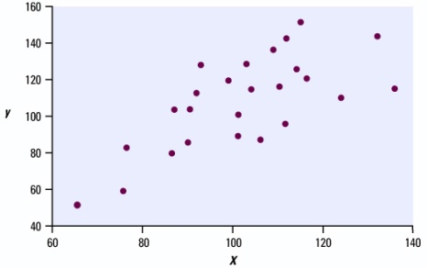
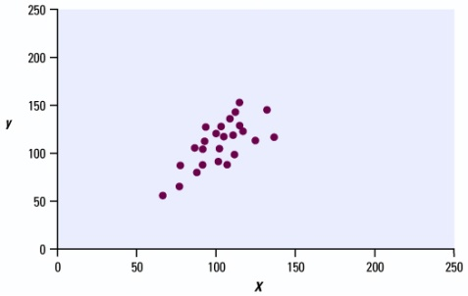
strength
Correlation: _________________ of a linear relationship
A linear relationship is ___________ if the points lie _________ to a straight line.
A linear relationship is ________ if the points are widely _________ about a line.
strong
close
weak
spread
Our eyes are not a good judge of the strength of a linear relationship. The two scatterplots above show the same data set on a different scale. Which data set appears to be more strongly correlated?
The right one looks more closely grouped, but it’s not. The left one is the same data on a different scale.

Slide 39
correlation coefficient (r)
a number that indicates both the ____________ and _____________ of the _________ relationship between 2 variables
strength direction
linear
Facts/Properties About Correlation
1. Correlation requires both variables to be ____________________.
2. The correlation coefficient (r) is always a number between ______ and ______.
3. If r is positive, then there is a ______________ relationship between the variables.
If r is negative, then there is a ______________ relationship between the variables.
4. The value of r will be exactly 1 or exactly -1 if ______________________________.
5. The closer r is to _____, the ___________ the relationship between the variables.
quantitative
-1
1
positive
negative
points are on a straight line
0
weaker

Slide 40
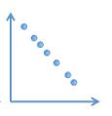
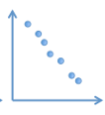
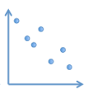
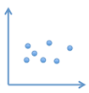
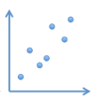
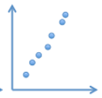
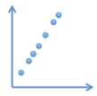
Perfect negative correlation
r = ______
Strong negative correlation
Weak
negative correlation
No correlation
r = ______
0
-1
Weak
positive
correlation
Strong positive
correlation
Perfect positive
correlation
r = ______
1

Slide 41
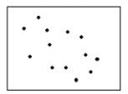
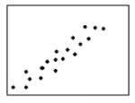
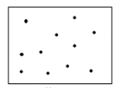
Example 1: Select the most likely value of the correlation coefficient for each scatterplot below.
A.
r = 0.87
r = -0.54
r = 0
r = -1.15
B.
r = 0.92
r = -0.88
r = 1
r = 0
C.
r = -0.95
r = 0
r = -1
r = 0.95

Slide 42
Example 2: Select the most likely value of the correlation coefficient (r) for each pair of variables.
x = outside temperature
y = ice cream sales
r = 0.83
r = 0
r = 1
r = -0.92
temperature goes up, sales go up r > 0
B. x = # of miles a car has been driven
y = the price of the car when sold
r = 0
r = -0.74
r = -1
r = 0.95
more miles, price goes down r < 0
C. x = height of your classmates
y = classmates’ scores on their
last math test
r = -1
r = 1
r = 0
r = 0.98
no relationship

Slide 43
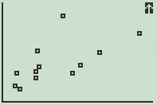
Example 3: Look again at the data relating sugar and calories of popular candy bars. Put the data in to L₁ and L₂ in your calculator and make a scatterplot. Sketch below.
Based on looking at the scatterplot, will the value of r (the correlation coefficient) be positive or negative? ________________________ Why does this make sense?
Make a prediction on the value of r. __________
positive
Candy with more sugar will probably have more calories.
.53

Slide 44
Finding r with your calculator:
First, the diagnostics must be on.
Press 2nd, 0. This will bring you to the catalog.
Find DiagnosticOn. Press ENTER and ENTER again.
4. Now to find r: press STAT, CALC, 4: LinReg(ax + b) Complete the command
LinReg(ax + b) L₁, L₂.
The value r at the bottom of the screen is the correlation coefficient. What value of r is shown on your calculator? ___________
.618

Slide 45
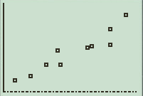
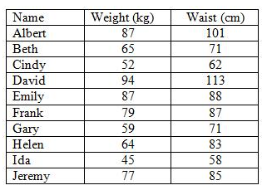
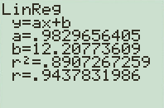
Example 4: The following table gives the weights (in kg) and waist sizes (in cm) for 10 students.
Calculate the value of the correlation coefficient.
What does the value of r tell you about the relationship between weight and waist size for these students?
.944
There is a strong positive relationship between weight and waist. Kids that weigh more have bigger waists.
*Emphasize interpreting r in context*

Slide 46
Assignment
11.4 Worksheet

Slide 47
Statistics lesson 11.5 Linear Regression
Learning Targets:
- I can find the equation of the least-squares
regression line (LSRL) and use it to predict
values.
- I can identify and interpret the slope and y-
intercept of the LSRL in context.

Slide 48
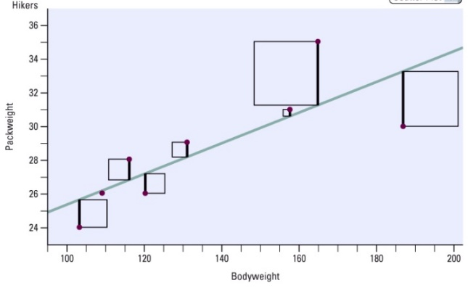
Line of Best Fit/Least-Squares Regression Line (LSRL)
best fit means that the sum of the squares of the vertical distances from each point to the line is as small as possible
used to predict values of y for values of x
Try this applet: http://www.rossmanchance.com/applets/RegShuffle.htm

Slide 49
Equation of the Least Squares Regression Line
y = ax + b
a = _________________: tells us how much y is predicted to change for every increase of 1 unit in x
b = _________________: tells us what y is predicted to be when x = 0
slope
y-intercept

Slide 51
Example 1: Use the candy bar data again:
Construct a scatter plot of the data set on the calculator. Make a sketch below.
Find the equation of the least-squares regression line (LSRL). Round values to 3 decimal places. STAT CALC 4: LinReg(ax+b) L₁ , L₂ ENTER
y = 2.829x + 300.040
What is the slope of the LSRL? Interpret the slope in context.
Slope = _______. This means that for each additional gram of sugar a candy bar has, we can predict the number of calories in the candy bar will ______ by _______
2.829
increase
2.829

Slide 52
c. What is the y-intercept of the LSRL? Interpret the y-intercept in context.
y-int = ____________. This means that if a candy bar has zero grams of sugar, we can predict the number of calories the candy bar will have will be ___________.
d. A King-sized Butterfinger has about 50 grams of sugar. Use your LSRL equation to predict the number of calories in Butterfinger bar.
e. A King-sized Butterfinger actually contains about 514 calories. Was the prediction you made with the LSRL equation too high or too low? By how much? Why do you think this happened?
f. Use your LSRL equation to predict the number of calories in a candy bar that has 65 grams of sugar.
300.04
300.04
y = 2.829(50) + 300.04
y = 441.49 calories
Too low. 514 - 441.49 = 72.51
Maybe because Butterfinger is also high in fat.
y = 2.829(65) + 300.04
y = 483.925 calories

Slide 53
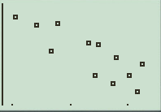
Example 2: Each member of an Algebra 2 class ran a 40-yard sprint and then did a long jump (with a running start). The table below shows the sprint times (in seconds) and the long-jump distance (in inches).
Sprint time (Sec) | Long Jump Distance (in)
5.41 | 171
5.05 | 184
7.01 | 90
7.17 | 65
6.73 | 78
5.68 | 130
5.78 | 173
6.31 | 143
6.44 | 92
6.50 | 139
6.80 | 120
7.25 | 110
a. Construct a scatter plot of the data on your calculator. Sketch here:
b. What is the value of the correlation coefficient (r)? __________
c. What does this value tell you about the relationship between the students’ sprint times and long-jump distances? (Is the relationship positive or negative? Strong or weak?)
-0.838
Strong, negative. Kids that are fast runners are also good jumpers.

Slide 54
Find the equation of the least-squares regression line (LSRL). Round values to 3 decimal places.
e. What is the slope of the LSRL? Interpret the slope in context.
Slope = ____________. This means that
f. What is the y-intercept of the LSRL? Interpret the y-intercept in context.
y-int = ____________. This means that
y = -45.743x + 414.786
-45.743
for each additional second it takes to run the sprint, we predict them to jump 45.743 inches less.
414.786
if a kid finishes the sprint in zero seconds, we predict they can jump 414.786 inches!
*Note: this is an extrapolation. Have a side discussion about why this is ok.

Slide 55
g. Use your LSRL equation to predict how far a student will jump if he/she runs the 40-yard sprint in 6.5 seconds.
h. One student in the class ran 40-yards in 6.5 seconds and jumped a distance of 139 inches. Was your prediction too high or too low? By how much?
y = -45.743(6.5) + 414.786
y = 117.457 inches
Too low
139 – 117.457 = 21.544 inches

Slide 56
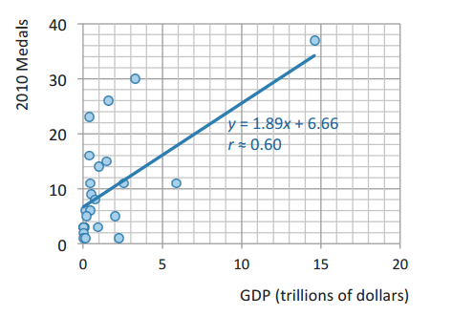
Example 3: The scatterplot below shows a country’s Gross Domestic Product (a measure of its wealth) and the number of medals it won in the 2010 Winter Olympics.
What does the data tell you about the relationship between GDP and performance in the Winter Games?
Germany’s GDP in 2010 was approximately $3.3 trillion. Based on this, how many medals would you predict that they won in the 2010 Winter Olympics? How confident are you in your prediction, and why?
Positive, but not a strong relationship. Countries with higher GDP tend to win more medals.
y = 1.89(33) + 6.66 = 12.897, so about 13 medals.
Not confident, since r = 0.6

Slide 57
c. Germany actually won 30 medals in 2010. How close was your prediction?
Not very close. Our prediction was too low by 17 medals.

Slide 58
There are other factors besides a country’s wealth that may predict success at the Olympics. For each country that has won a medal at the Winter games, two other data values were collected: the latitude of the country’s capital and the number of medals the country won in 2006. Plots of these variables are shown below:
Based on the LSRL equations and the values of the correlation
coefficients, which variable do you feel does the best job of predicting
Olympic performance (GDP, latitude, or 2006 medals)? Why?
Use the best LSRL equation to predict the number of medals won by the
Germany in 2010. Is this prediction better than your prediction in part b?
2006 Medals because r = 0.91, which means there is a strong relationship between these variables.
Latitude of German capital: 52.5º
Medals (2006): 29

Slide 59
There are other factors besides a country’s wealth that may predict success at the Olympics. For each country that has won a medal at the Winter games, two other data values were collected: the latitude of the country’s capital and the number of medals the country won in 2006. Plots of these variables are shown below:
Use the best LSRL equation to predict the number of medals won by the
Germany in 2010. Is this prediction better than your prediction in part b?
Latitude of German capital: 52.5º
Medals (2006): 29
y = 0.95(29) + 0.8
y = 28.35
This is much closer to the actual medal count (30).

Slide 60
Assignment
11.5 Worksheet

