Slide 1
Algebra 2B
Unit 12
Rationals (Algebraic)

Slide 2
Lesson 12.1
Learning Targets:
I can simplify Rational Expressions
I can simplify complex fractions

Slide 3
Vocabulary
  Rational Expression: It’s the ratio of two polynomial
  expressions
  Examples: or
Undefined for: ________________________________________
denominator = 0
Complex Fraction: It’s a rational expression whose
numerator and/or denominator
contains a rational expression.
Examples:

Slide 4
Multiplying Rational Expressions:
Dividing Rational Expressions:
Review:
How to multiply and divide monomials: Lesson 5.1
How to multiply, divide and find the power of a power:
Lesson 5.1
How to factor polynomials: see Factoring Flow Chart

Slide 5

Summary of Factoring Techniques
For all polynomials, first factor out the greatest common factor (GCF).
For a binomial, check to see if it is any of the following:
  difference of squares: x² − y² = ( x + y) ( x − y)
  difference of cubes: x³ − y³ = ( x − y) ( x² + xy + y²)
  sum of cubes: x³ + y³ = ( x + y) ( x² − xy + y²)
For a trinomial, use the X
  ax² + bx + c:

Slide 6


Slide 7
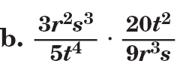

Slide 9
Simplify
d.

Slide 11


Slide 16

7.

Slide 17
7.
b – a

Slide 20
Closure 12.1(in class):

Slide 22
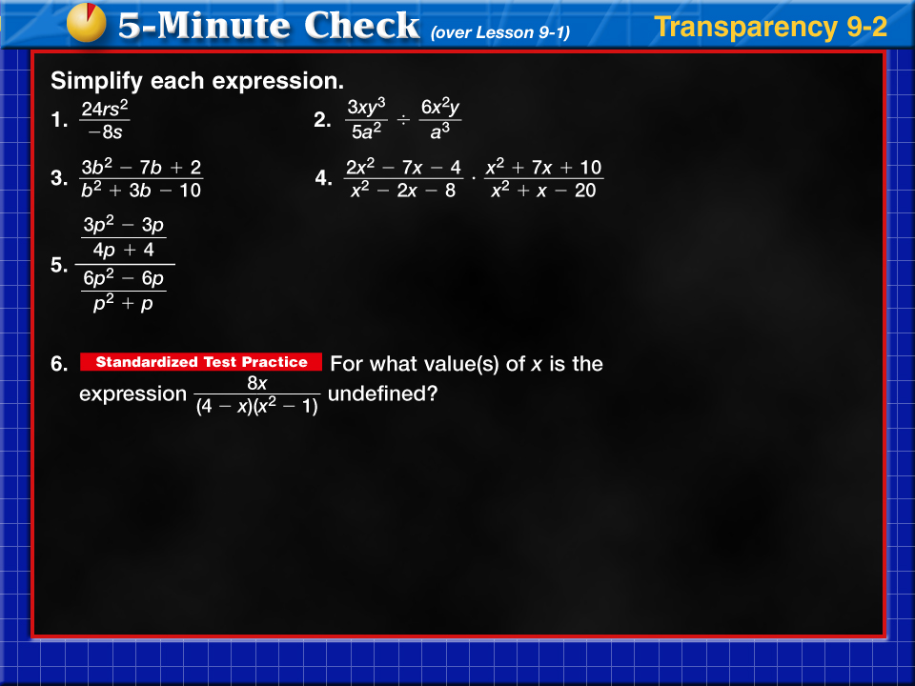
Transparency 2

Slide 23
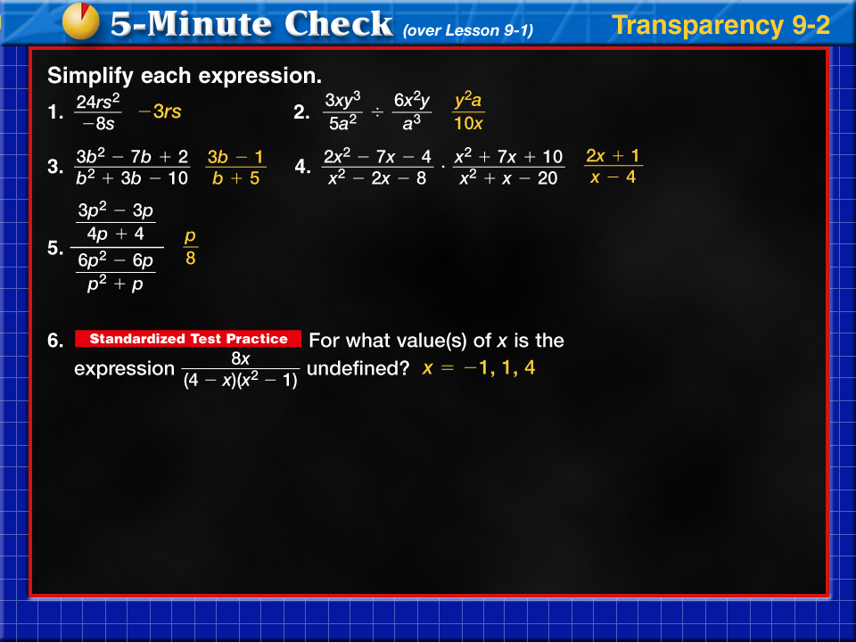



Transparency 2a

Slide 24







12.1

Slide 25





Slide 26
Lesson 12.2
Objectives:
I can determine the LCM of polynomials
I can add and subtract rational expressions.

Slide 27
Vocabulary
To add and subtract Rational Expressions:
To find equivalent fractions with the same denominator,
we need the LCM.

Slide 31

Your Turn:

Slide 32
Your Turn:

Slide 33

Your Turn:

Slide 34
Your Turn:

Slide 37
Closure Lesson 12.2 (in class):

Slide 38
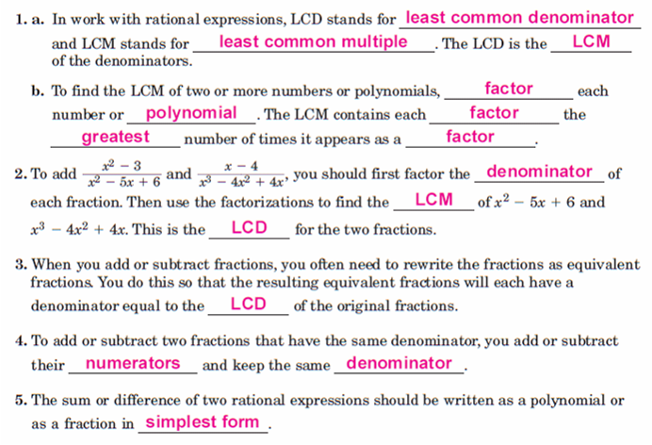

Slide 39
Warm-up 12.2

Slide 40
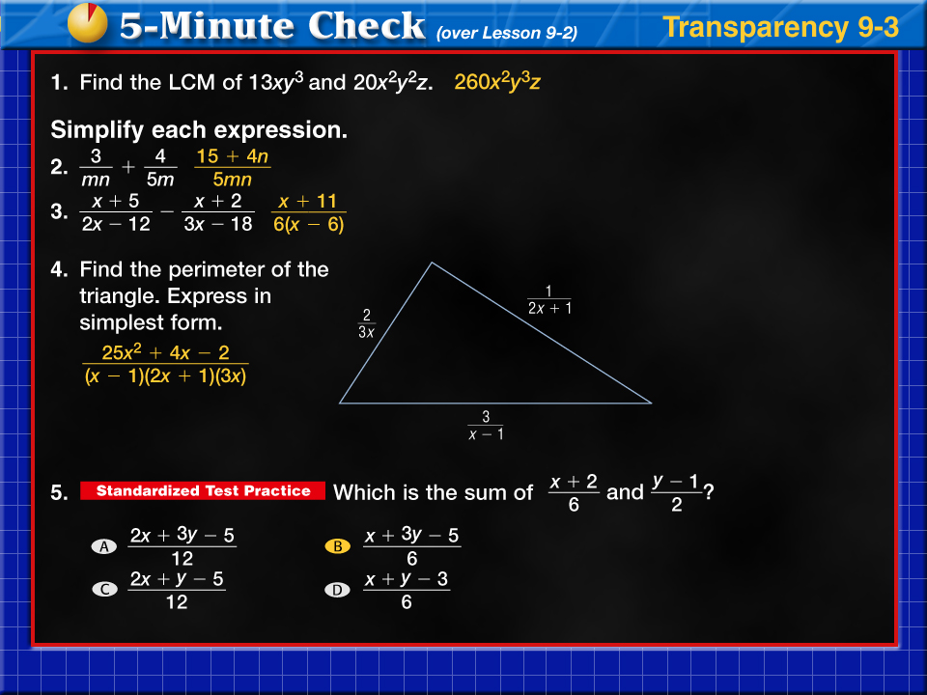
Transparency 3a

Slide 41
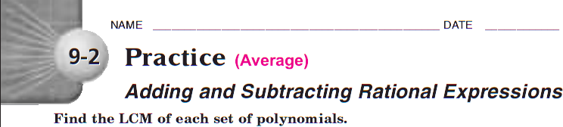



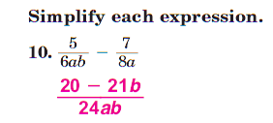
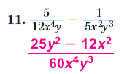





12.2

Slide 42


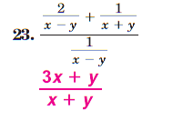

Slide 43
Lesson 12.3
Objectives:
I can solve Rational Equations.

Slide 44
Vocabulary
A rational equation is any equation that contains one or more rational expressions
Hint: When solving a rational equation, eliminate the fractions first!
Check the solutions in the original equation

Slide 45
Restriction: ________________

Slide 46
None (no variables on the bottom)
Restriction: ________________

Slide 47
Restriction: ________________

Slide 48
Restriction: ________________

Slide 49
Restriction: ________________

Slide 50
Restriction: ________________

Slide 51
Restriction: ________________

Slide 52
Restriction: ________________

Slide 53
12.3

