Slide 1
Algebra 2B
Unit 13
Graphing Rational Functions

Slide 2
Lesson 13.1
Learning Targets :
I can determine the Vertical Asymptotes and the Point of Discontinuity (Hole)
I can graph Rational Functions

Slide 3
Vocabulary
the unbroken and consistent existence or
operation of something over a period.
Continuity:_________________________________________________
_________________________________________________________
To find the asymptote(s) and/or hole(s) of a rational function,
we look at its denominator.
*Being able to graph a function without lifting your pencil.

Slide 4
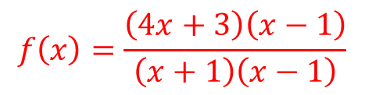
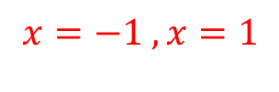




Step 1: Factor completely.
Step 2: Find the restricted domain
values. When is the
denominator zero?
Locations of Discontinuity
Step 3: Determine if the restriction
is a vertical asymptote
or a hole.
If the factor of the restriction can
reduce, then it is a hole.
Asymptote(s): ________________________
Hole(s): _____________________________

Slide 5
In your own words,
vertical asymptote: _______________________________________________
_______________________________________________
hole: _______________________________________________
_______________________________________________

Slide 6
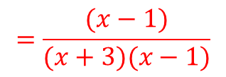













x
f(x)
Hole
V.A.
Asymptote(s): ________________________
Hole(s): _____________________________

Slide 7















x | f(x)
V.A.
Asymptote(s): ________________________
Hole(s): _____________________________

Slide 8
x | f(x)
Asymptote(s): ________________________
Hole(s): _____________________________

Slide 9
Use your graphing calculator to get the table of values.
Asymptote(s): ________________________
Hole(s): _____________________________

Slide 10
Asymptote(s): ________________ Asymptote(s): _______________
Hole(s): _____________________ Hole(s): ____________________

Slide 11
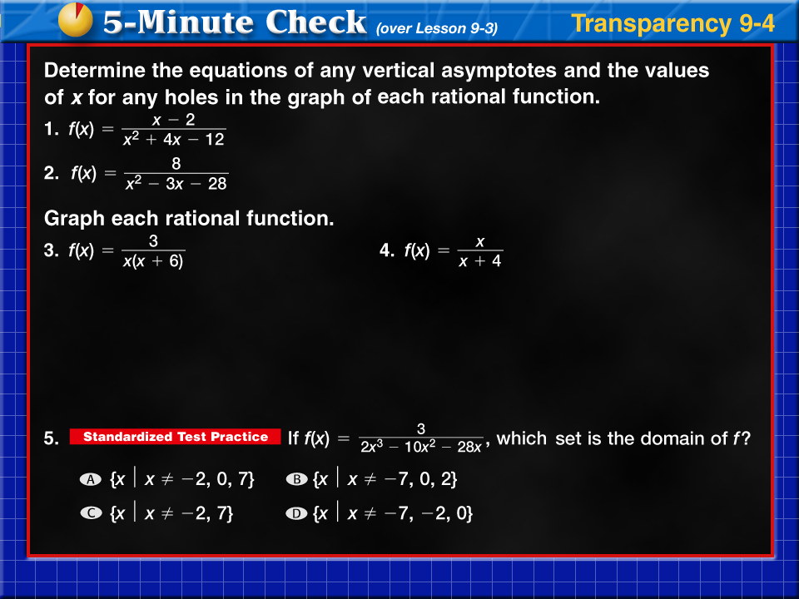



Transparency 4
Click the mouse button or press the
Space Bar to display the answers.

Slide 12
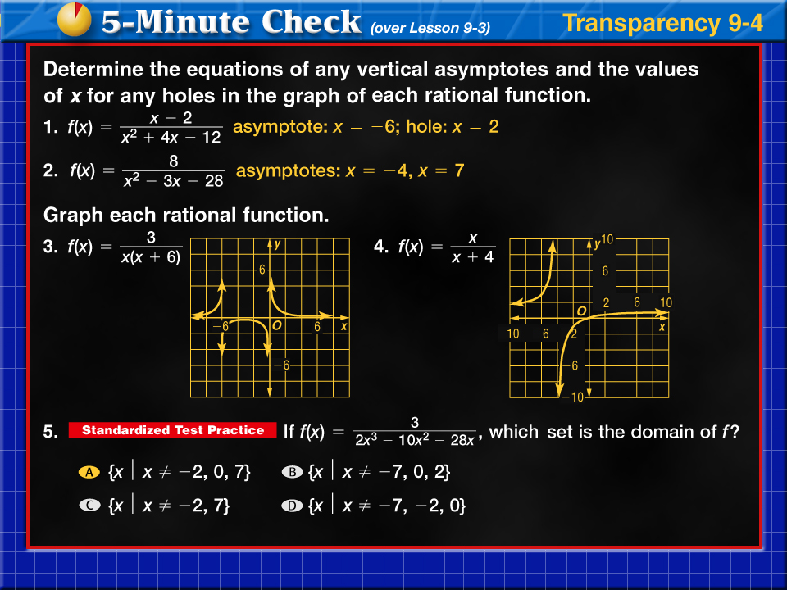

Transparency 4a

Slide 13
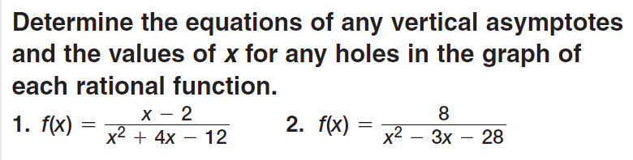
Warm-up 13.2: on the back of closure
Asymptote: ____________
Hole: _________________
Asymptote: ____________
Hole: _________________

Slide 14
Warm-up 13.2

Slide 15
Lesson 13.2
Learning Targets :
I can recognize and solve direct and joint variation problems
I can recognize and solve inverse variation problems

Slide 16
Vocabulary

Slide 17
Examples:

Slide 18
Examples:

Slide 19
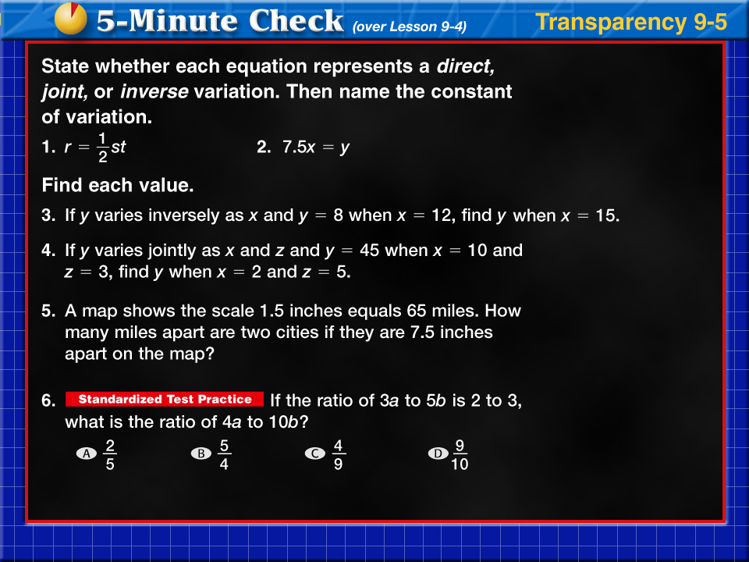
Transparency 5
Click the mouse button or press the
Space Bar to display the answers.

Slide 20
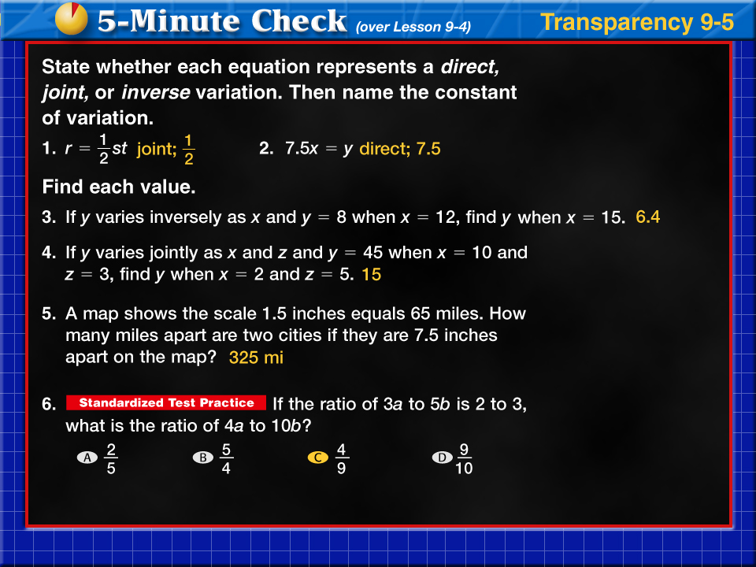
Transparency 5a

Slide 21
Lesson 13.3
Learning Targets :
I can identify graphs and equations as different types of functions
I can graph parent function equations with small variations.

Slide 22

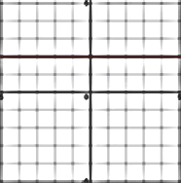

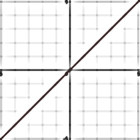


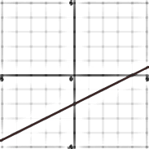


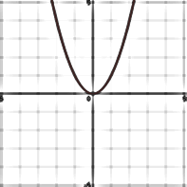
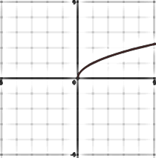


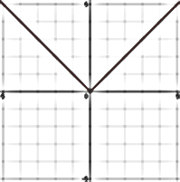
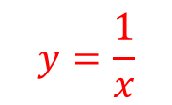
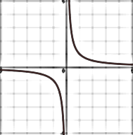
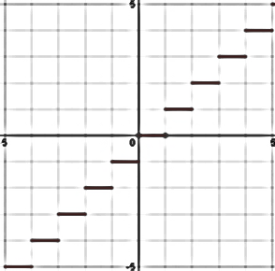

Family Name | Parent Function Equation | Sample of Graph
Constant
Identity
Direct (Linear)
Quadratic
Square Root
Absolute Value
Rational (Inverse)
Greatest Integer

Slide 23
Use your Family Functions Cheat sheet to identify the functions represented by each graph.

Slide 25
________________________ __________________________

Slide 26
______________________ _______________________

Slide 27
_______________________ _________________________

Slide 28
________________________ __________________________

Slide 29
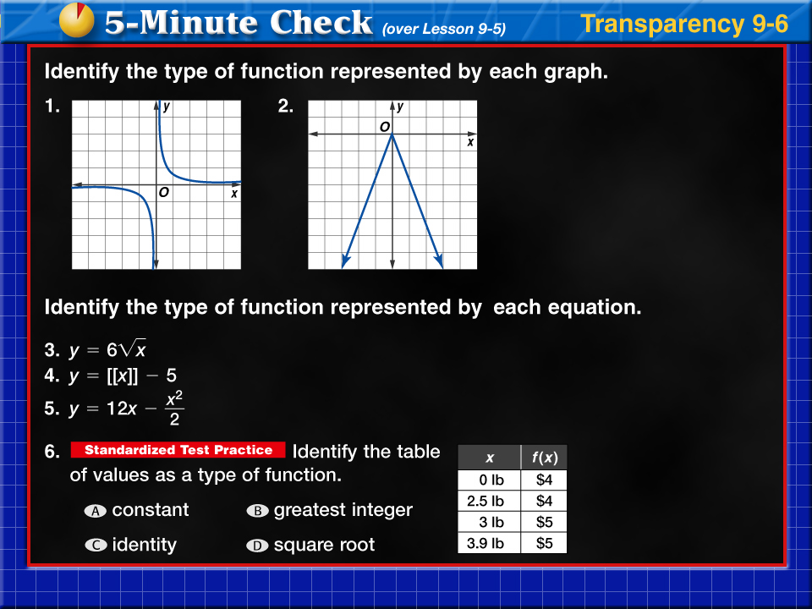
Transparency 6
Click the mouse button or press the
Space Bar to display the answers.

Slide 30
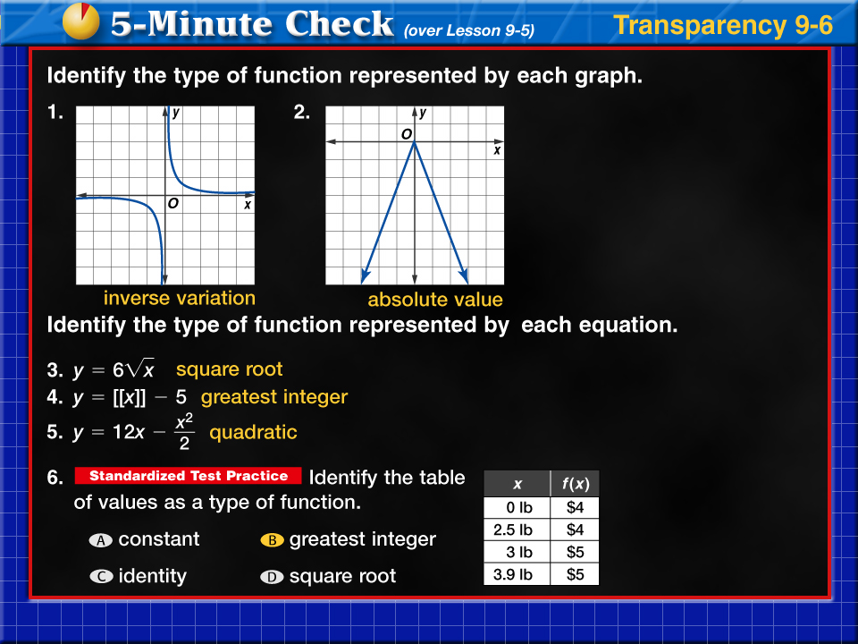
Transparency 6a

