Slide 1
I can identify and draw
points, lines, and planes.
I can identify and draw
collinear and coplanar points.
I can identify and draw
intersecting lines and planes in
space.
Lesson 1-1

Slide 2
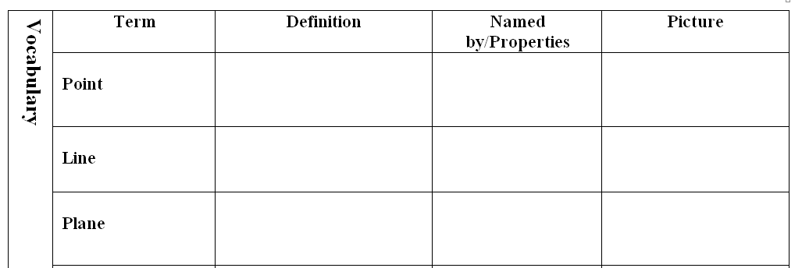
location
One capital letter
P
made up of 2 or more points
2 capital letters (or 1 script)
P
Q
n
R
made up of 3 or more points not on a line
3 capital letters (or 1 script)

Slide 3
3 or more points on the same line
4 or more points on the same plane

Slide 4
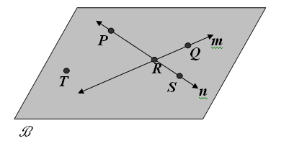
or line m
RQ
or
QR
or plane B
Plane PRT
R

Slide 5
T
PS
RP
PRS
P, R, and S

Slide 6
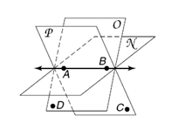
P
or
AB
BA

Slide 8
ASSIGNMENT:
1.1 Worksheet, due tomorrow

Slide 9
I can measure segments.
I can find the measure of missing parts with numbers given
Lesson 1-2

Slide 10
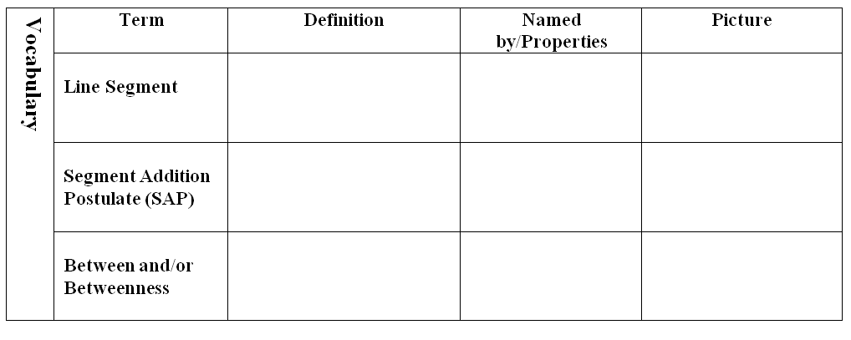
has two endpoints
A
C
AC or CA
part + part = whole
AB + BC = AC
A
B
C
3 points that are collinear where AB + BC = AC means B is “between” A and C

Slide 11
part + part = whole
7 cm
7.9 in

Slide 12
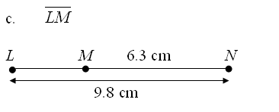
part + part = whole
x
x + 6.3 = 9.8
x = 3.5 cm

Slide 13
part + part = whole
5x
7x
48
5x + 7x
= 48
12x = 48
x = 4

Slide 14
part + part = whole
4a + 10
3a – 5
A
B
C
19
4a + 10
+ 3a – 5
= 19
7a + 5
= 19
a = 2
AB = 18

Slide 15
Your turn!
x = 2
ST = 4

Slide 16
C
Segments that are the same length
≅
AB CD
D
A
B

Slide 17
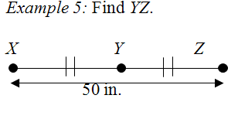
25 in

Slide 18
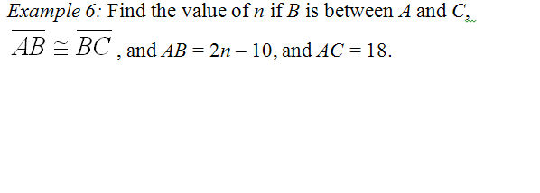
2n – 10
2n – 10
A
B
C
18
2n – 10
+ 2n – 10
= 18
4n – 20
= 18
n = 9.5

Slide 19
20
40

Slide 20
ASSIGNMENT:
1-2 worksheet

Slide 21
I can find the distance between two points
I can find the midpoint between two points
Lesson 1-3

Slide 22
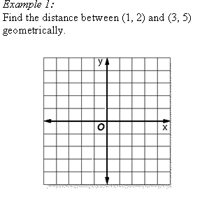
c
3.61
3
2

Slide 23
6.40
c
4
5

Slide 25
x₁
y₁
x₂
y₂
$$d=\sqrt{{(3−1)}^{2}+{(5−2)}^{2}}$$
$$d=\sqrt{{(2)}^{2}+{(3)}^{2}}$$
$$d=\sqrt{4+9}$$
$$d=\sqrt{13}≈3.61$$

Slide 26
x₁
y₁
x₂
y₂
$$d=\sqrt{{(−3−4)}^{2}+{(−6−7)}^{2}}$$
$$d=\sqrt{{(−7)}^{2}+{(−13)}^{2}}$$
$$d=\sqrt{49+169}$$
$$d=\sqrt{218}≈14.8$$

Slide 27
$$d=\sqrt{157}≈12.53$$

Slide 28
A
C
AB =
BC =
B
CA =
perimeter = 5.83 + 6.71 + 9.22 = 21.76

Slide 29
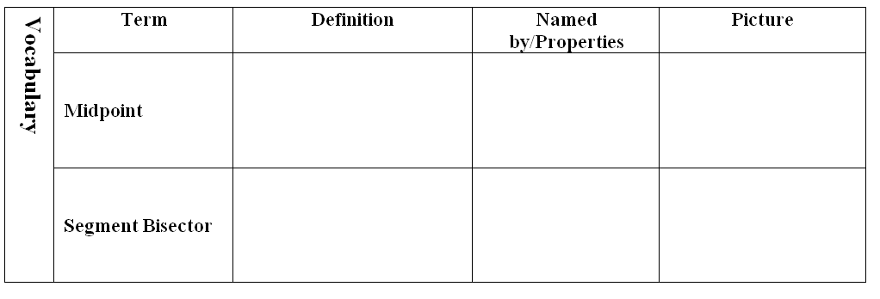
The point that cuts a segment in half
AX = XB
A
X
B
A line that cuts a segment in half
AX = XB
A
B

Slide 30
( , )
x₁ + x₂
y₁ + y₂
2
2
Avg of x’s
Avg of y’s

Slide 31
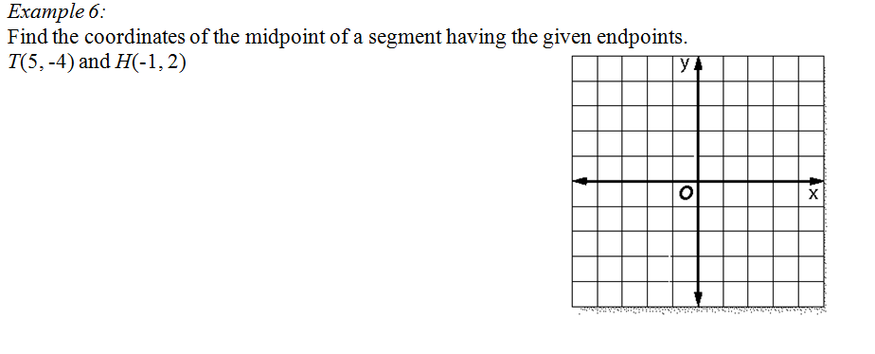
5 + -1
-4 + 2
2
2
4
-2
2
2
(2, -1)
2
-1
(in Q IV)

Slide 32
(3.5, 3)
(-0.5, 1)

Slide 33
ASSIGNMENT:
1-3 worksheet

Slide 34
I can find the perimeter of a triangle using the distance formula
Lesson 1-3B

Slide 35
I can measure angles
I can classify types of angles
I can identify and use the congruent angles
Lesson 1-4

Slide 36
X
has one endpoint, goes forever in one direction
BA
AB
A
B
∠C
two rays with a common endpoint
∠ACB
A
B
2
∠BCA
C
∠2

Slide 37
two angles with the same measure
∠A ≅ ∠B
A
B
A ray that cuts an angle in half

Slide 38
part + part = whole

Slide 39
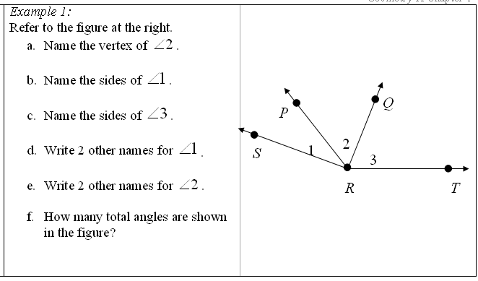
R
RS
RP
RQ
RT
SRP
PRS
PRQ
QRP
6

Slide 40
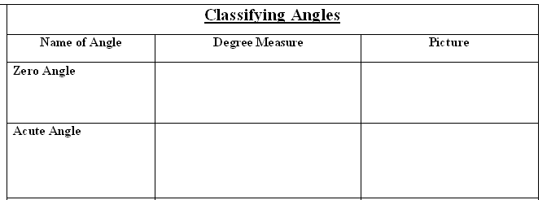
0°
between 0° and 90°

Slide 41
90°
between 90° and 180°
180°

Slide 42
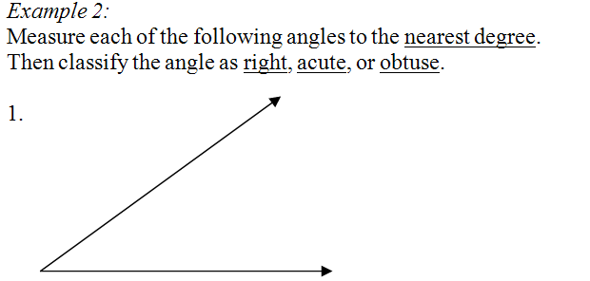
37°
acute

Slide 43
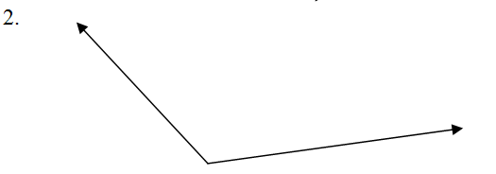
125°
obtuse

Slide 44
75°
90°
acute
right

Slide 45
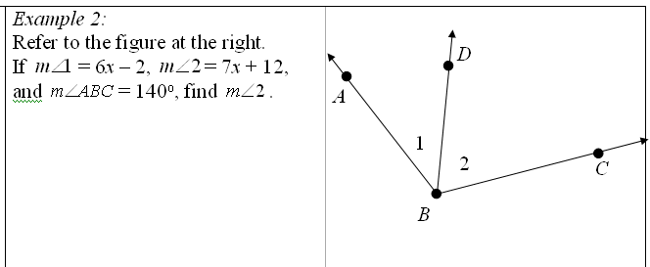
3
6x – 2
7x + 12
6x - 2
+ 7x + 12
= 140
13x + 10
= 140
140
13x = 130
7(10) + 12
x = 10
= 82°

Slide 46
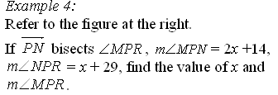
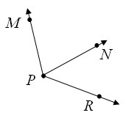
4
2x + 14
44°
44°
7x + 12
x + 29
2x + 14
= x + 29
x + 14
= 29
x = 15
15 + 29
= 44°
88°

Slide 47
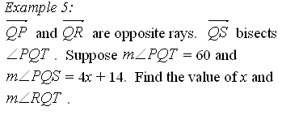
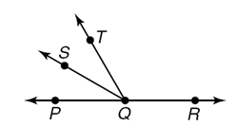
5
30
4x + 14
30
4x + 14
= 30
4x
= 16
x = 4
180 – 60
= 120°

Slide 48
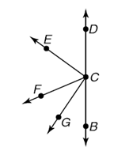
6
5x + 10 + 5x + 10
+ 4x – 1 + 4x – 1
= 180
5x + 10
55°
18x + 18
= 180
5x + 10
55°
18x = 162
x = 9
35°
4x – 1
35°
m ECF = 55°
4x – 1
m GCE = 90°

Slide 49
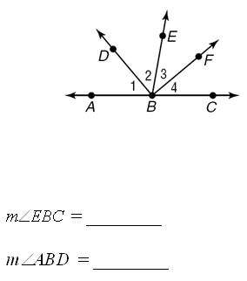
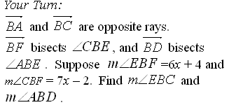
80°
50°

Slide 50
ASSIGNMENT:
Lesson 1-4 worksheet

Slide 51
I can identify and use special pairs of angles
I can identify perpendicular lines
Lesson 1-5

Slide 52
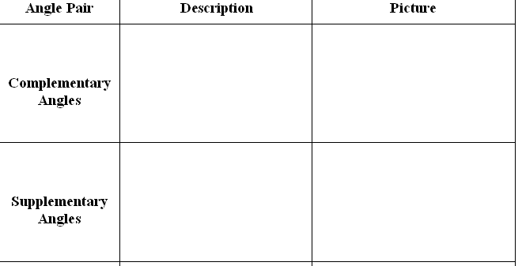
40°
2 angles with a sum of 90°
50°
2 angles with a sum of 180°

Slide 53
2 angles that share a vertex and side
2 adjacent angles that make a line

Slide 54
2 non-adjacent angles formed by intersecting lines
1
2
4
3
lines that intersect to form right angles
X
A
B
Y
┴
AB XY

Slide 55
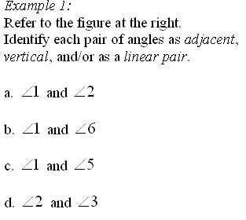
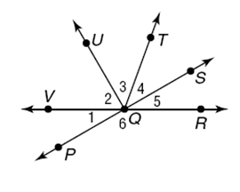
adjacent
adjacent,
linear pair
vertical
adjacent

Slide 56
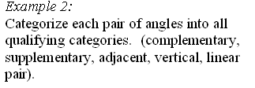
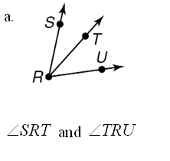
adjacent

Slide 57
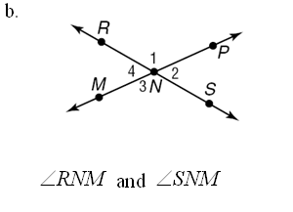
supplementary
adjacent
linear pair

Slide 58
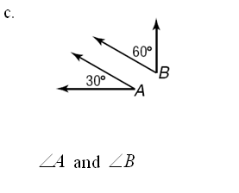
complementary

Slide 59
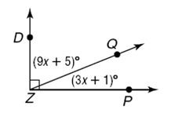
9x + 5
+ 3x + 1
= 90
12x + 6 = 90
12x = 84
x = 7

Slide 60
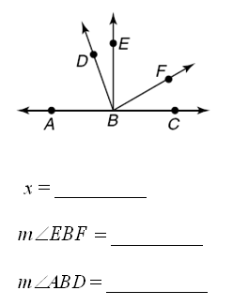
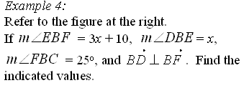
20
x
3x + 10
70
65
25
x
+ 3x + 10
= 90
20
4x + 10 = 90
70
4x = 80
65
x = 20

Slide 61
x
+ 21 + 2x
= 90
67
21 + 2x
3x + 21 = 90
x
23
3x = 69
x = 23
23° and 67°

Slide 62
ASSIGNMENT:
Lesson 1-5 worksheet

Slide 63
I can identify and name polygons
I can find perimeters of polygons
Lesson 1-6

Slide 64
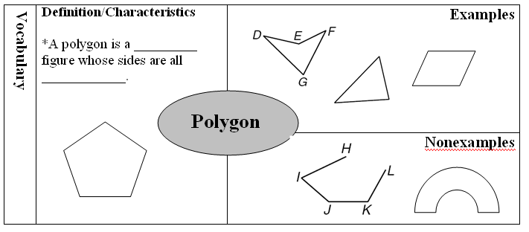
closed
segments

Slide 65
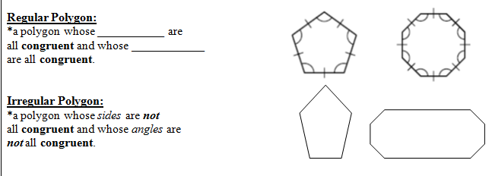
sides
angles

Slide 66
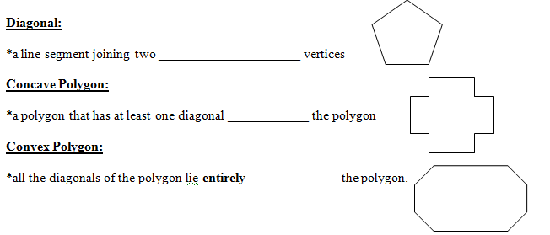
non-adjacent
outside
inside

Slide 67
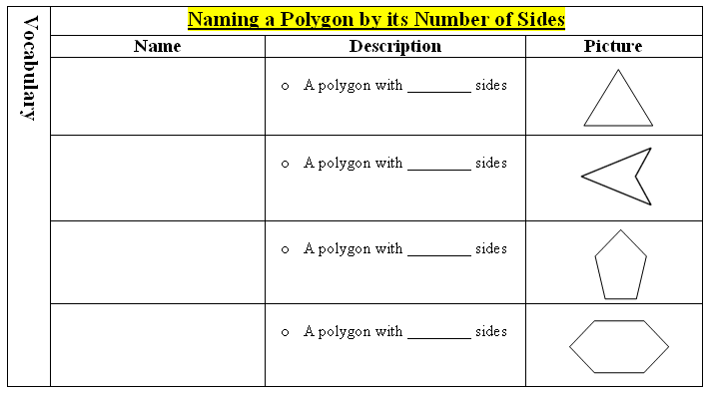
3
triangle
quadrilateral
4
pentagon
5
hexagon
6

Slide 68
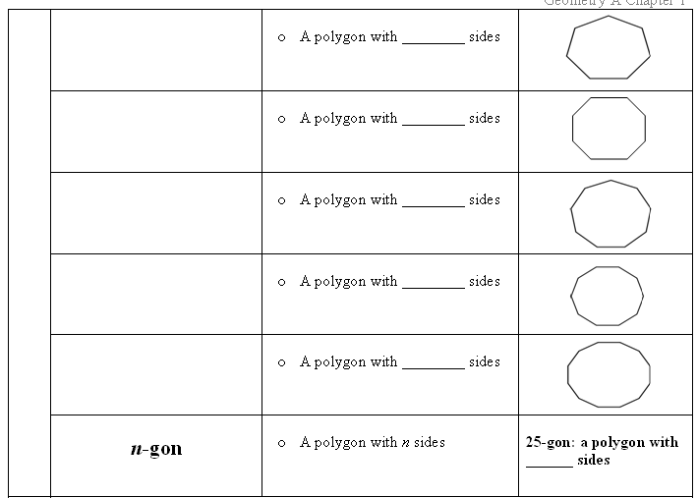
heptagon
7
octagon
8
nonagon
9
decagon
10
dodecagon
12
25

Slide 69
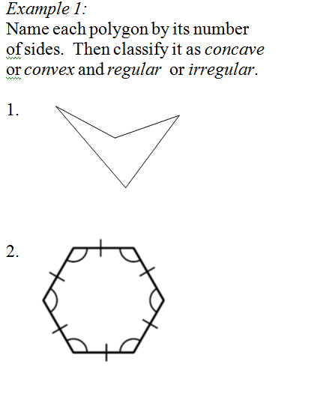
quadrilateral
concave
irregular
hexagon
convex
regular

Slide 70
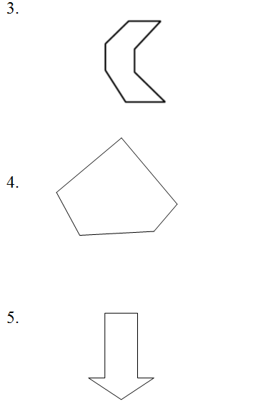
octagon
concave
irregular
pentagon
convex
irregular
heptagon
concave
irregular

Slide 71
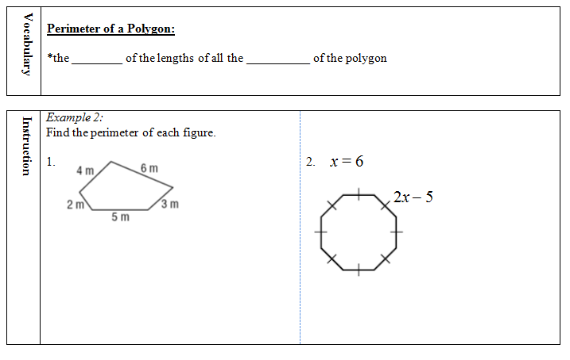
sum
sides
7
4 + 6 + 3 + 5 + 2
= 20 m
8(7)
= 56 units

Slide 72
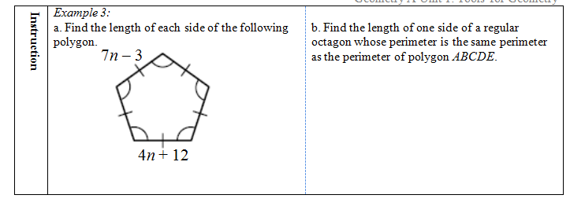
X
7n – 3
= 4n + 12
3n – 3 = 12
32
3n = 15
n = 5

Slide 73
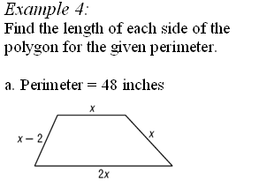
x
+ x
+ 2x
+ x – 2
= 48
10
8
10
5x – 2 = 48
20
5x = 50
x = 10

Slide 74
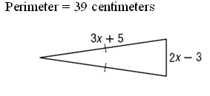
17
5
17
3x + 5
+ 3x + 5
+ 2x – 3
= 39
8x + 7 = 39
8x = 32
x = 4

Slide 75
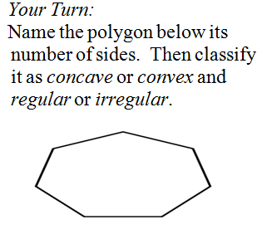
heptagon
convex
irregular

Slide 76
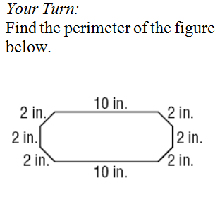
32 in

Slide 77
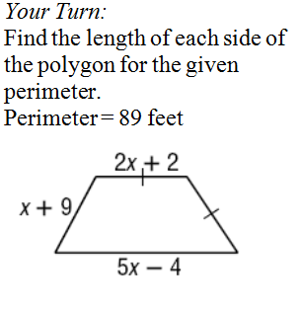
x = 8
18
17
18
36

Slide 78
ASSIGNMENT:
1-6 worksheet

Slide 79
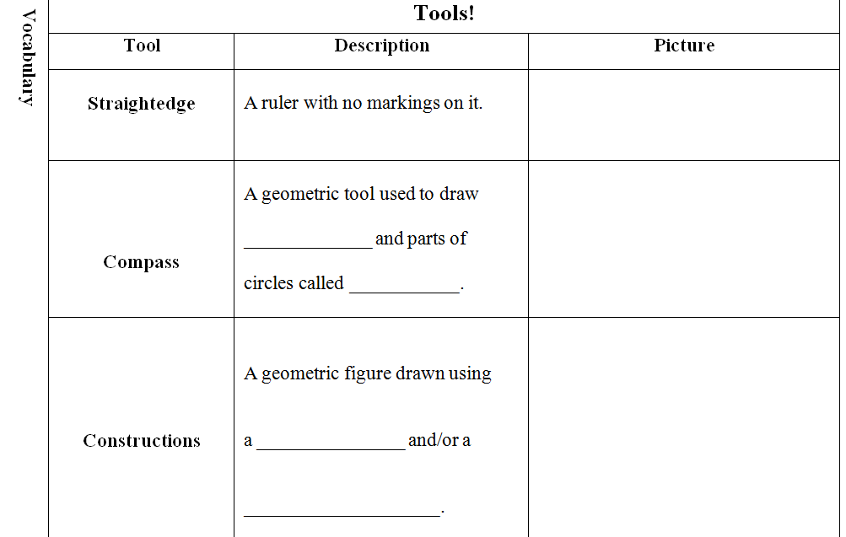
circles
arcs
compass
straightedge

Slide 80
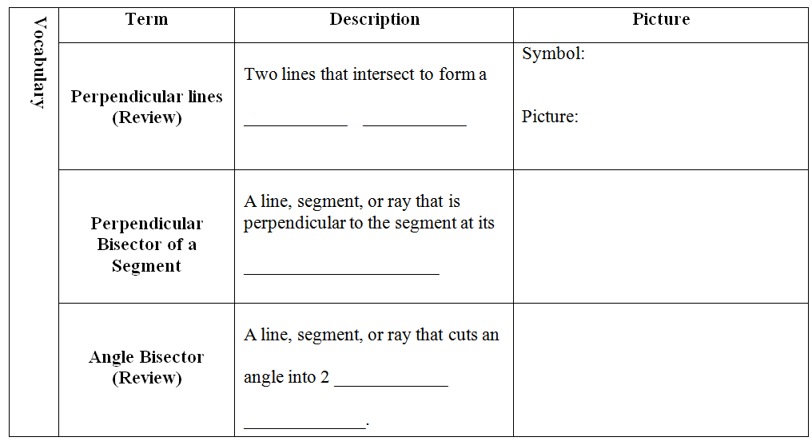
┴
right angle
midpoint
congruent
parts

Slide 83
Assignment
1-7 worksheet

