Slide 1
Algebra 2A – Unit 3
Quadratic Functions

Slide 2
Algebra 2A – Unit 3
Lesson 3.1
Solving Quadratic Equations by factoring

Slide 3
Lesson 3.1
Learning Targets:
I can solve quadratic equations by factoring.
I can write a quadratic equation when given its roots.

Slide 4

































Review: Factoring Trinomials
Hint: Always set equal to zero and check for GCF first!
Any trinomial: Example:
Perfect square trinomial: Example:
Difference of two squares: Example:
Factor
Factor
Split the middle term.
$$x^{2}−b^{2}=0$$
$$x^{2}−64=0$$
$$(x+b)(x−b)=0$$
$$(x+8)(x−8)=0$$

Slide 5
Vocabulary
Zero Product Property:
To write a quadratic equation with roots p and q:
For any real numbers a and b, if ab = 0, then either a = 0 or b = 0, or both a and b equal zero.
Write the pattern: (x – p)(x – q) = 0

Slide 6







Example 1: Solve by factoring
3x² = 15x
Set the equation equal to zero.
Factor out the GCF if possible.
Use another factoring method if possible.
Set the factor/s equal to zero.
Solve.
$$3x^{2}−15x=0$$
$$3x(x−5)=0$$
$$3x=0$$
$$x−5=0$$
$$x=0$$
$$x=5$$
$$\left\{0, 5\right\}$$

Slide 7




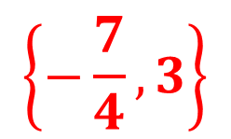

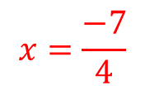

Example 2: Solve by factoring
Set the equation equal to zero.
Factor out the GCF if possible.
Use another factoring method if possible.
Set the factor/s equal to zero.
Solve.
4x² - 5x = 21
$$4x^{2}−5x−21=0$$
$$(4x+7)(x−3)=0$$
$$4x+7=0$$
$$x−3=0$$
$$4x=−7$$
$$x=3$$
$$x=\frac{−7}{4}$$
$$\left\{−\frac{7}{4}, 3\right\}$$

Slide 8



Write the quadratic equation given its roots
Example 3: Write a quadratic equation with roots 3 and -5.
$$x=3 x=−5$$
$$\left(x−3\right)\left(x+5\right)=0$$
$$x^{2}+2x−15=0$$

Slide 9
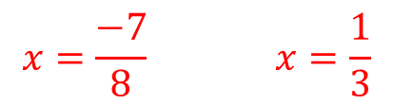



Write the quadratic equation given its roots
Example 4: Write a quadratic equation with roots -7/8 and 1/3 .
$$x=\frac{−7}{8} x=\frac{1}{3}$$
$$8x=−7 3x=1$$
$$\left(8x+7\right)\left(3x−1\right)=0$$
$${24x}^{2}+13x−7=0$$

Slide 10
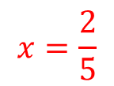





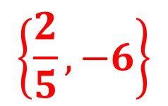
Your Turn 1: Solve by factoring
5x² + 28x – 12 = 0
$$(5x−2)(x+6)=0$$
$$5x−2=0$$
$$x+6=0$$
$$5x=2$$
$$x=−6$$
$$x=\frac{2}{5}$$
$$\left\{\frac{2}{5}, −6\right\}$$

Slide 11
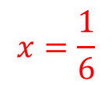




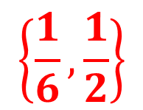

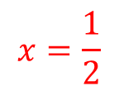
Your Turn 2: Solve by factoring
12x² - 8x + 1 = 0
$$(6x−1)(2x−1)=0$$
$$6x−1=0$$
$$2x−1=0$$
$$6x=1$$
$$2x=1$$
$$x=\frac{1}{6}$$
$$x=\frac{1}{2}$$
$$\left\{\frac{1}{6}, \frac{1}{2}\right\}$$

Slide 12



Your Turn 3: Write a quadratic equation with roots -5.
$$x=−5 x=−5$$
$$\left(x+5\right)\left(x+5\right)=0$$
$$x^{2}+10x+25=0$$

Slide 13
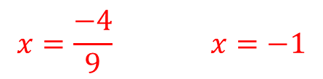



Your Turn 4: Write a quadratic equation with roots -4/9 and -1
$$x=\frac{−4}{9} x=−1$$
$$9x=−4 x=−1$$
$$\left(9x+4\right)\left(x+1\right)=0$$
$${9x}^{2}+13x+4=0$$

Slide 14
Lesson 3.1: Assessment
Check for Understanding:
Closure 3.1
Homework:
Practice 3.1

Slide 15
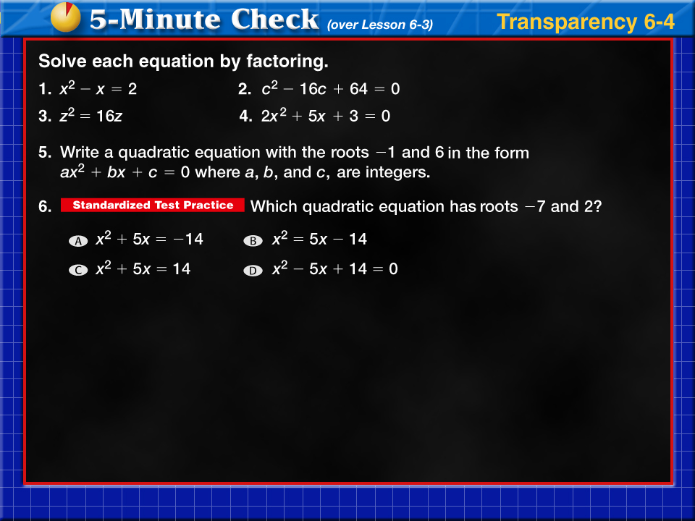



Transparency 4
Click the mouse button or press the
Space Bar to display the answers.

Slide 16
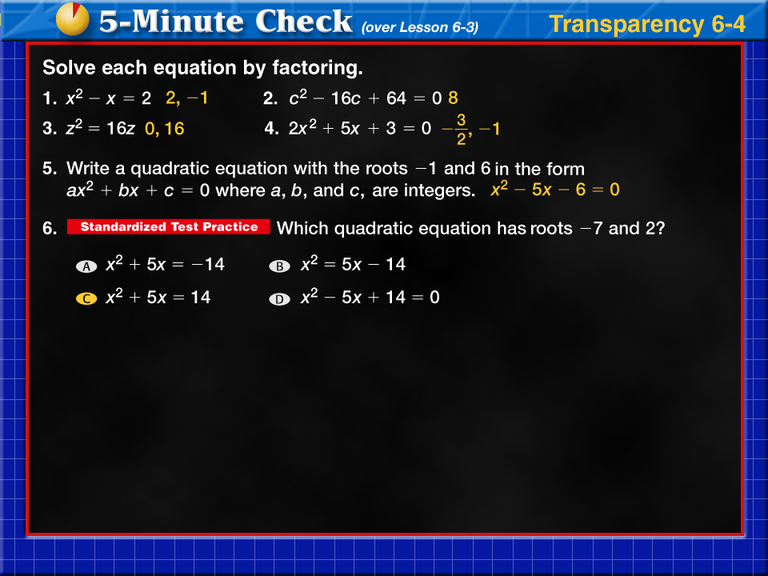

Transparency 4a

Slide 17
Lesson 3.2
Solving Quadratic Equations by using the QuadraticFormula

Slide 18
Lesson 3.2
Learning Targets:
I can solve quadratic equations by using the Quadratic Formula
I can use the discriminant to determine the number and types of roots

Slide 19






Vocabulary
Quadratic Equation: Quadratic Formula:
Discriminant:
Two rational roots: Two irrational roots:
__________________ ____________________
__________________ ____________________
One rational root: Two complex roots
_________________ __________________

Slide 20
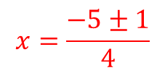
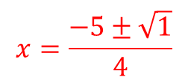
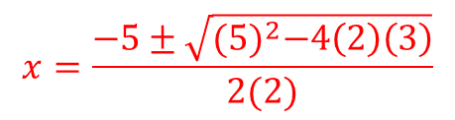
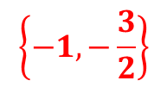

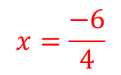
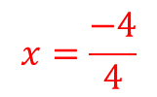
Example 1:
2x² + 5x + 3 = 0
a = ___ b = ___ c = ___
Discriminant: _________________________
Number & type of roots: ________________
2
5
3
$${(5)}^{2}−4\left(2\right)\left(3\right)=1$$
2 rational roots
$$x=\frac{−5±\sqrt{{(5)}^{2}−4\left(2\right)\left(3\right)}}{2(2)}$$
$$x=\frac{−5±1}{4}$$
$$x=\frac{−4}{4}$$
$$x=\frac{−6}{4}$$
$$x=\frac{−5±\sqrt{1}}{4}$$
$$\left\{−1, −\frac{3}{2}\right\}$$

Slide 21
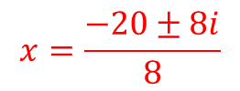
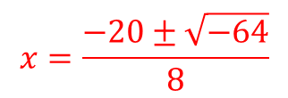
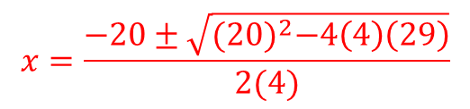
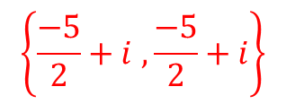

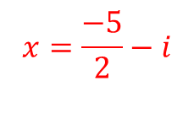
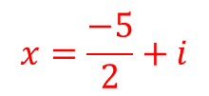
Example 2:
4x² + 20x + 29 = 0
a = ___ b = ___ c = ___
Discriminant: _________________________
Number & type of roots: ________________
4
20
29
$${(20)}^{2}−4\left(4\right)\left(29\right)=−64$$
2 complex roots
$$x=\frac{−20±\sqrt{{(20)}^{2}−4\left(4\right)\left(29\right)}}{2(4)}$$
$$x=\frac{−20±8i}{8}$$
$$x=\frac{−5}{2}+i$$
$$x=\frac{−5}{2}−i$$
$$x=\frac{−20±\sqrt{−64}}{8}$$
$$\left\{\frac{−5}{2}+i ,\frac{−5}{2}+i\right\}$$

Slide 22
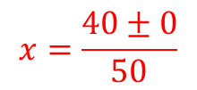
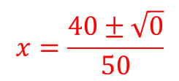

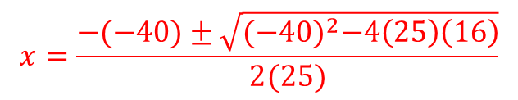


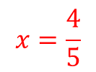
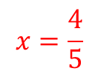
Example 3:
25 x² - 40x = – 16
a = ___ b = ___ c = ___
Discriminant: _________________________
Number & type of roots: ________________
$${25x}^{2}−40x+16=0$$
25
-40
16
$${(−40)}^{2}−4\left(25\right)\left(16\right)=0$$
1 rational root
$$x=\frac{−(−40)±\sqrt{{(−40)}^{2}−4\left(25\right)\left(16\right)}}{2(25)}$$
$$x=\frac{40±0}{50}$$
$$x=\frac{4}{5}$$
$$x=\frac{4}{5}$$
$$x=\frac{40±\sqrt{0}}{50}$$
$$\left\{\frac{4}{5}\right\}$$

Slide 23
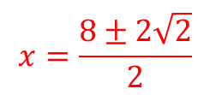
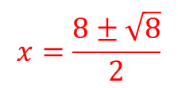

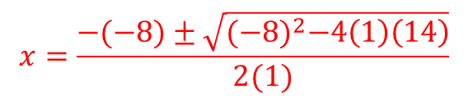




Example 4:
x² - 8x = -14
a = ___ b = ___ c = ___
Discriminant: _________________________
Number & type of roots: ________________
$$x^{2}−8x+14=0$$
1
-8
14
$${(−8)}^{2}−4\left(1\right)\left(14\right)=8$$
2 irrational roots
$$x=\frac{−(−8)±\sqrt{{(−8)}^{2}−4\left(1\right)\left(14\right)}}{2(1)}$$
$$x=\frac{8±2\sqrt{2}}{2}$$
$$x=4+\sqrt{2}$$
$$x=4−\sqrt{2}$$
$$x=\frac{8±\sqrt{8}}{2}$$
$$\left\{5.4, 2.6\right\}$$

Slide 24
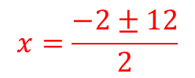
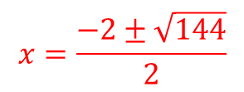
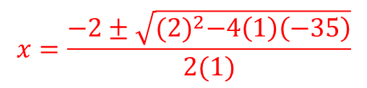


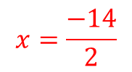
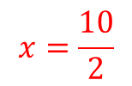
Your Turn 1:
x² + 2x - 35 = 0
a = ___ b = ___ c = ___
Discriminant: _________________________
Number & type of roots: ________________
1
2
-35
$${(2)}^{2}−4\left(1\right)\left(−35\right)=144$$
2 rational roots
$$x=\frac{−2±\sqrt{{(2)}^{2}−4\left(1\right)\left(−35\right)}}{2(1)}$$
$$x=\frac{−2±12}{2}$$
$$x=\frac{10}{2}$$
$$x=\frac{−14}{2}$$
$$x=\frac{−2±\sqrt{144}}{2}$$
$$\left\{5, −7\right\}$$

Slide 25
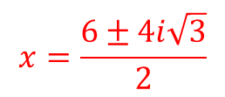
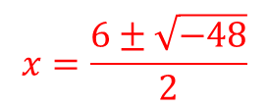
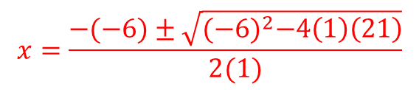




Your Turn 2:
x² - 6x + 21 = 0
a = ___ b = ___ c = ___
Discriminant: _________________________
Number & type of roots: ________________
1
-6
21
$${(−6)}^{2}−4\left(1\right)\left(21\right)=−48$$
2 complex roots
$$x=\frac{−(−6)±\sqrt{{(−6)}^{2}−4\left(1\right)\left(21\right)}}{2(1)}$$
$$x=\frac{6±4i\sqrt{3}}{2}$$
$$x=3+2i\sqrt{3}$$
$$x=3−2i\sqrt{3}$$
$$x=\frac{6±\sqrt{−48}}{2}$$
$$\left\{3+2i\sqrt{3}, 3−2i\sqrt{3}\right\}$$

Slide 26
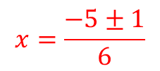
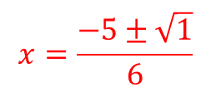

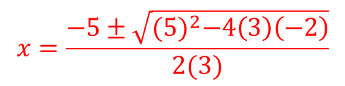
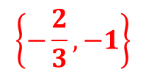

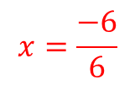
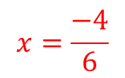
Your Turn 3:
3x² +5x = 2
a = ___ b = ___ c = ___
Discriminant: _________________________
Number & type of roots: ________________
$${3x}^{2}+5x−2=0$$
3
5
-2
$${(5)}^{2}−4\left(3\right)\left(−2\right)=1$$
2 rational roots
$$x=\frac{−5±\sqrt{{(5)}^{2}−4\left(3\right)\left(−2\right)}}{2(3)}$$
$$x=\frac{−5±1}{6}$$
$$x=\frac{−4}{6}$$
$$x=\frac{−6}{6}$$
$$x=\frac{−5±\sqrt{1}}{6}$$
$$\left\{−\frac{2}{3},−1\right\}$$

Slide 27
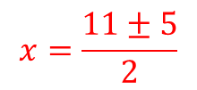
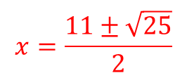
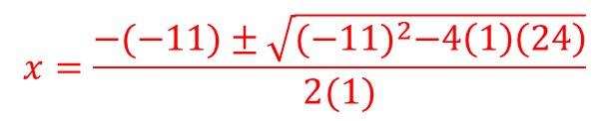


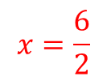

Your Turn 4:
x² - 11x + 24 = 0
a = ___ b = ___ c = ___
Discriminant: _________________________
Number & type of roots: ________________
1
-11
24
$${(−11)}^{2}−4\left(1\right)\left(24\right)=25$$
2 rational roots
$$x=\frac{−(−11)±\sqrt{{(−11)}^{2}−4\left(1\right)\left(24\right)}}{2(1)}$$
$$x=\frac{11±5}{2}$$
$$x=\frac{16}{2}$$
$$x=\frac{6}{2}$$
$$x=\frac{11±\sqrt{25}}{2}$$
$$\left\{8, 3\right\}$$

Slide 28
Lesson 3.2: Assessment
Check for Understanding:
Closure 3.2
Homework:
Practice 3.2

Slide 29

Transparency 6
Click the mouse button or press the
Space Bar to display the answers.

Slide 30

Transparency 6a

