Slide 1
Unit 4 – Polynomials (Basics)
Algebra 2A

Slide 2
Unit 4 Introduction
I can use power properties to simplify monomials.

Slide 3
What is it?
Examples:
b^{n}
Power
Important characteristic:
Nonexamples:
Base: ____
Exponent: ____
Shortcut for repeated multiplications

Slide 4
What is it?
Examples:
x³ • x⁴
b^{n} • b^{m} = b^{n + m}
same bases
(2x³y)(5x)
Product of Powers
Important characteristic:
Nonexamples:
Add the
exponents
x³ • x⁴ ≠ x¹²

Slide 5
Example 1: Simplify the following
(4⁵)(4²)
(6x²)(x⁴)
(3x⁴y)(-4x²)
a. b. c.

Slide 6
Your Turn 1: Simplify the following
(2³)(2⁴)
(5v⁴)(3v)
(-4ab⁶)(7a²b³)
1. 2. 3.

Slide 7
What is it?
Examples:
(b^{n}) ^{m}= b^{nm}
same bases
Power of Powers
Important characteristic:
Nonexamples:
Multiply the
exponents

Slide 8
I can simplify product of Powers.
Example 2: Simplify the following
a. b. c. (3xy)²
(x⁵)²
(y⁷)³

Slide 9
Your Turn 2: Simplify the following
(m ⁶)²
(2b²)⁴
(4abc)²
1. 2. 3.

Slide 10
Example 3: Simplify the following
(10ab⁴)³ (3b²)²
d.

Slide 11
Your Turn 3: Simplify the following
(2xy²)³ (-4x⁵)²
4.

Slide 12
What is it?
Examples:
Quotient of Powers
Important characteristic:
Nonexamples:
Subtract the
exponents

Slide 13
I can simplify quotient of monomials.
Example 4
a. 16x³y⁴
4 x⁵y
b.

Slide 14
Your Turn!
(3xy⁵)²
(2x³y⁷)³

Slide 15
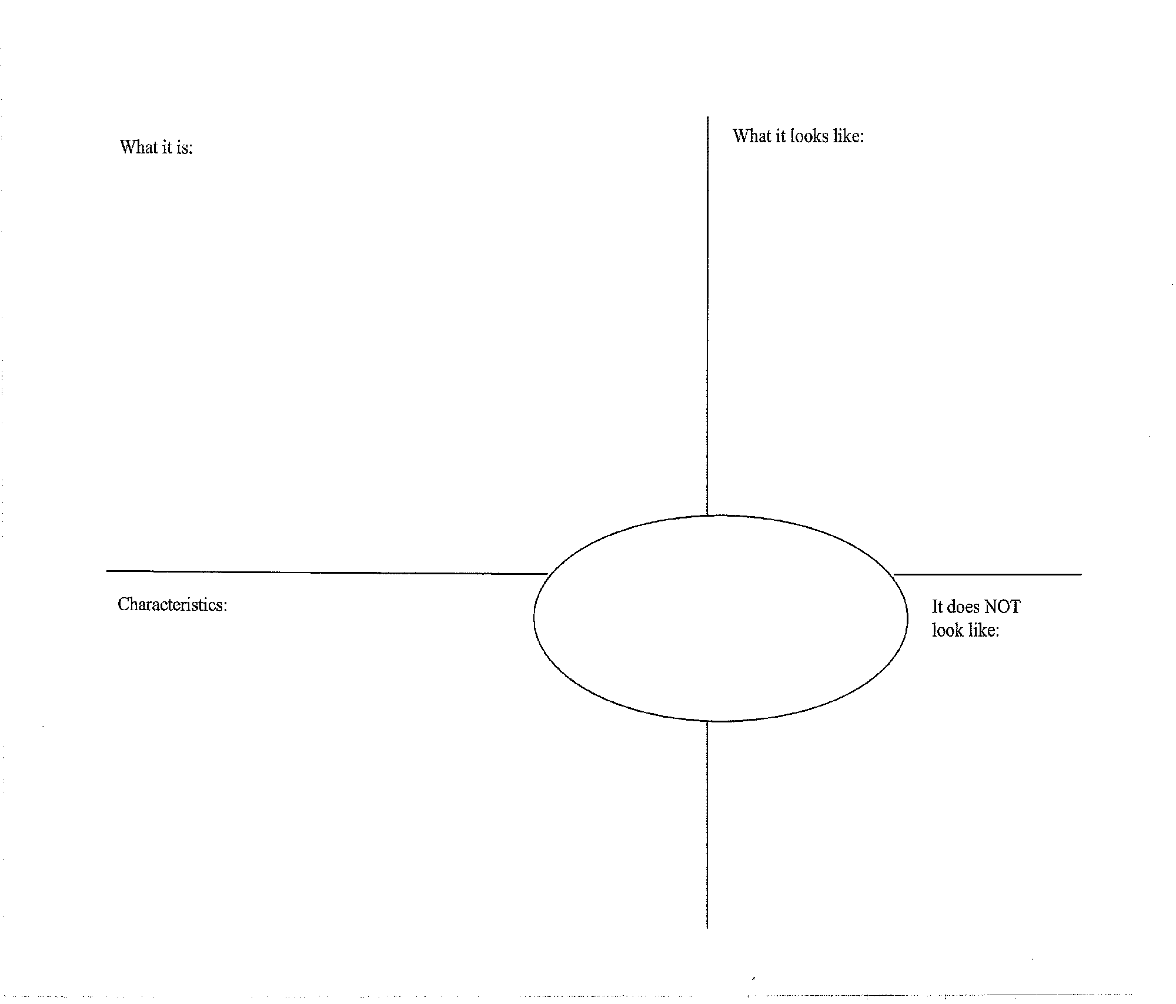
(5xy)⁰ = 1
(b)⁰ = 1
Zero Exponents
Anything to the
power of zero is one!
(5xy)⁰ ≠ 0

Slide 16

(5a)⁻¹ =
(b)^{-n} =
Negative Exponents
Negative exponents
“move” up or down to
make it a positive exp.
(5a)⁻¹ ≠ -5a

Slide 17
Negative exponent rule:
a^{-n}
=
a^{-n} is the reciprocal of a^{n}
^{Example1:}
^{1.} x^{-3 2.} 5a⁻²b⁰ ^{3.} -4a⁻⁷b⁻³

Slide 18
^{Your Turn 1:}
^{a.} 3w^{-3 b.} 4x⁻⁷ ^{c.} 3x⁰y⁻⁴

Slide 19
^{Example 2:}
^{4.} ^{5.}

Slide 20
^{Your Turn 2:}
^{d.} ^{e.} ^{f.}

Slide 21
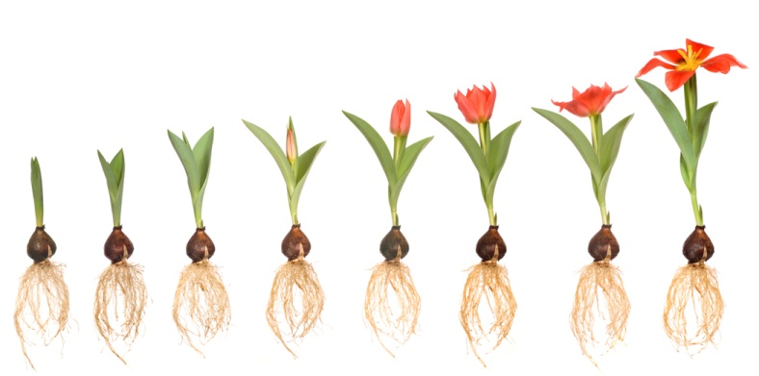
Roots of Real Numbers lesson 4.1
Learning Targets:
I can simplify radicals.
I can use a calculator to approximate radicals.

Slide 22

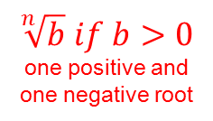
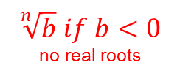
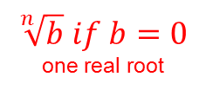






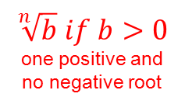
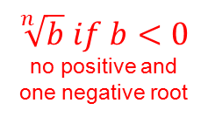









Simplifying Radicals
Even Roots:
Odd Roots:
index
power
power
index
If you have an even root and an odd powered answer,
you must take the absolute value of it to get the principal root.

Slide 23










Example 1: Simplify.
a.
or
b.
c.

Slide 24
Your Turn 1: Simplify.
a.
b.
c.

Slide 25
Example 2: Simplify.
a.
b.

Slide 26
Your Turn 2: Simplify.
a.
b.
c.

Slide 27





Example 3: Use a calculator to approximate each value
to three decimal places.
a.
Look at the Math button on the calculator:
b.
c.

Slide 28



Your Turn 2: Use a calculator to approximate each value
to three decimal places.
a.
b.
c.

Slide 29
Learning Targets Reflection:
I can simplify radicals.
I can use a calculator to approximate radicals.

Slide 30
Radical Expressions lesson 4.2
Objectives:
Simplify radical expressions.
Add, subtract, multiply, and divide radical expressions.

Slide 31
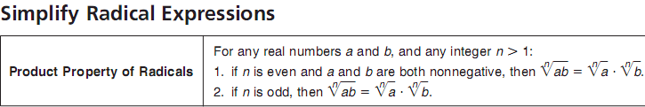
Example 1: Simplify.
a.
b.

Slide 32
Your Turn 1: Simplify.
a.
b.
c.

Slide 33


Example 2: Simplify.
a.
b.

Slide 34


Your Turn 2: Simplify.
a.
b.

Slide 35
Example 3: Simplify. (Adding radicals.)

Slide 36
Your Turn 3: Simplify.

Slide 37
Example 4: Simplify. (Multiplying radicals.)
a.
b.

Slide 38
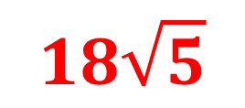
Your Turn 4: Simplify.
a.
$$18\sqrt{5}$$

Slide 39
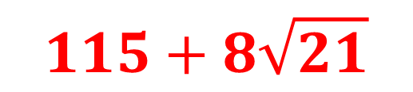
b.
$$115+8\sqrt{21}$$

Slide 40

Example 5: Simplify. (Dividing radicals.)
Remember conjugates!!!
a.

Slide 41

b.

Slide 42

Your Turn 5: Simplify.
a.

Slide 43

b.

Slide 44
Assignment
4.2 Worksheet
* Skip #7 *

Slide 45
Rational Expressions lesson 4.3
Objectives:
Write expressions with rational exponents in radical form, and vice versa.
Simplify expressions in exponential or radical form.

Slide 46
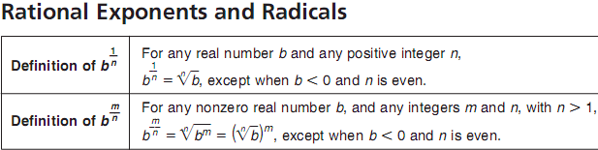

Example 1:
Example 2:

Slide 47

Example 3:

Slide 48


Example 1: Write the expression in radical form.
Your Turn 1: Write the expression in radical form.

Slide 49

Example 2: Write each radical using rational exponents.

Slide 50


Your Turn 2: Write each radical using rational exponents.
a.
b.

Slide 51

Example 3: Simplify.
a.

Slide 52
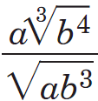
b.

Slide 53

c.

Slide 54



Your Turn 3: Simplify.
a.
b.
c.

Slide 55
Assignment
4.3 Worksheet

Slide 56
Radical Equations lesson 4.4
Learning Target:
I can solve equations containing radicals.

Slide 57

Solve Radical Equations:
The following steps are used in solving equations that have variables in the radicand. Some algebraic procedures may be needed before you use these steps.
Step 1: Isolate the radical on one side of the equation.
(No #’s in front or separate.)
Step 2: To eliminate the radical, raise each side of the equation to a power
equal to the index of the radical.
Step 3: Solve the resulting equation.
Step 4: Check your solution in the original equation to make sure that you
have not obtained any extra roots.

Slide 58
Example 1: Solve.
Check:

Slide 59
Your Turn 1: Solve.
Check:

Slide 60
Example 2: Solve.
Check:

Slide 61
Your Turn 2: Solve.
Check:

Slide 62
Your Turn 3: Solve and check each equation.
a.

Slide 63
Your Turn 3: Solve and check each equation.
b.

Slide 64
Your Turn 3: Solve and check each equation.
c.

Slide 65
Assignment
4.4 Worksheet

Slide 66

Complex Numbers lesson 4.5
Learning Targets:
I can add and subtract complex numbers.
I can multiply and divide complex numbers.

Slide 67
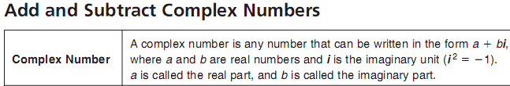
Imaginery:

Slide 68

Example 1: Simplify. (add & subtract)
a.
b.

Slide 69
Your Turn 1: Simplify.
a.
b.
c.

Slide 70
Example 2: Simplify. (multiply)

Slide 71
Your Turn 2: Simplify.

Slide 72

Example 3: Simplify. (divide)

Slide 73

Your Turn 3: Simplify.

Slide 74
Example 4: Solve.

Slide 75
Your Turn 4: Solve.

Slide 76
Check for understanding.
Simplify.
1.
2.

Slide 77

Check for understanding.
3.
4.
Solve.
4.

