Slide 1
Polynomial Functions
Unit 5
Algebra 2A

Slide 2
A polynomial function is a function of the form
f (x) = a_{n} x ^{n} + a_{n – 1} x ^{n – 1} +· · ·+ a ₁ x + a ₀
a_{n}
a ₀
^{n}
^{n – 1}
^{n}
For this polynomial function, only one variable (x)
a_{n} is the leading coefficient,
a ₀ is the constant term, and
n is the degree.
a_{n}
leading coefficient
a₀
n
degree
Where a_{n} ≠ 0 and the exponents are all whole numbers.
a_{n} ≠ 0
A polynomial function is in standard form if its terms are
written in descending order of exponents from left to right.
descending order of exponents from left to right.

Slide 3
You are already familiar with some types of polynomial
functions. Here is a summary of common types of
polynomial functions.
Degree
Type
Standard Form
0
Constant
f (x) = a ₀
1
Linear
f (x) = a₁x + a ₀
2
Quadratic
f (x) = a ₂ x ² + a ₁ x + a ₀
3
Cubic
f (x) = a ₃ x ³ + a ₂ x ² + a ₁ x + a ₀
4
Quartic
f (x) = a₄ x ⁴ + a ₃ x ³ + a ₂ x ² + a ₁ x + a ₀

Slide 4
Value of a function: f (k)
One way to evaluate polynomial functions is to use
direct substitution.
Another way to evaluate a polynomial
is to use synthetic substitution.

Slide 5
Real Zeros of a polynomial function: Maximum number of real zeros is equal to the degree of the polynomial.
Real zeros: where the graph crosses the x-axis.
How many (total) zeros do the following functions have?
f(x) = x + 2 g(x) = x²– 4 h(x) = x³– 2x² – 10x + 20 p(x) = x⁴ + 8x² - 10
one: –2 two: 2, –2 three: -3.16, 2, 3.16 four: -1, 1 & 2 complex
The zeros may be real or complex...
The Fundamental Theorem of Algebra:
Counting complex and repeated solutions, an nth degree
polynomial equation has exactly n solutions.

Slide 6
END BEHAVIOR OF POLYNOMIAL FUNCTIONS
The end behavior of a polynomial function’s graph
is the behavior of the graph, which is f(x), as x approaches infinity
(+ ∞) or negative infinity (– ∞). The expression
x + ∞ is read as “x approaches positive infinity.”

Slide 7
A B C D

Slide 8

Identifying Polynomial Functions
Decide whether the function is a polynomial function. If it is,
write the function in standard form and state its degree, type
and leading coefficient.
1
f (x) = x 2 – 3x4 – 7
2
SOLUTION
The function is a polynomial function.
1
Its standard form is f (x) = – 3x 4 + x 2 – 7.
2
It has degree 4, so it is a quartic function.
The leading coefficient is – 3.

Slide 9
Identifying Polynomial Functions
Decide whether the function is a polynomial function. If it is,
write the function in standard form and state its degree, type
and leading coefficient.
f (x) = 6x 2 + 2 x –1 + x
SOLUTION
The function is not a polynomial function because the term
2x ^{–1} has an exponent that is not a whole number.

Slide 10
Identifying Polynomial Functions
Decide whether the function is a polynomial function. If it is,
write the function in standard form and state its degree, type
and leading coefficient.
f (x) = x 3 + 3 ^{x}
SOLUTION
The function is not a polynomial function because the
term 3 ^{x} does not have a variable base and an exponent
that is a whole number.

Slide 11
Identifying Polynomial Functions
Decide whether the function is a polynomial function. If it is,
write the function in standard form and state its degree, type
and leading coefficient.
f (x) = – 0.5 x + π x 2 – 2
SOLUTION
The function is a polynomial function.
Its standard form is f (x) = π x2 – 0.5x – 2.
It has degree 2, so it is a quadratic function.
The leading coefficient is π.

Slide 12


Identifying Polynomial Functions
Polynomial function?
1
f (x) = x 2 – 3 x 4 – 7
2
f (x) = x 3 + 3^{x}
f (x) = 6x2 + 2 x– 1 + x
f (x) = – 0.5x + π x2 – 2

Slide 13
Your Turn 1: What are the degree and leading coefficient?
a) 3x² - 2x⁴ – 7 + x³
b) 100 -5x³ + 10x⁷
c) 4x² – 3xy + 16y²
d) 4x⁶ + 6x⁴ + 8x⁸ – 10x² + 20

Slide 14
Value of a function Using Direct Substitution
Use direct substitution to evaluate
f (x) = 2 x 4 − 8 x 2 + 5 x − 7 when x = 3.
Solution:
f (3) = 2 (3)4 − 8 (3) 2 + 5 (3) − 7 = 98

Slide 15
Value of a function Using Synthetic Substitution
Use synthetic substitution to evaluate
f (x) = 2 x 4 + −8 x 2 + 5 x − 7 when x = 3.

Slide 16
Using Synthetic Substitution
SOLUTION
2 x ⁴ + 0 x ³ + (–8 x ²) + 5 x + (–7)
Polynomial in
standard form
Polynomial in
standard form
3 •
2 0 –8 5 –7
3
Coefficients
Coefficients
6
18
30
105
x-value
2
6
10
35
98
The value of f (3) is the last number you write,
In the bottom right-hand corner.

Slide 17
Your Turn 2: Use direct substitution.
f(x)= 2x² - 3x + 1
f(-4)

Slide 18
Your Turn 3: Use direct substitution.
f(x)= x² – 4x – 5
f(a²-1)

Slide 19
Your Turn 4: Use Synthetic Substitution
Find f(2)
a. 3x² - 2x⁴ – 7 + x³
Your Turn 5: Use Synthetic Substitution
Find f(-5)
b. 100 – 5x³ + 10x⁴

Slide 20
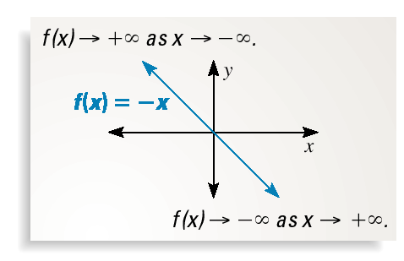
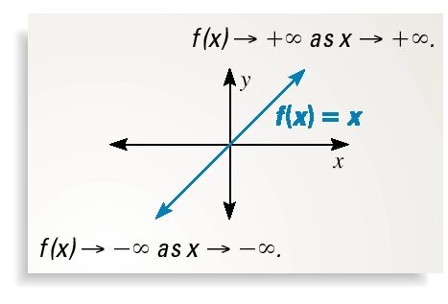
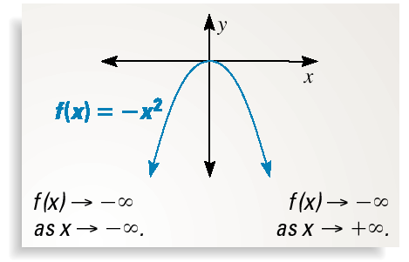
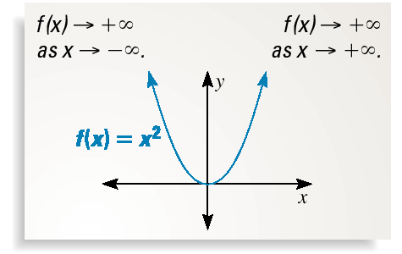
GRAPHING POLYNOMIAL FUNCTIONS
f(x)=
f(x)=
f(x)=
f(x)=
END BEHAVIOR
f(x)=
f(x)=
f(x)=
f(x)=
f(x)=

Slide 21
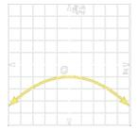
Your Turn 6:
For each graph below,
• describe the end behavior,
• determine whether it represents an odd-degree or an even-degree function, and
• state the number of real zeros.
Degree: ___ End behavior:
# real zeros: _____

Slide 22
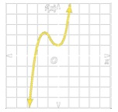
Your Turn 7:
For each graph below,
• describe the end behavior,
• determine whether it represents an odd-degree or an even-degree function, and
• state the number of real zeros.
Degree: ___ End Behavior
# real zeros: _____

Slide 23
Your Turn 8:
For each graph below,
• describe the end behavior,
• determine whether it represents an odd-degree or an even-degree function, and
• state the number of real zeros.
Degree: ___ End behavior:
# real zeros: _____

Slide 24
Your Turn 9: Your own:
For each graph below,
• describe the end behavior,
• determine whether it represents an odd-degree or an even-degree function, and
• state the number of real zeros.
Degree: ___ End behavior:
# real zeros: _____

Slide 25
Closure 5.1

Slide 26
Lesson 5.1
Check for understanding:
Closure 5.1
Homework:
Practice 5.1

Slide 27
Warm-up 5.1

Slide 28
Warm-up 5.1

Slide 29
5.2 Graphs of Polynomial Functions

Slide 30
We have learned how to graph functions with the following degrees:
0 Example: f(x) = 2 horizontal line
1 Example: f(x) = 2x – 3 line
2 Example: f(x) = x2 + 2x – 3 parabola
How do you graph polynomial functions with degrees higher than 2?

Slide 31
Graphs of Polynomial Functions:
We’ll make a table of values, then graph...
are continuous (there are no breaks)
have smooth turns
with degree n, have at most n – 1 turns
Follows end behavior according to n (even or odd) and to a_{n} (positive or negative).

Slide 32
End behavior of a polynomial function:
A B C D
END BEHAVIOR FOR POLYNOMIAL FUNCTIONS
n x – ∞ x +∞
> 0 even f (x) + ∞ f (x) + ∞
> 0 odd f (x) – ∞ f (x) + ∞
< 0 even f (x) – ∞ f (x) – ∞
< 0 odd f (x) + ∞ f (x) – ∞

Slide 33
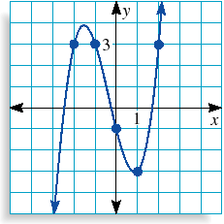

Graphing Polynomial Functions
Graph: f(x) =x³ + x² - 4x - 1
n: __ an: ___ # turns: at most ____ # total zeros: ____
# real zeros: at most _____
# Real Zeros: ___
between ___ and ___ x = _________
between ___ and ___ x = _________
between ___ and ___ x = _________
Approximate zeros: _____________________________
Relative Maxima value: ____ @ x = ____
Relative Minima value: ____ @ x = ____
–3
–2
–1
0
1
2
3
The degree is odd and the leading coefficient is positive,
so f (x)
x
f(x)
–
as x
–
and f (x)
+
as x
+
.
–7
3
3
–1
–3
3
23
left
right

Slide 34
Example 2 : Graph by making a table of values and find the zeros. f (x) = –x⁴ – 2x³ + 2x² + 4x. n: __ a_{n}: ___ # turns: at most ____ # total zeros: ____ # real zeros: at most _____
End Behavior:
x | -3 | -2 | -1 | 0 | 1 | 2 | 3
f(x) | -21 | 0 | -1 | 0 | 3 | -16 | -105
# Real zeros: ______
Zeros: ______ (exact) & _______(exact)
between ____ and ____ ( x = __________)
between ____ and _____ ( x = __________)
Relative Maxima: _____ @ ________
_____ @ ________
Relative Minima: _____ @ ________

Slide 35
Your Turn 1 : Graph by making a table of values and find the zeros. f (x) = 3x³ – 9x + 1 n: __ a_{n}: ___ # turns: at most ____ # total zeros: ____ # real zeros: at most _____
End Behavior:
# Real zeros: ______
Zeros: ______ (exact) & _______(exact)
between ____ and ____ ( x = __________)
between ____ and _____ ( x = __________)
Relative Maxima: _____ @ ________
_____ @ ________
Relative Minima: _____ @ ________

Slide 36
Your Turn 2 : Graph by making a table of values and find the zeros. f (x) = -x³ + 4x. n: __ a_{n}: ___ # turns: at most ____ # total zeros: ____ # real zeros: at most _____
End Behavior:
# Real zeros: ______
Zeros: ______ (exact) & _______(exact)
between ____ and ____ ( x = _____)
between ____ and _____ ( x = _____)
Relative Maxima: _____ @ ________
_____ @ ________
Relative Minima: _____ @ ________

Slide 37
Lesson 5.2
Check for understanding:
Closure 5.2
Homework:
Practice 5.2

Slide 38
Warm-up/Review Lesson 5.2
a) Real Zeros: check table
___________________________________
b) x-coord. ______ (max/min?) Value: ______
x-coord. ______ (max/min?) Value: ______
a) Real Zeros: use 2nd calc ___________________________________
b) x-coord. ______ (max/min?) Value: ______
x-coord. ______ (max/min?) Value: ______
x-coord. ______ (max/min?) Value: ______

Slide 39
Warm-up/Review Lesson 7.2
a) Real Zeros: ___________________________________
b) x-coord. ______ (max/min?) Value: ______
x-coord. ______ (max/min?) Value: ______
a) Real Zeros: ___________________________________
b) x-coord. ______ (max/min?) Value: ______
x-coord. ______ (max/min?) Value: ______
x-coord. ______ (max/min?) Value: ______

Slide 40
5.3: Solving Polynomial Equations by using quadratic techniques

Slide 41

Vocabulary
Quadratic form:
Quadratic formula:
u

Slide 42
Example 1: Write the given expression in quadratic form, if possible
Answer:

Slide 43
Example 2: Write the given expression in quadratic form, if possible
The answer will have to look like:
Answer:

Slide 44
Example 3: Write the given expression in quadratic form, if possible
The answer will have to look like:
Answer:

Slide 45
Example 4: Write the given expression in quadratic form, if possible
The answer will have to look like:
Answer:

Slide 46
In your own words: What is necessary for an expression to be written in quadratic form?
____________________________________________________________________________
____________________________________________________________________________

Slide 47
In your own words: What is necessary for an expression to be written in quadratic form?
You look at the two terms that are not constants and compare the exponents on the variable.
If one of the exponents is twice the other, the trinomial can be written in quadratic form.

Slide 48
Your Turn 1: Write the given expressions in quadratic form, if possible
a) 2x⁴ + x² + 3 | b) x¹² + 5
c) x⁶ + x⁴ + 1 | d) x - 2x^{1/2} + 3

Slide 49
Your Turn 1: Write the given expressions in quadratic form, if possible. Show u
2x⁴ + x² + 3 u = x² Answer: 2u² + 1u + 3 | b) x¹² + 5 u = x⁶ Answer: 1u² + 5
c) x⁶ + x⁴ + 1 Answer: Not possible | d) x – 2x^{1/2} + 3 u = x^{1/2} Answer: u² – 2u + 3

Slide 50
Example 5: Solve

Slide 51
Your Turn 2: Solve each equation

Slide 52
Example 7: Solve
Answers

Slide 53
Example 8: Solve
Answers

Slide 54
Your Turn 3: Solve
Answer: -27 & -8

Slide 55
Warm-up/Review Lesson 5.3

Slide 57
5- 4: Polynomial Division, Factors, and Remainders

Slide 58
5- 4: Polynomial Division, Factors, and Remainders
Objectives:
I can determine whether a binomial is a factor of a polynomial by using synthetic substitution.

Slide 59
Review of Synthetic Division
Example 1:
Example 2

Slide 60
Review of Synthetic Division & Long Division
Example 3:

Slide 62
Example 3:

Slide 63
Example 4:
Given that (x+2) is a factor of f(x), find the remaining factors of the polynomial
Remaining factors: ______________________________

Slide 64
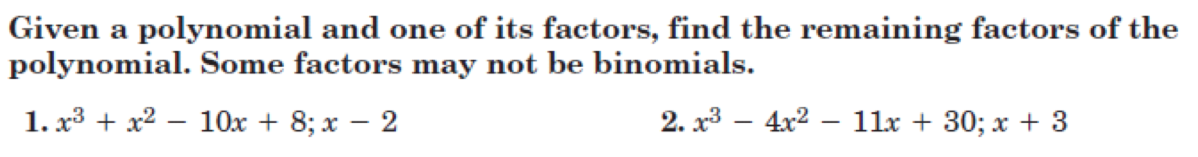
Your Turn 1

Slide 65
Lesson 5.4
Check for understanding:
Closure 5.4
Homework:
Practice 5.4

Slide 66
5-5: Roots & Zeros of
Polynomial Functions
Find all the exact zeros of a polynomial function by:
1) graphing calculator
2) Synthetic substitution
3) Quadratic formula

Slide 67
Vocabulary
Complex zeros always in pairs!
A polynomial function may have __ or __ or __ …or any _____ number of complex zeros.
Examples: _________ & _________(its conjugate)
_________ & _________(its conjugate)
_________ & _________(its conjugate)

Slide 68
Example 1:Find all exact zeros
Step 1: Use your graphing calculator to find at least one real zero
& use synthetic substitution to get the depressed polynomial.
Step 2: Once you get a polynomial with degree 2
you can solve the quadratic equation (by the method of your choice!)
Step 3: Give the Answer: the Zeros are ________________________________

Slide 69
Example 2: Find all the exact zeros of
Step 1: Graphing calculator & Synthetic substitution
Try another zero until you get a depressed polynomial with degree 2.
Step 2: Solve the quadratic equation!
Step 3: Zeros are _________________________________

Slide 70
Your Turn 1: Find all the zeros of
Step 1:
Step 2:
Step 3: Answer_________________

Slide 71
Example 3: Write a polynomial function of least degree
with integer coefficients whose zeros include
4 & 7i → _________(its conjugate)
Remember:
Imaginary roots always come in pairs
If p & q are roots of an equation, then (x-p) and (x-q) are factors!!!
So, because there are ___ zeros, the least degree will be: ____. And we get the polynomial function with the least degree by multiplying:

Slide 72
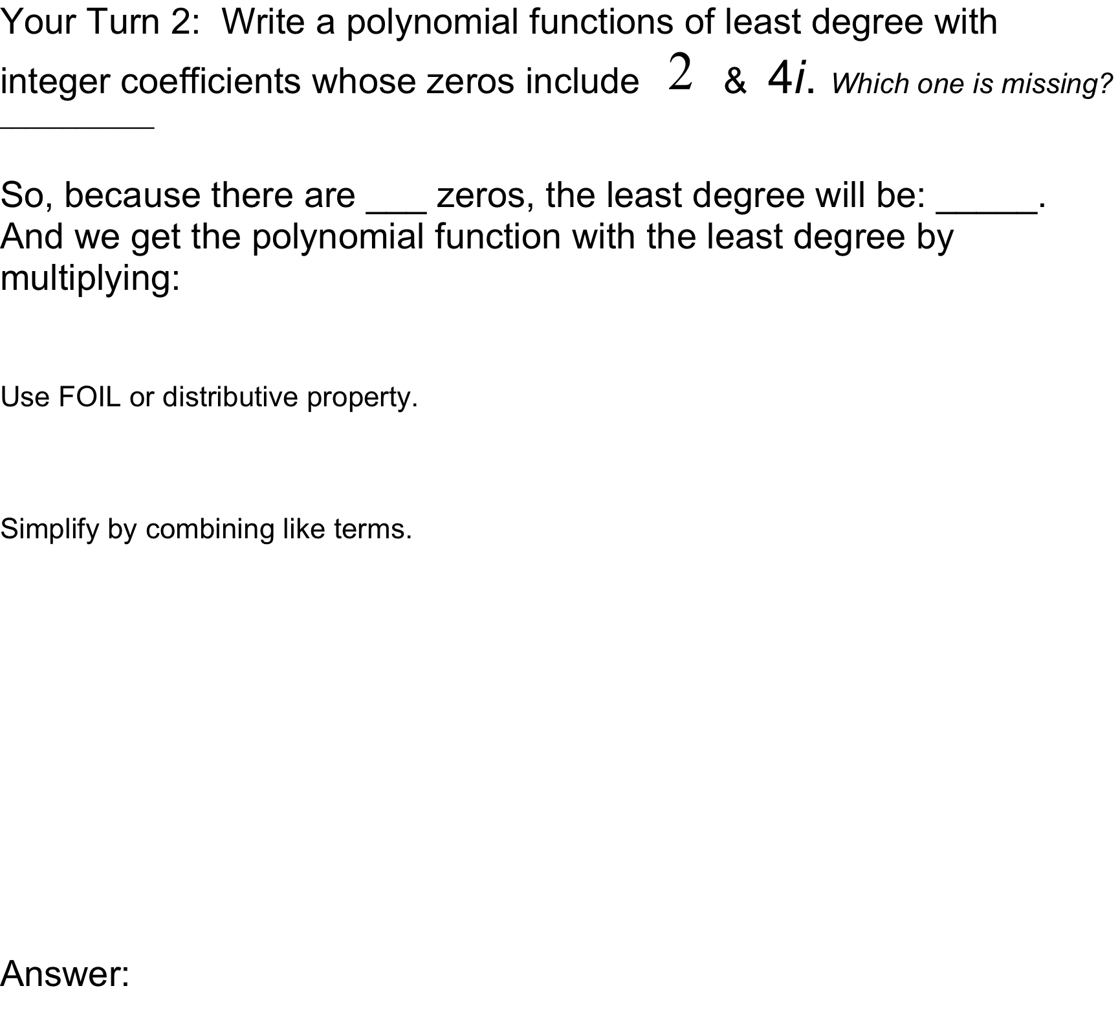

Slide 73
Warm-up/Review Lessons 5.3 & 5.5
Solve the following equations. Give exact answers. You may use any method.
1.
total # of zeros: _____ # Real zeros: _____
2.
total # of zeros: _____ # Real zeros: _____

Slide 74
Warm-up/Review Lessons 5.3 & 5.5
3.
Give exact answers! total # of zeros: _____ # Real zeros: _____

Slide 75
5.6 Function Operations
Learning Targets:
I can find the sum, difference, product, and quotient of functions.
I can find composition of functions.
Chek 5.5 Assignment

Slide 76
Vocabulary

Slide 77
Composition of Functions
There is a 40% off sale at Old Navy and as an employee you receive a 10% discount, how much will you pay on a $299 jacket?
You do not get 50% off…
...this is an example of a composite function.
You will pay 90% of the cost (10% discount) after you pay 60% (40% discount).

Slide 78
Composition of Functions
There is a 40% off sale at Old Navy and as an employee you receive a 10% discount, how much will you pay on a $299 jacket.
You will pay 90% of the cost (10% discount) after you pay 60% (40% discount).
The two functions look like this… f(x) = 0.9x g(x) = 0.6x
We can put these together in a composite function that looks like this… f(g(x))
“f of g of x”

Slide 79
f(x) = 0.9x and g(x) = 0.6x
What is f(g(x)) when x = 299?
Work from the inside out (find g of 299 first)...
f(g(299)) g(0.6 • 299) = 179.4
Now, find f of 179.4...
f(0.9 • 179.4) = 161.46
The jacket will cost $161.46

Slide 80
Function Operations
You can perform operations, such as addition, subtraction, multiplication, and division, with functions…
restriction: g(x) = 0
because:_____________________

Slide 81

Your Turn 1
You can perform operations, such as addition, subtraction, multiplication, and division, with functions…
restriction: g(x) = 0
because:_____________________

Slide 82
Example 2:

Slide 83
Example 3:
If f(x) = x² – 5 and g(x) = 3x² + 1 find f[g(2)] and g[f(2)]

Slide 84
Your Turn 2:
Find
and

Slide 85
Your Turn 3:
Find
and

