Slide 1
Lesson 5-1
I can draw reflected images.
I can recognize and draw lines of symmetry

Slide 2
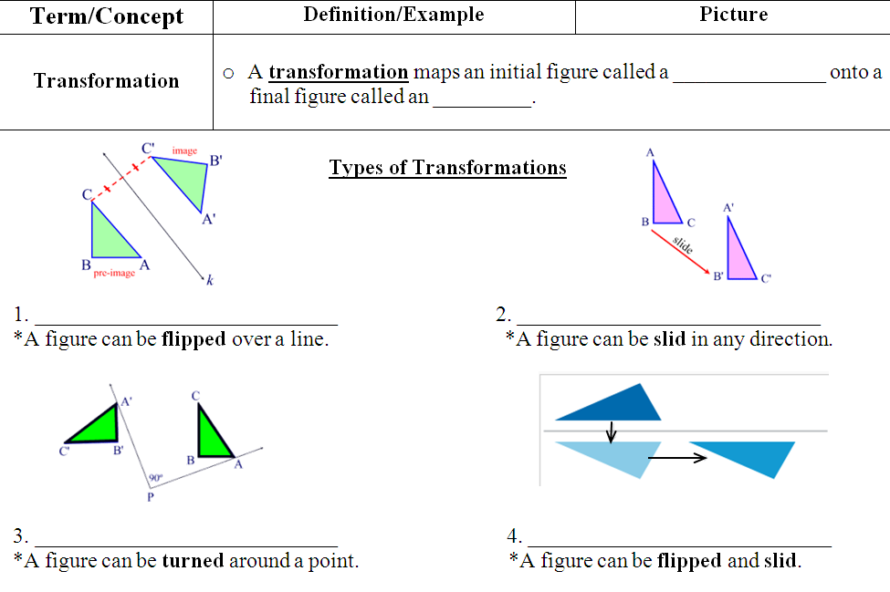
preimage
image
reflection
translation
rotation
glide reflection

Slide 3
R
R
R
R

Slide 4
R
R
R
R

Slide 5
R
R
R

Slide 6
R
R
R

Slide 7
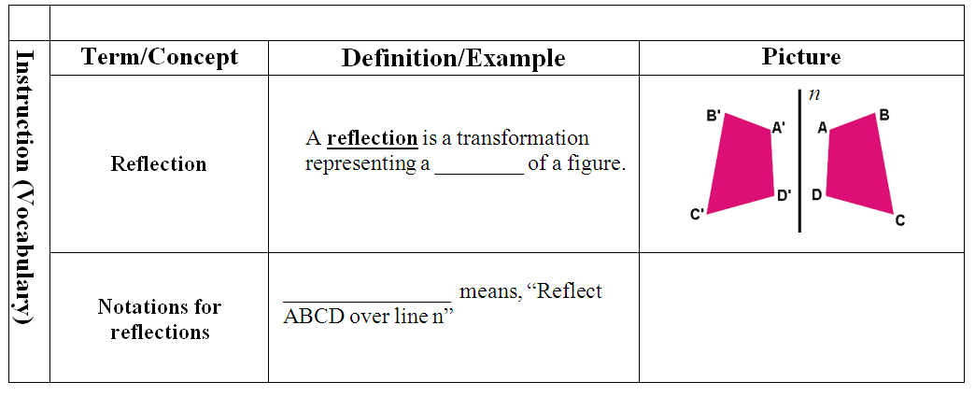
mirror image
r_{n} (ABCD)

Slide 8
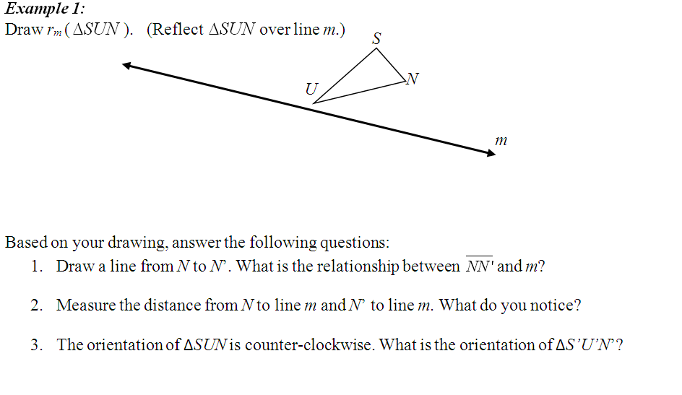
U’
N’
S’
m ⟘ NN’
Distance is equal
clockwise

Slide 9
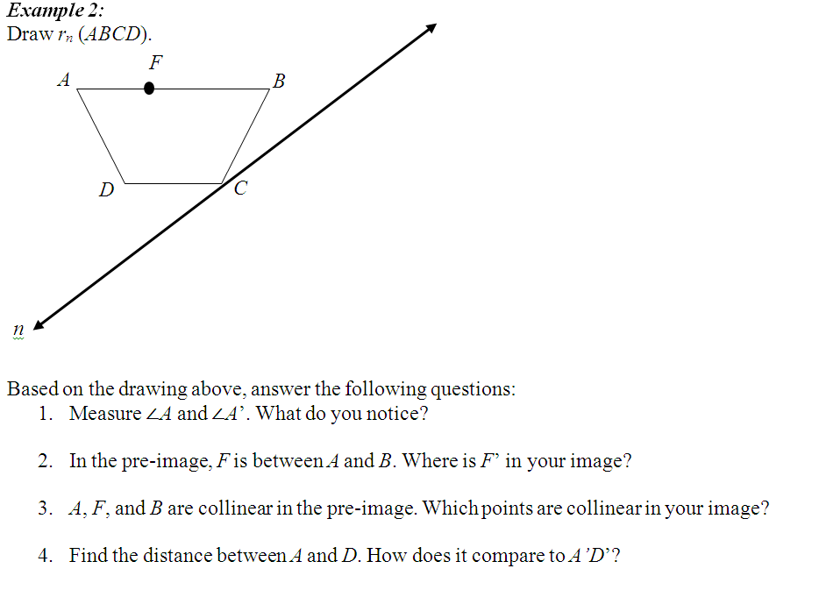
B’
C’
D’
F’
A’
m ∠A = m∠ A’
Between A’ and B’
A’, F’ and B’
AD = A’D’

Slide 10
reflection
angle measure
composite
reflections
betweenness
collinearity
distance

Slide 11
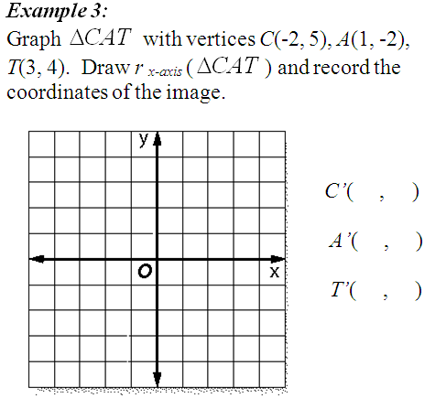
C
T
A’
-2 -5
1 2
3 -4
A
T’
C’

Slide 12
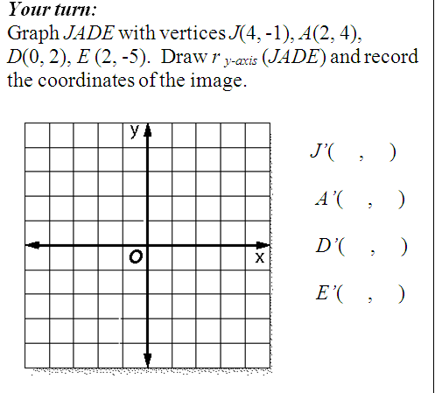
A’
A
-4 -1
D’
D
-2 4
0 2
J’
J
-2 -5
E’
E

Slide 13
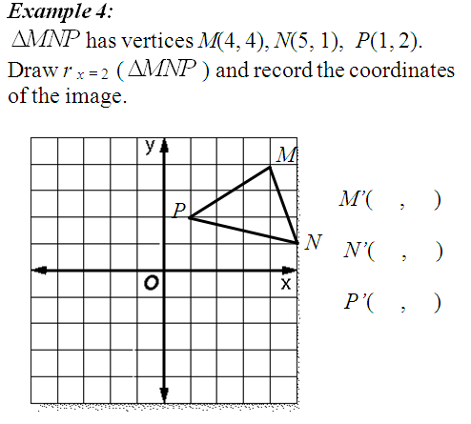
M’
P’
0 4
N’
-1 1
3 2

Slide 14
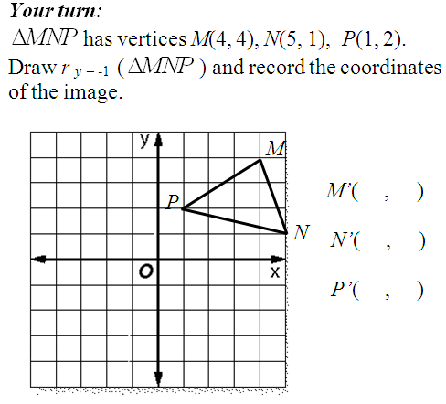
4 -6
5 -3
1 -4
N’
P’
M’

Slide 15
ACT Warm Up
Work on the warm up
Have your 5.1 homework out so I can come around to check it!

Slide 16
Lesson 5-2
I can draw translated images using coordinates
I can draw translated images using repeated reflections

Slide 17
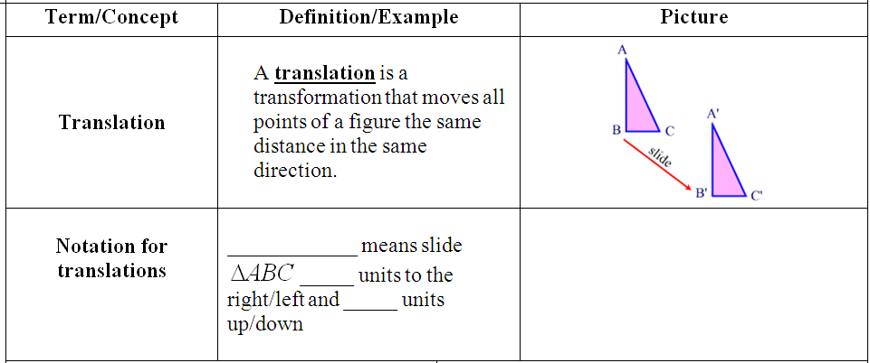
T_{(x, y)}
x
y

Slide 18
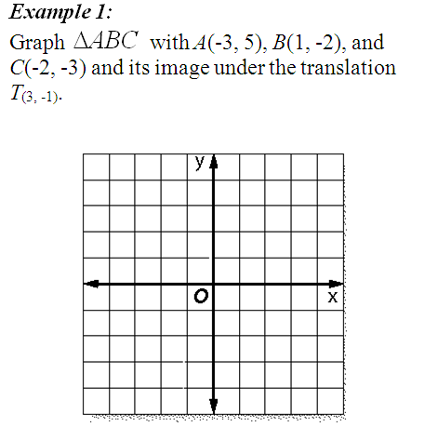
right 3, down 1
A
A’
B
C
B’
C’

Slide 19
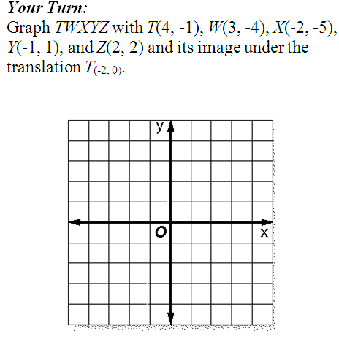
left 2
Z’
Z
Y’
Y
T
T’
W’
W
X’
X

Slide 20
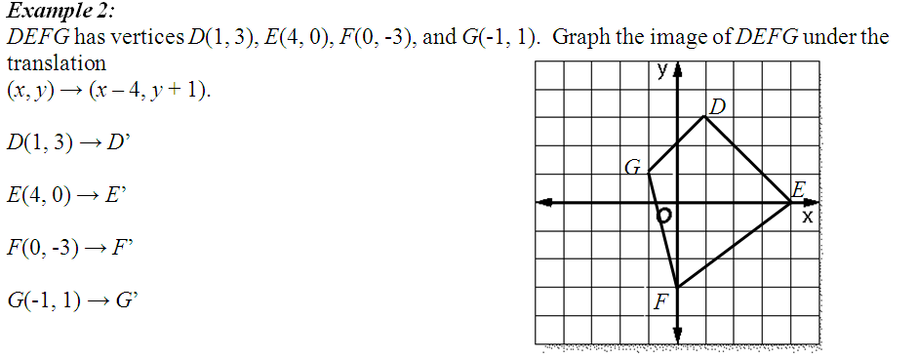
D’
(-3, )
4
G’
E’
(0, )
1
(-4, )
-2
F’
(-5, )
2
left 4, up 1
T_{(-4, 1)}

Slide 21
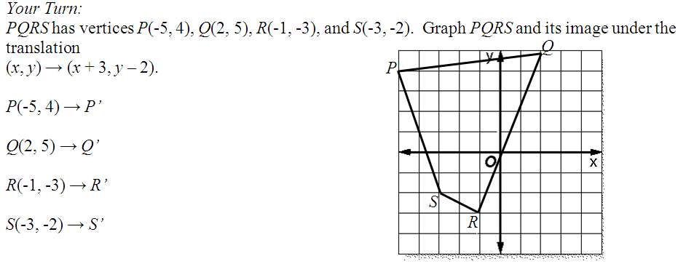
Q’
(-2 , )
2
P’
(5 , )
3
(2 , )
-5
(0 , )
-4
S’
R’
right 3, down 2
T_{(3, -2)}

Slide 22
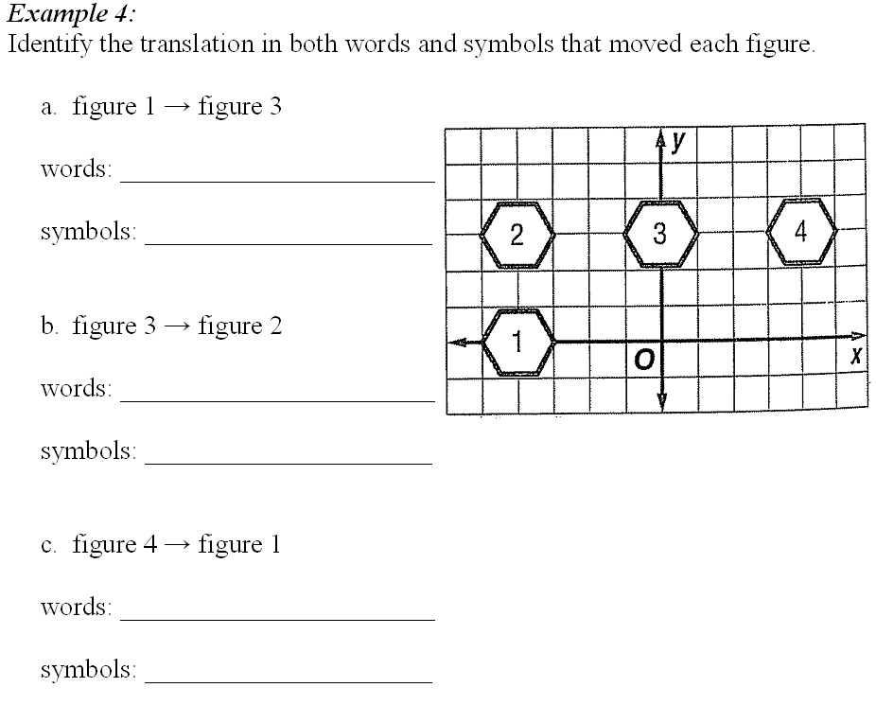
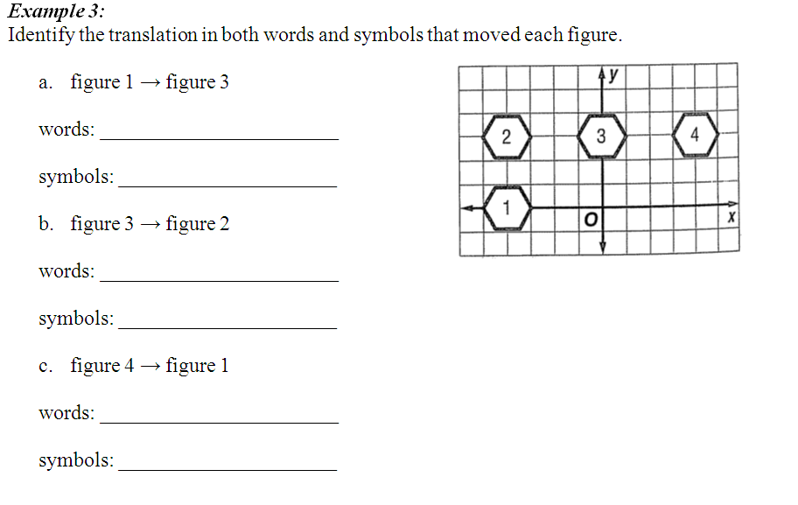
right 4,
up 3
T_{(4, 3)}
left 4
T_{(-4, 0)}
left 8,
down 3
T_{(-8, -3)}

Slide 23
Warm Up… on whiteboards!
x = 3

Slide 24
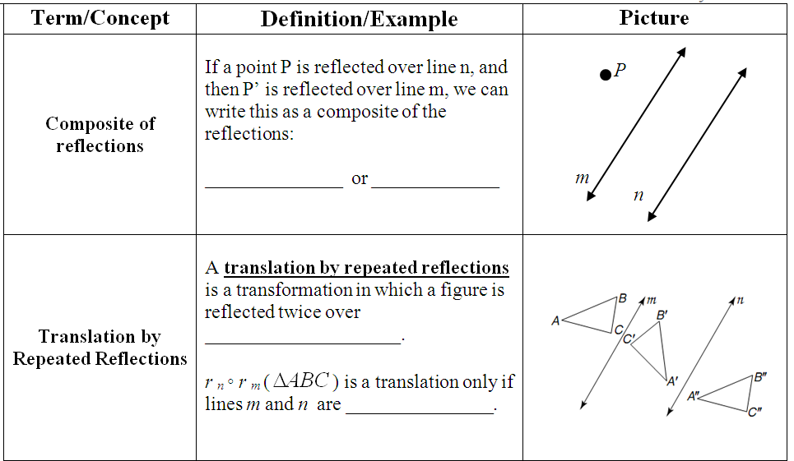
P’
r _{m}(r _{n}(P))
r _{m}∘ r _{n}(P)
n
P’’
m
parallel lines
parallel

Slide 25
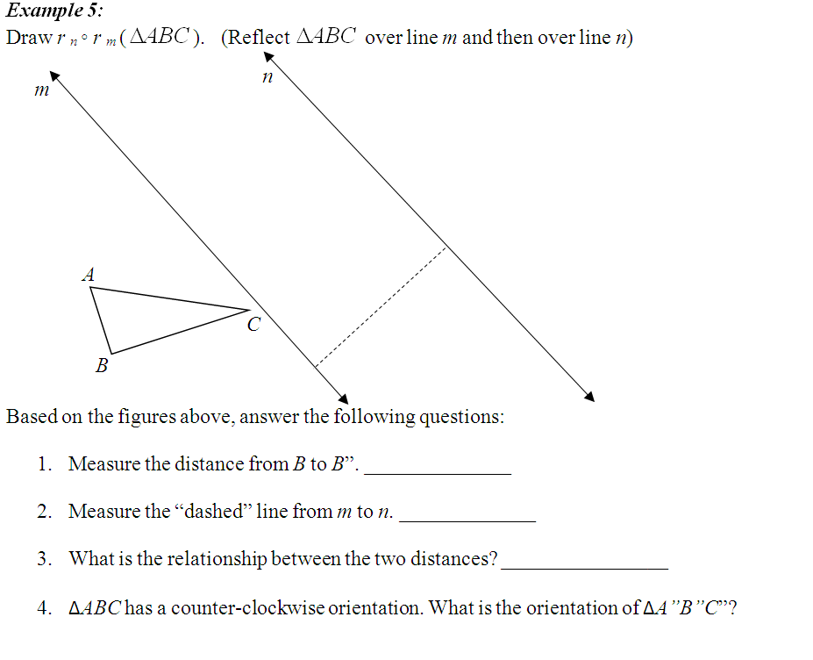
A’’
C’’
A’
B’’
B’
C’
5 cm
2.5 cm
BB” is twice as long
counterclockwise

Slide 26
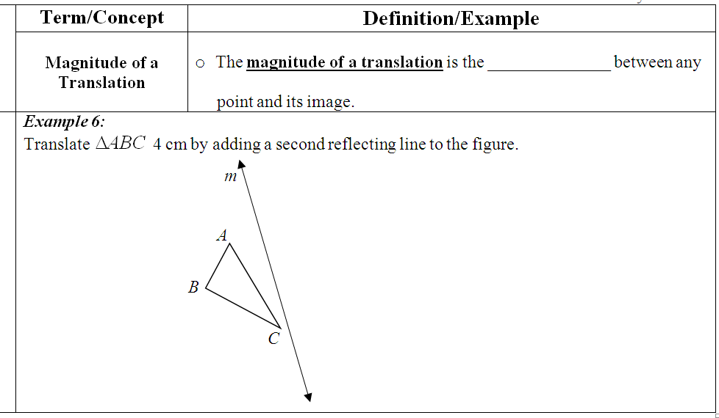
distance
A’’
A’
B’
B’’
C’’
C’
2 cm

Slide 27
Lesson 5-3
I can draw rotated images using the angle of rotation
I can identify the order and magnitude of rotational symmetry

Slide 28
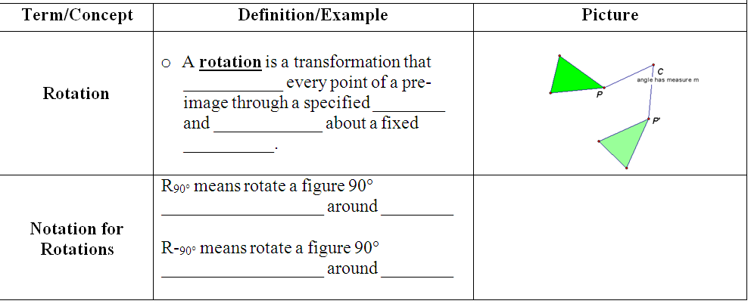
turns
angle
direction
point
+
counterclockwise
(0, 0)
clockwise
(0, 0)
–

Slide 29
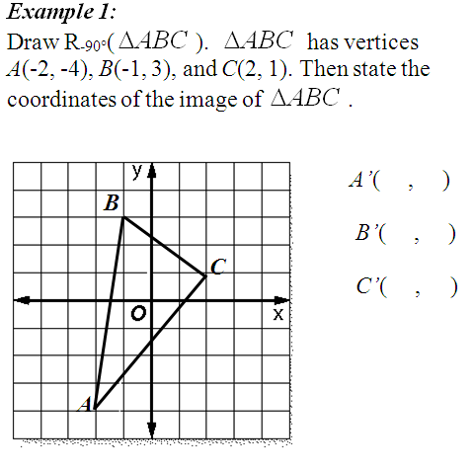
clockwise
-4 2
A’
3 1
B’
1 -2
C’

Slide 30
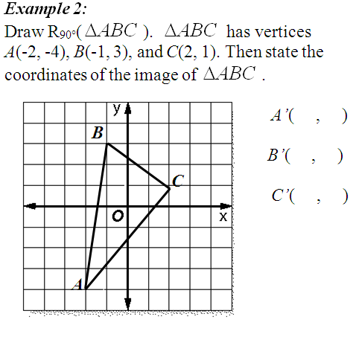
counterclockwise
4 -2
C’
-3 -1
-1 2
B’
A’

Slide 31
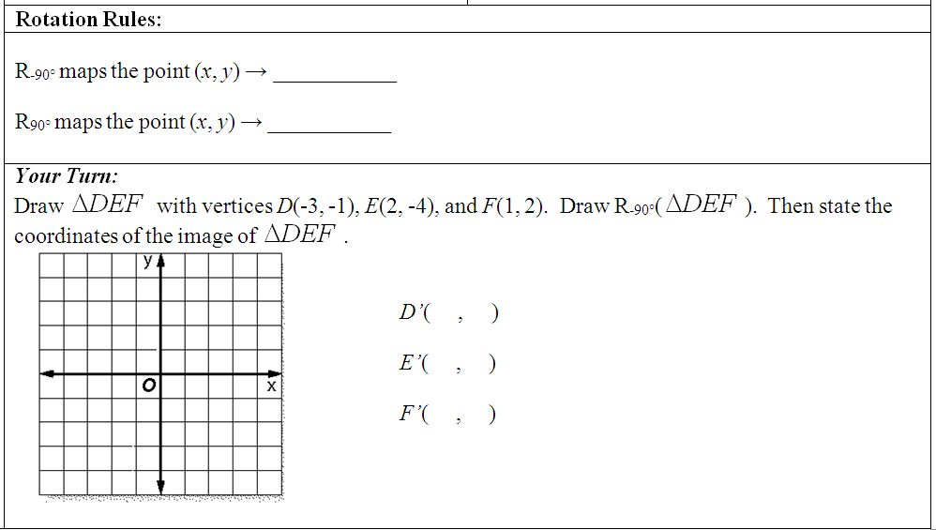
(y, -x)
(-y, x)
D’
F
-1, 3
-4, -2
D
F’
2, -1
E’
E

Slide 32
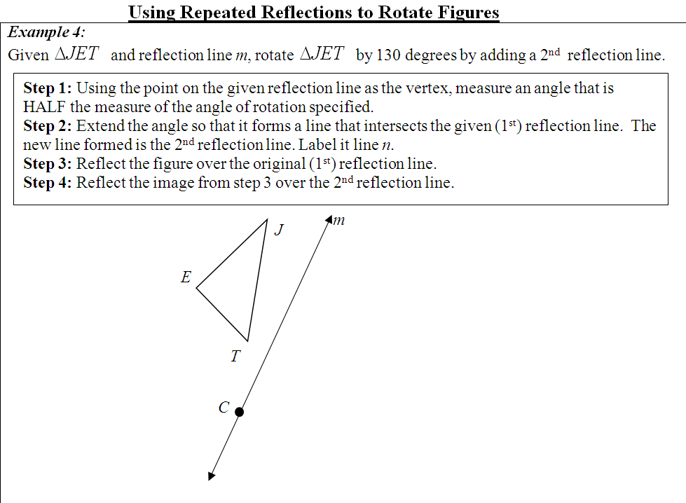
130
= 65ᵒ
2
65°

Slide 33
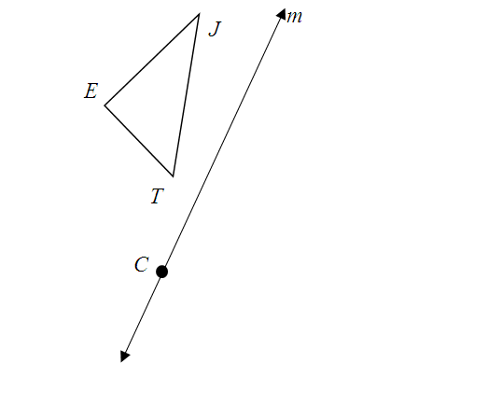
J’
T’
E’
E’’
T’’
J’’

Slide 35
J’
130°
T’
E’
E’’
T’’
J’’

Slide 36
130°
same
counterclockwise

Slide 37
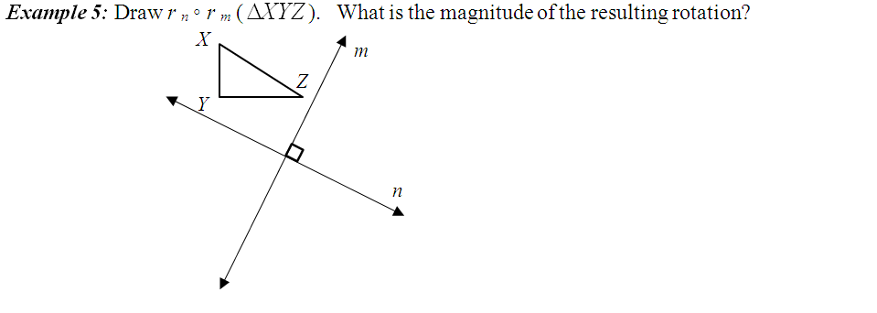
Z’
90(2) = 180°
X’
Z’’
Y’
Y’’
X’’

Slide 38
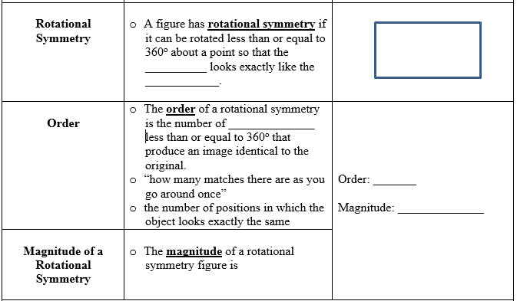
image
preimage
rotations
2
180°
360
order

Slide 39
4
8
5
1
90°
45°
72°
360°

Slide 40
Lesson 5-4
I can draw images using glide reflections
I can identify composites of transformations

Slide 41
composite
reflection
translation
Slide parallel to reflecting line

Slide 42
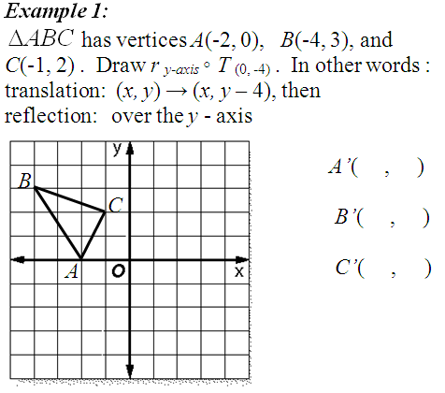
2 -4
4 -1
B’’
1 -2
C’
C’’
B’
A’
A’’

Slide 43
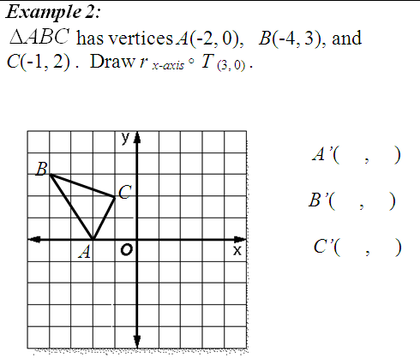
1 0
B’
C’
-1 -3
A’
A’’
2 -2
C’’
B’’

Slide 44
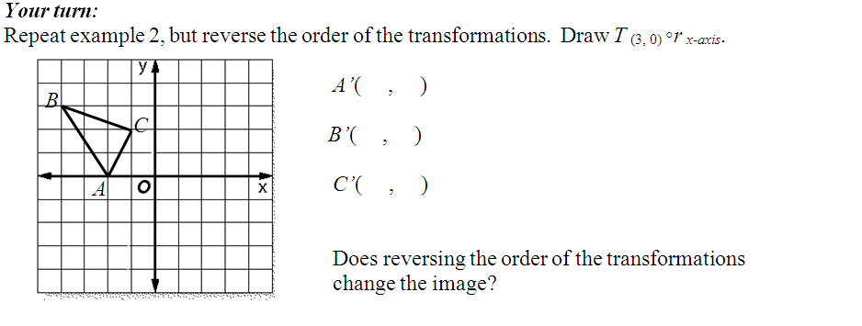
1 0
-1 -3
A’’
A’
2 -2
C’’
C’
B’
B’’
No!

Slide 45
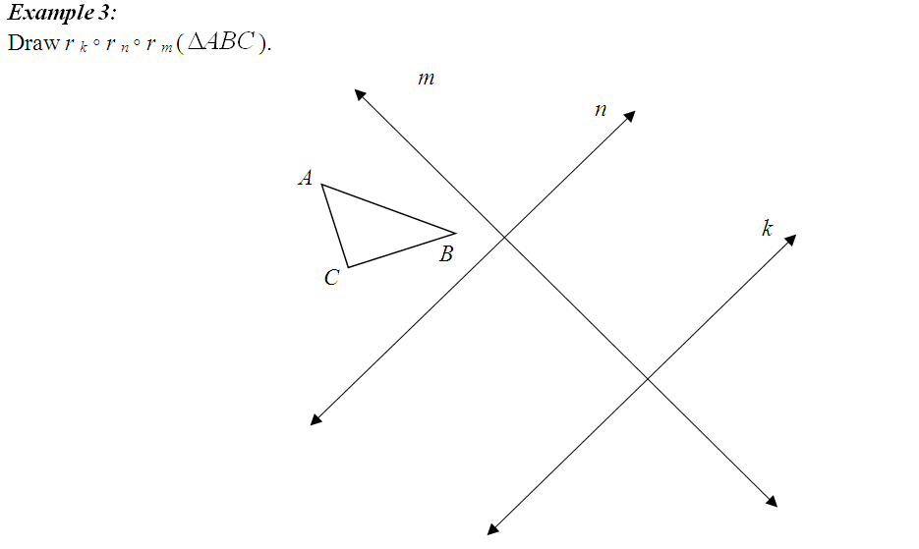
A’”’
C’’’
B’’’

Slide 46
Glide reflection
yes
yes
yes
yes
△ABC is clockwise
counterclockwise

Slide 47
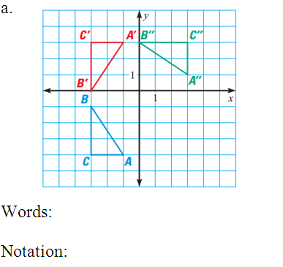
y = -0.5
Reflect over y = -0.5, rotate CW 90ᵒ
r_{y} _{= -0.5} (△ABC)
R _{-90ᵒ} ∘

Slide 48
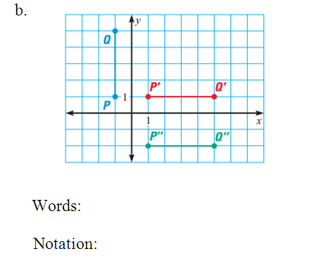
Rotate CW 90ᵒ, slide down 3
T_{(0, -3)} ∘
R_{-90ᵒ} (PQ)

Slide 49
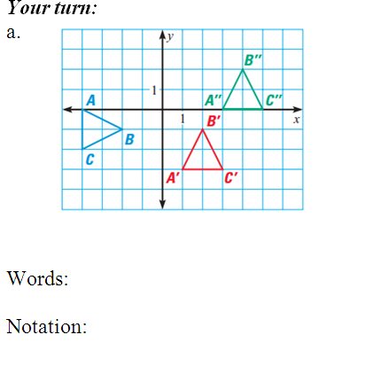
Rotate CCW 90ᵒ, slide right 2 and up 3
T _{(2,} ₃₎∘
R_{90ᵒ} (△ABC)

Slide 50
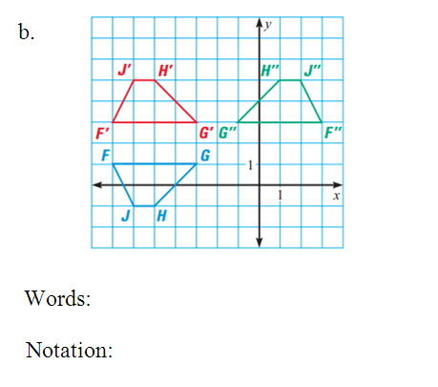
x = -2
y = 2
Reflect over y = 2, reflect over x = -2
r_{y} ₌ ₂ (FGHJ)
r _{x = -2} ∘

