Slide 1
Lesson 6-1
I can recognize and apply properties of sides and angles of parallelograms
I can recognize and apply properties of the diagonals of a parallelogram

Slide 2
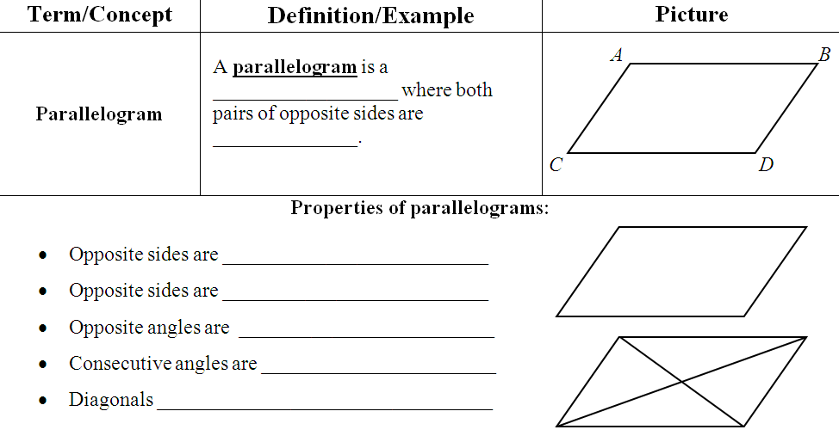
quadrilateral
parallel
parallel
congruent
congruent
supplementary
bisect each other

Slide 3
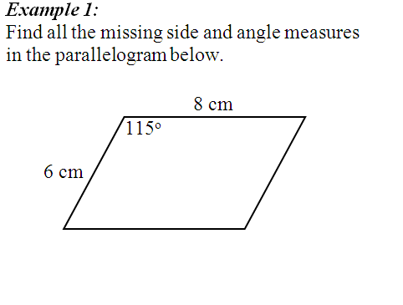
65°
6 cm
65°
115°
8 cm

Slide 4
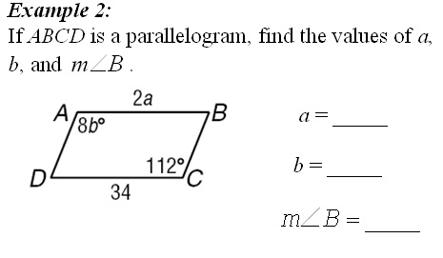
17
14
68°
2a = 34
8b = 112

Slide 5
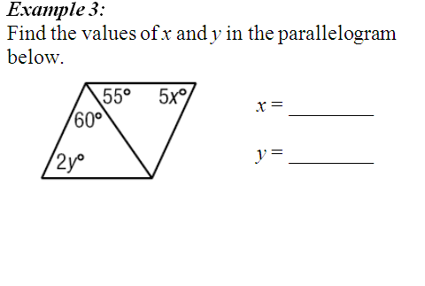
13
60°
32.5
55°
5x + 55 + 60 = 180
2y + 55 + 60 = 180

Slide 6
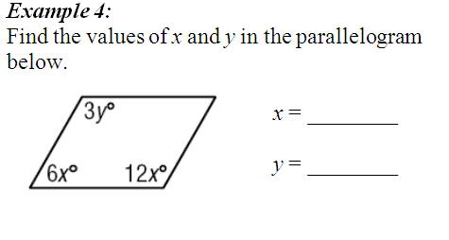
10
40
60°
120°
6x + 12x = 180
3y = 120
x = 10
y = 40

Slide 7
Warm up
Given these points: A(4, 0) B(0, 3) C(-3, -1) D(1, -4)
Find:
The distance of AB and CD.
The slope of AB and CD.
The midpoint of AC and BD.

Slide 8
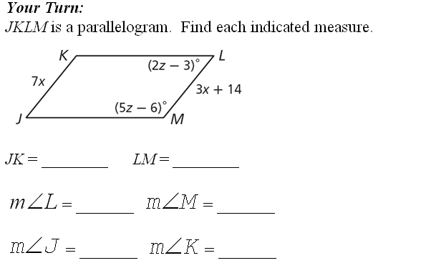
3x + 14 = 7x
x = 3.5
24.5
24.5
2z – 3 + 5z – 6 = 180
51°
129°
x = 27
51°
129°

Slide 9
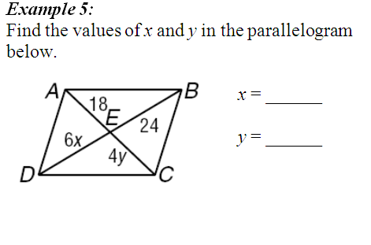
4
4.5
6x = 24
4y = 18

Slide 10
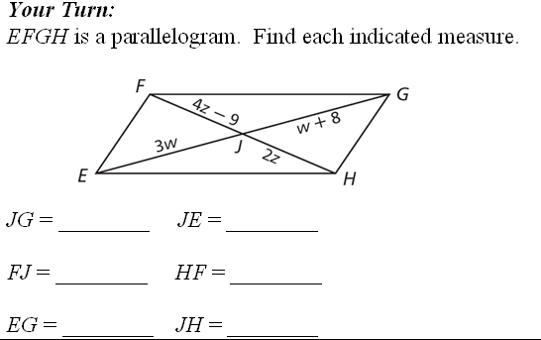
3w = w + 8
w = 4
12
12
4z – 9 = 2z
9
18
z = 4.5
24
9

Slide 11
ASSIGNMENT
6.1 worksheet

Slide 12
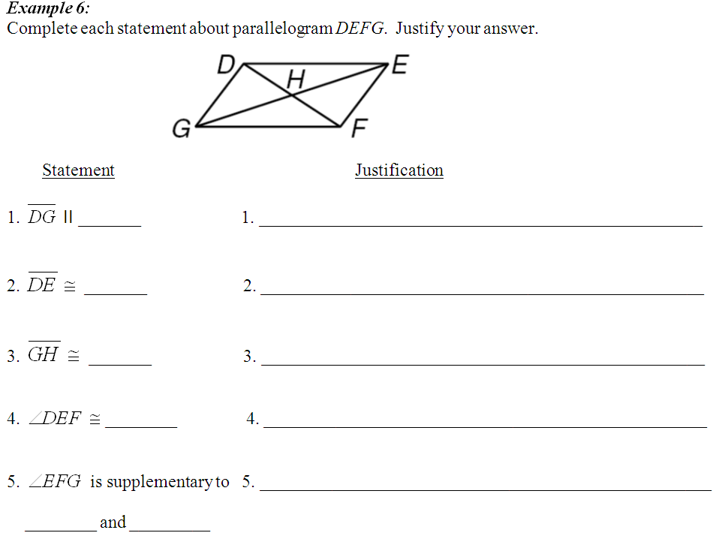
EF
Opp sides are parallel
GF
Opp sides are congruent
EH
Diagonals bisect each other
∠FGD
Opp angles are congruent
Consec angles are suppl.
∠DEF
∠DGF

Slide 13
Warm up
ACT warm up on your warm up sheet!
Have your 6.1 worksheet out so I can check it off!

Slide 14
Lesson 6-2
I can recognize the conditions that ensure a quadrilateral is a parallelogram
I can prove that a set of points forms a parallelogram in the coordinate plane

Slide 15
m = 3/5
slope
m = 3/5

Slide 16
1
3
–
slope AB =
slope AD =
5
1
1
3
–
slope DC =
slope BC =
5
1
AB ∥ DC
AD ∥ BC
and

Slide 17
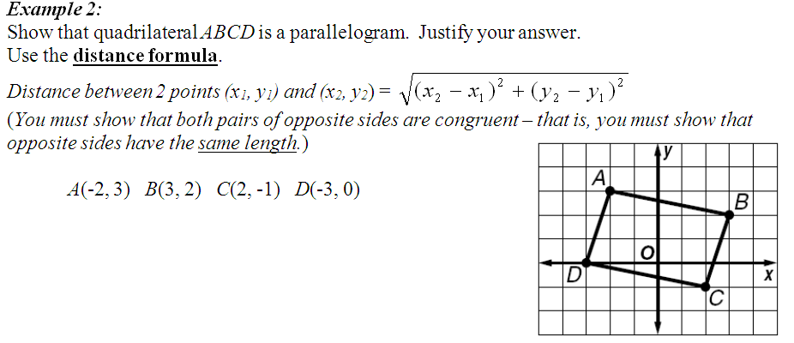
$$\sqrt{26}$$
$$\sqrt{10}$$
AB =
AD =
$$\sqrt{26}$$
$$\sqrt{10}$$
DC =
BC =
AB ≅ DC
and
AD ≅ BC

Slide 18
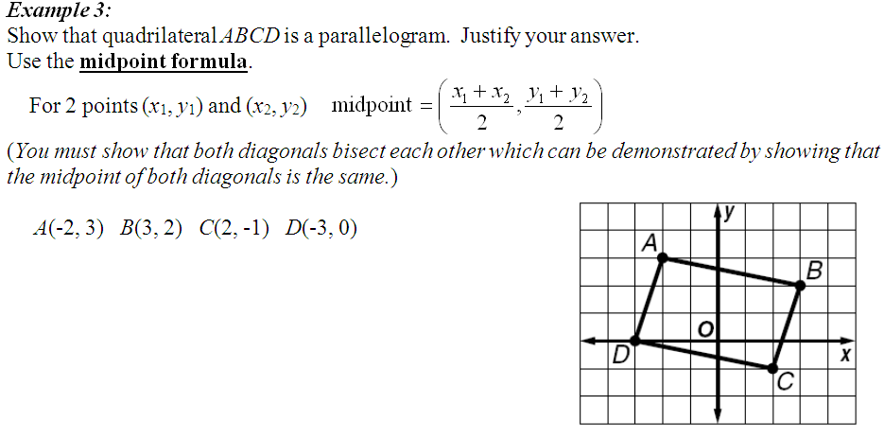
(0, 1)
mp of AC =
(0, 1)
mp of BD =
diagonals bisect each other

Slide 19
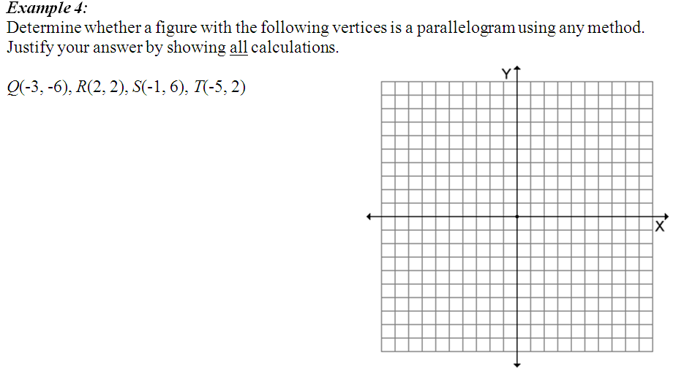
S
(-1.5, 2)
mp of TR =
T
R
(-2, 0)
mp of SQ =
Q
Diagonals DON’T bisect each other

Slide 20
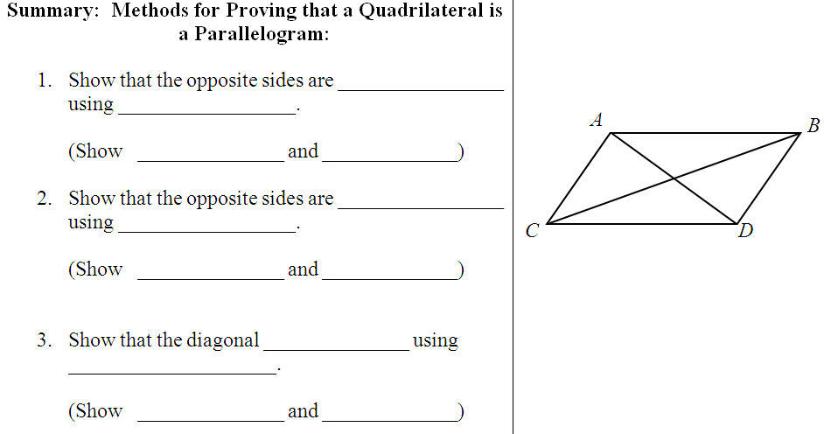
parallel
slope formula
AB ∥ CD
AC ∥ BD
congruent
distance formula
AB ≅ CD
AC ≅ BD
bisect
midpoint formula
mp of AD
=
mp of CB

Slide 21
ASSIGNMENT
6-2 worksheet

Slide 22
Warm Up

Slide 23
Lesson 6-3
I can recognize and apply properties of rectangles
I can determine whether parallelograms are rectangles

Slide 24
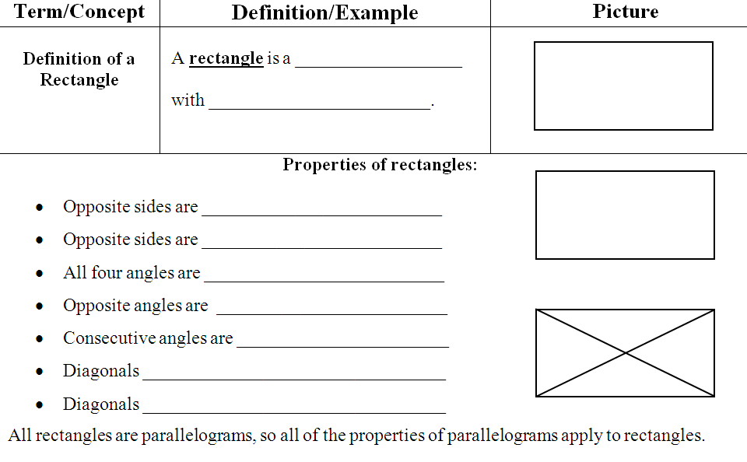
quadrilateral
4 right angles
parallel
congruent
90°
congruent
supplementary
bisect each other
Are congruent

Slide 25
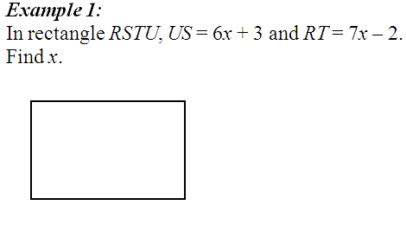
R
R
S
S
6x + 3 = 7x – 2
5 = x
U
U
T
T

Slide 26
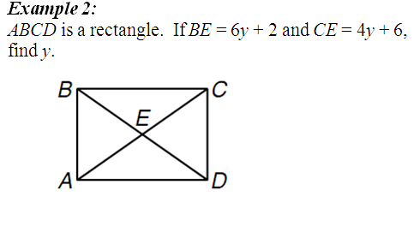
6y + 2 = 4y + 6
y = 2

Slide 27
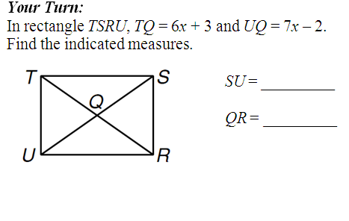
66
33
6x + 3 = 7x – 2
x = 5

Slide 28
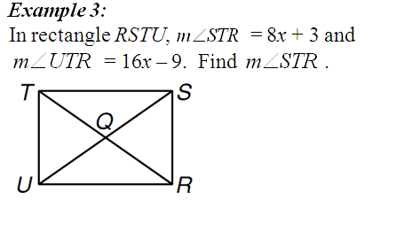
8x + 3 + 16x – 9 = 90
24x – 6 = 90
x = 4
m∠STR = 35°

Slide 29
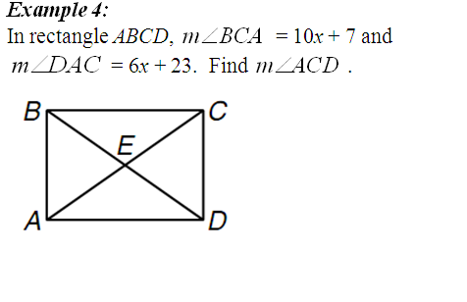
47°
?
10x + 7 = 6x + 23
x = 4
m∠ACD = 90 – 47 = 43°

Slide 30
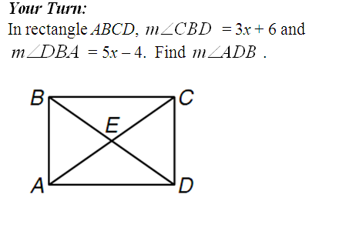
39°
3x + 6 + 5x – 4 = 90
x = 11
?
m∠ADB = 39°

Slide 31
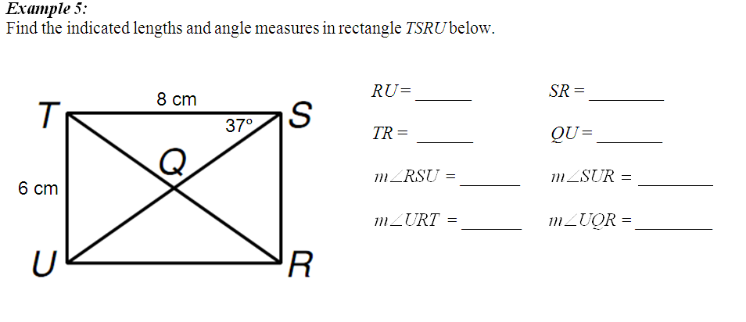
8 cm
6 cm
10 cm
5 cm
53°
53°
37°
37°
106°
37°
37°
6² + 8² = c²
c
6
100 = c²
10 = c
8

Slide 32
ASSIGNMENT
6-3 worksheet

Slide 33
WARM-UP: Find a, b and c so that WXYZ is a parallelogram
W
X
22°
m∠WZX = 36°
2b – 4
m∠WXZ = 22°
10
3c – 2
m∠YZX = 5a°
m∠YXZ = (2b – 4)°
36°
5a
WZ = 10 cm
Z
Y
XY = 3c – 2 cm

Slide 34
WARM-UP: Find a, b and c so that WXYZ is a parallelogram
W
X
22°
5a = 22
a = 4.4
2b – 4
10
2b – 4 = 36
3c – 2
b = 20
36°
3c – 2 = 10
5a
Z
Y
c = 4

Slide 35
Lesson 6-4
I can recognize the conditions that ensure a quadrilateral is a rectangle
I can prove that a set of points forms a rectangle in the coordinate plane

Slide 36
m = 3/5
slopes
opposite reciprocals
m = -5/3
3
5
• –
= -1
5
3

Slide 37
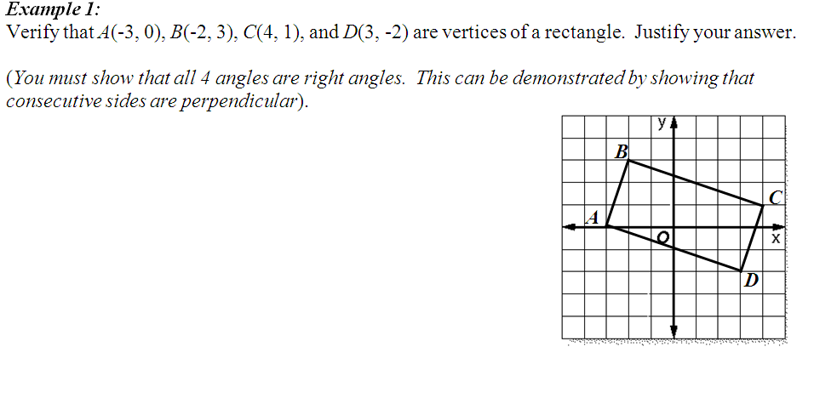
3/1
slope of AB =
-1/3
3/1
slope of BC =
-1/3
3/1
slope of CD =
3/1
3/1
slope of DA =
-1/3
AB ⊥ BC,
BC ⊥ CD,
and DA ⊥ AB
CD ⊥ DA,

Slide 38
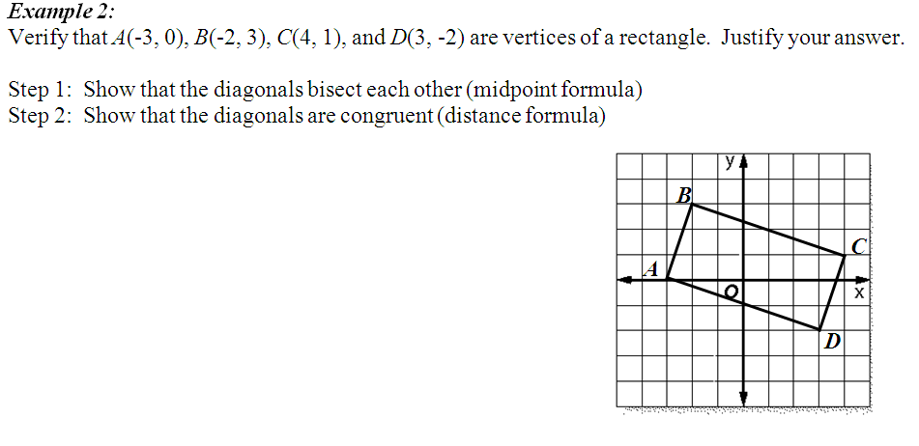
(0.5,0.5)
mp of AC =
✓ parallelogram
mp of BD =
(0.5, 0.5)
$$\sqrt{50}$$
Dist AC =
✓ rectangle
$$\sqrt{50}$$
Dist BD =
Diagonals bisect each other AND are congruent

Slide 39
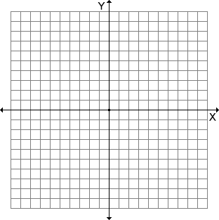
(2.5,4.5)
mp of LG =
(2.5, 4.5)
mp of BH =
✓ parallelogram
G
B
H
$$\sqrt{34}$$
L
Dist LG =
✗ Not a rectangle
$$\sqrt{26}$$
Dist BH =
Diagonals are not congruent

Slide 40
ASSIGNMENT
6-4 worksheet

Slide 41
Lesson 6-5
I can recognize and apply the properties of rhombi
I can recognize and apply the properties of squares

Slide 42
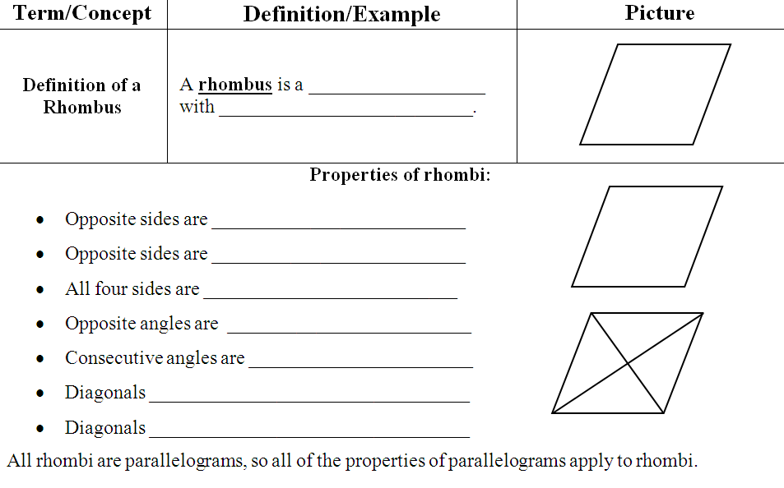
quadrilateral
4 congruent sides
parallel
congruent
congruent
congruent
supplementary
bisect each other
are perpendicular

Slide 43
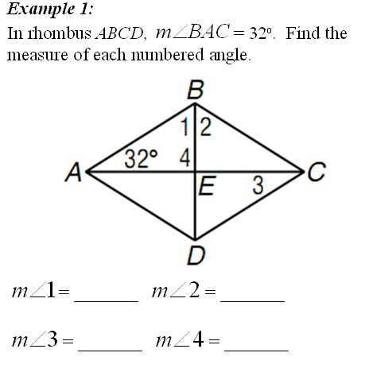
58°
58°
32°
90°

Slide 44
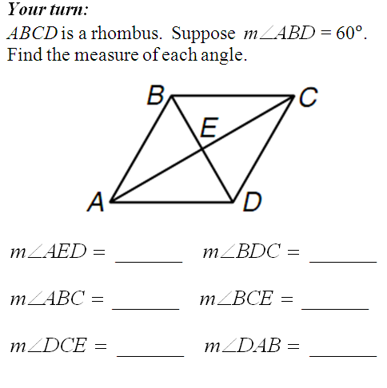
60°
30°
60°
30°
30°
60°
60°
30°
90°
60°
120°
30°
30°
60°

Slide 45
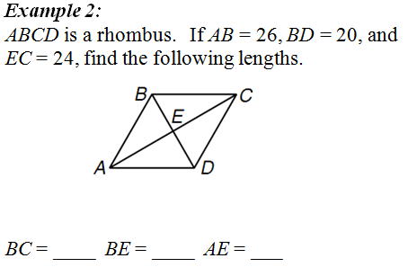
26
10
48

Slide 46
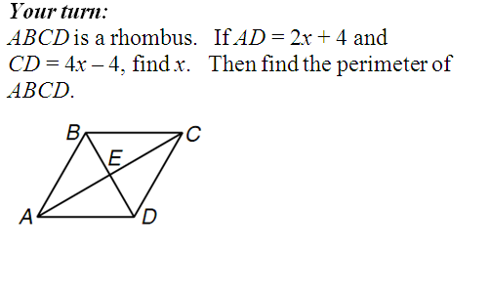
2x + 4 = 4x – 4
4x – 4
x = 4
2x + 4
12
Perimeter = 4(12) = 48

Slide 47
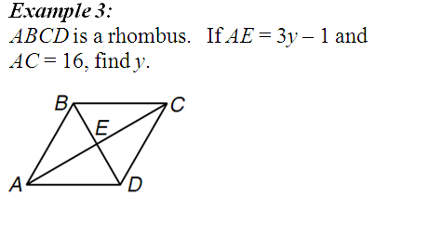
3y – 1 = 8
8
y = 3
3y – 1

Slide 48
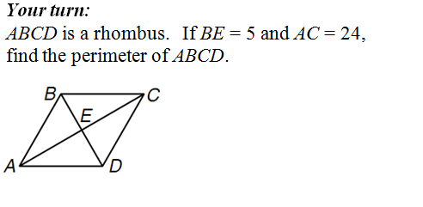
12
5² + 12² = c²
5
c
169 = c²
13 = c
Perimeter = 52

Slide 49
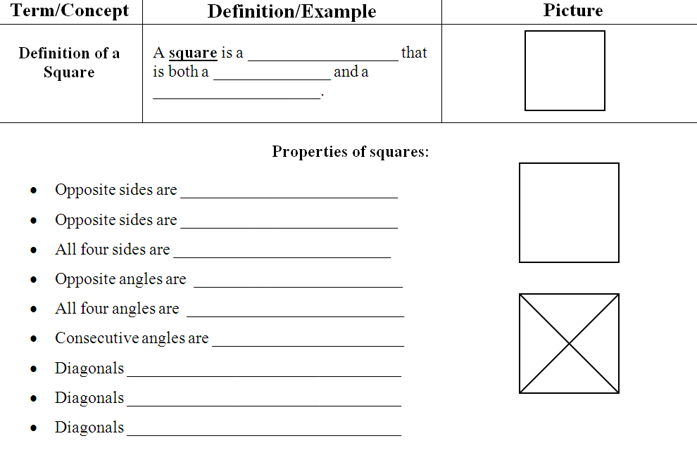
quadrilateral
rectangle
rhombus
parallel
congruent
congruent
congruent
90°
supplementary
bisect each other
are congruent
are perpendicular

Slide 50
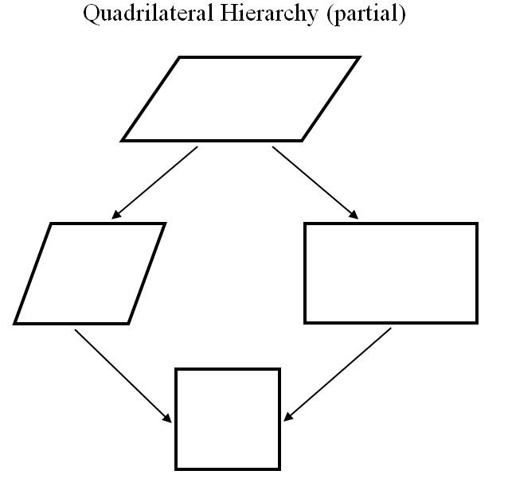
diagonals bisect
parallelogram
diagonals bisect AND ⏊
diagonals bisect AND ≅
rhombus
rectangle
square
diagonals bisect, ≅ AND ⏊

Slide 51
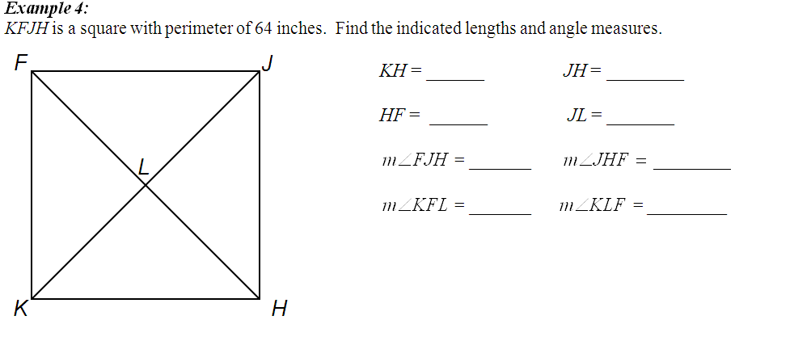
16
16
16
22.6
11.3
90°
45°
16
16
45°
90°
45°
45°
16² + 16² = c²
16
512 = c²
22.6 = c

Slide 52
ASSIGNMENT
6-5 worksheet

Slide 53
Lesson 6-6
I can recognize the conditions that ensure a quadrilateral is a rhombus or square
I can prove that a set of points forms a rhombus or square in the coordinate plane

Slide 54
STEPS:
Check if the shape is a parallelogram.
Use midpoint formula to see if the diagonals bisect
2. Check if the shape is a Rectangle.
Use distance formula to see if the diagonals are congruent
3. Check if the shape is a rhombus.
Use slope formula to see if the diagonals are perpendicular
If the answer is “yes” to all of the above, the figure is also a …
SQUARE

Slide 55
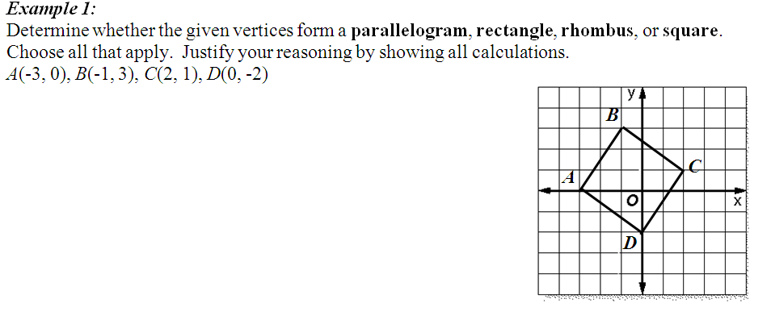
(-0.5, 1.5)
✓ parallelogram
mp of AC =
(-0.5, 1.5)
mp of BD =
$$\sqrt{26}$$
✓ rectangle
Dist AC =
$$\sqrt{26}$$
Dist BD =
1
✓ rhombus
slope AC =
5
5
–
slope BD =
1

Slide 56
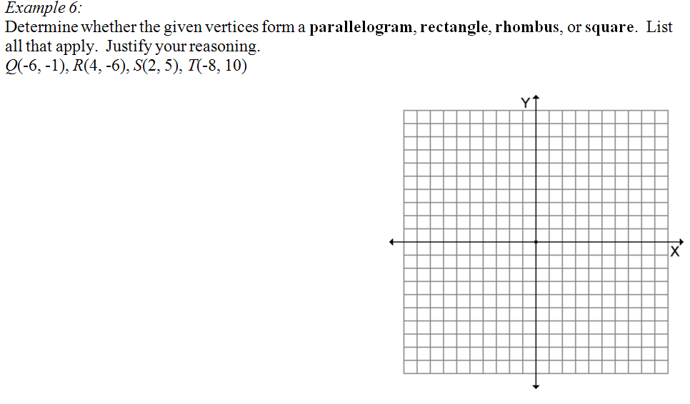
(-2, 2)
T
mp of QS =
✓
(-2, 2)
mp of RT =
S
$$\sqrt{100}$$
Dist QS =
✗
$$\sqrt{400}$$
Dist RT =
Q
6
3
slope QS =
=
8
4
✓
R
16
4
slope RT =
–
= –
12
3

Slide 57
ASSIGNMENT
6-6 worksheet

Slide 58
Lesson 6-7
I can recognize and apply the properties of trapezoids
I can solve problems involving the medians of trapezoids

Slide 59
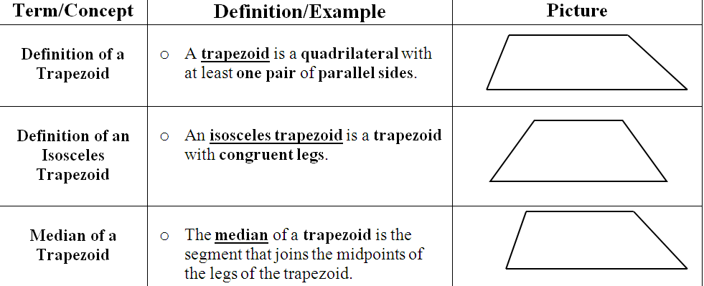

Slide 60
half
sum
bases
HJ + LK
MN =
2
Median is the average of the bases

Slide 61
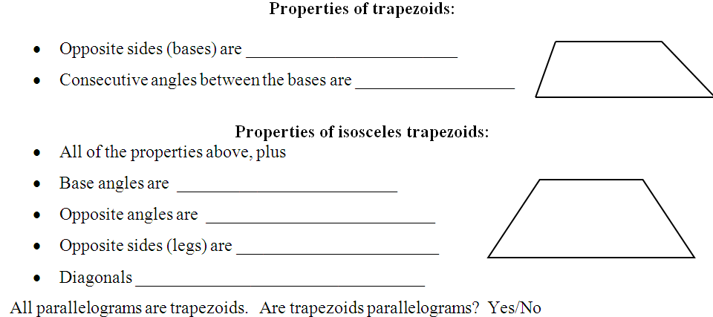
parallel
180°
180°
supplementary
congruent
supplementary
congruent
are congruent

Slide 62
32
46
?
32 + 60
MN =
= 46
60
2
68
76
68 + x
76 =
?
2
= 84

Slide 63
20
3x + 5
+ 9x – 5
= 30
2
40
12x
= 60
x = 5

Slide 64
180 – 85 = 95°
180 – 35 = 145°

Slide 65
58
70°
110°
110°

Slide 66
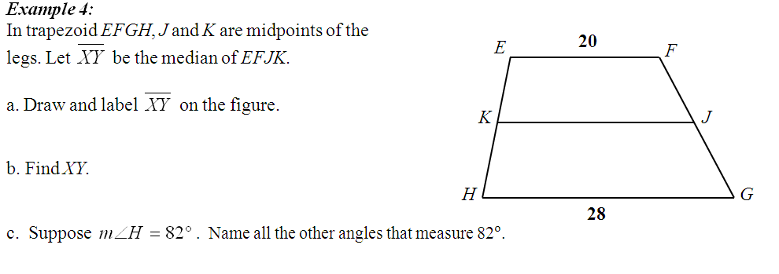
X
Y
24
22
∠JKE
∠YXE

Slide 67
61
V
W
66.5
83°

Slide 68
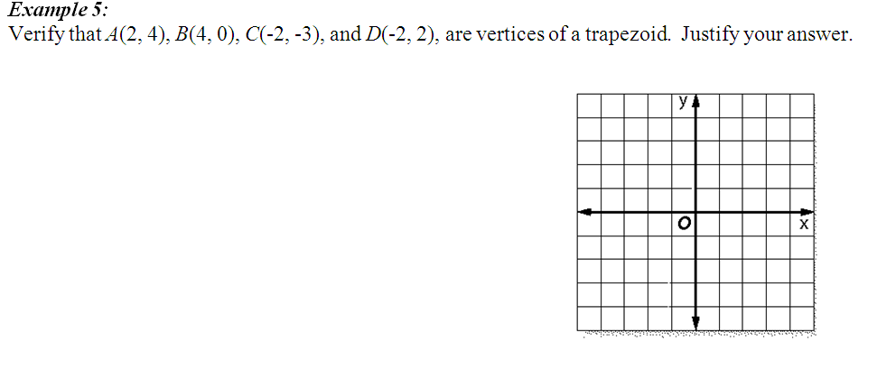
Need to show one pair of sides are parallel
A
2
1
slope AD =
=
D
4
2
3
1
B
slope BC =
=
6
2
C
AD ∥ BC

Slide 69
ASSIGNMENT
6-7 worksheet

Slide 70
Lesson 6-8
I can recognize and apply the properties of kites
I can use the quadrilateral hierarchy

Slide 71
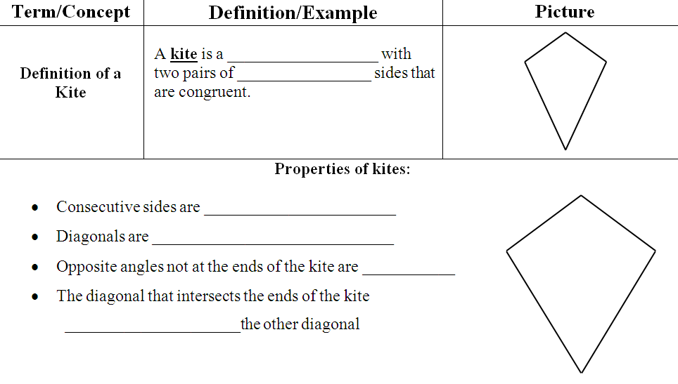
quadrilateral
consecutive
end
congruent
perpendicular
congruent
bisects
end

Slide 72
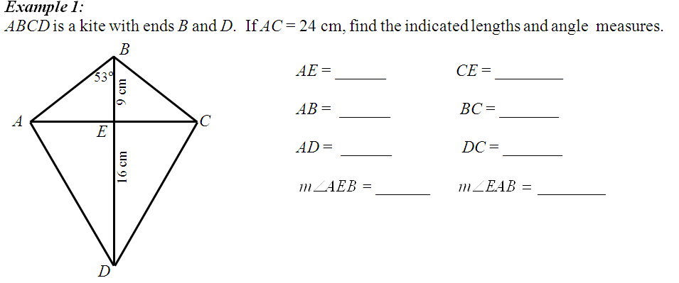
12
12
15
15
12
20
20
90°
37°
9² + 12² = c²
12² + 16² = c²
225 = c²
400 = c²
15 = c
20 = c

Slide 73
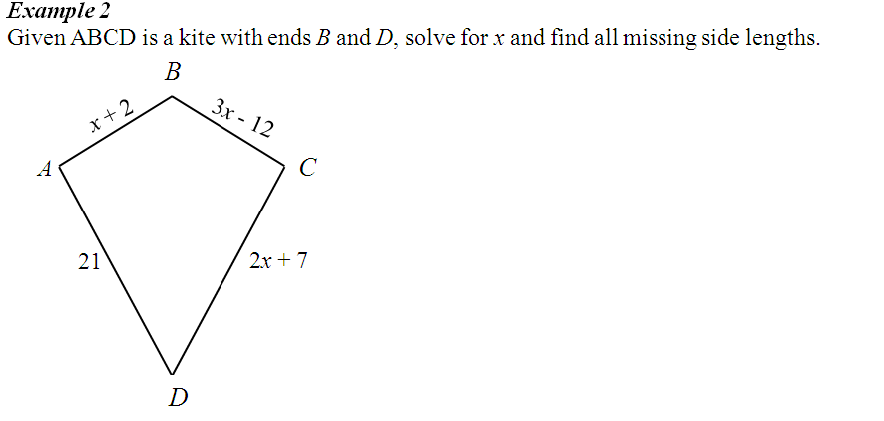
9
9
2x + 7 = 21
x = 7
21

Slide 74
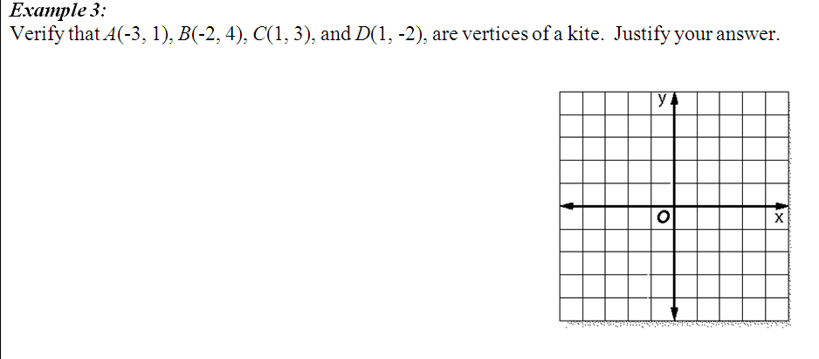
B
Dist AB =
C
Dist BC =
A
Dist CD =
D
Dist DA =
AB ≅ BC
CD ≅ DA
and

Slide 75
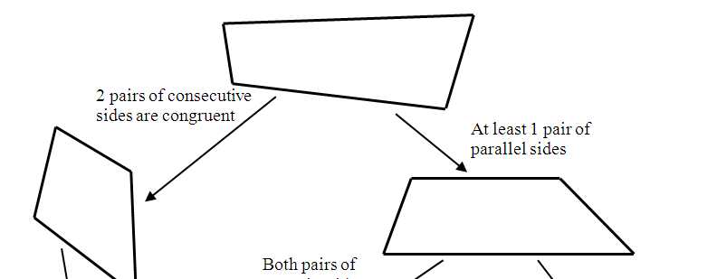
Quadrilateral
Kite
Trapezoid

Slide 76
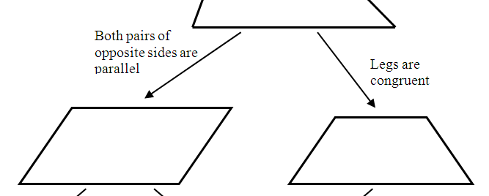
Trapezoid
Isosceles Trapezoid
Parallelogram

Slide 77
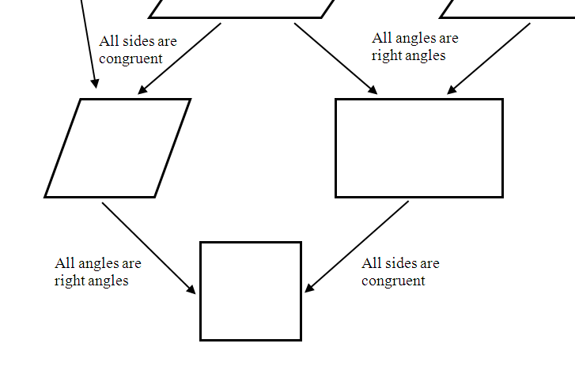
Parallelogram
Rhombus
Rectangle
Square

Slide 78
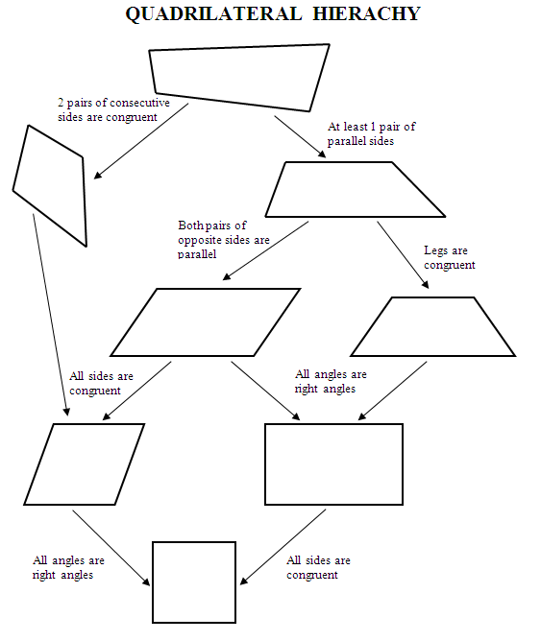
Quadrilateral
Kite
Trapezoid
Parallelogram
Isosceles Trapezoid
Rhombus
Rectangle
Square

Slide 79
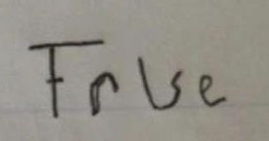
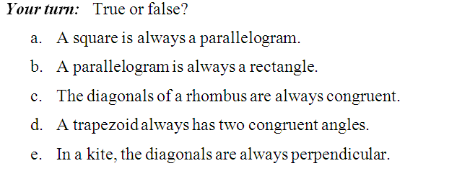
X
True
False
False
False
True

Slide 80
ASSIGNMENT
6-8 worksheet

Slide 81
Lesson 6-9
I can construct a
Parallelogram
Rectangle
Rhombus
Square

Slide 82
bisect

Slide 83
bisect
are ≅

Slide 84
bisect
are ⊥

Slide 85
bisect
are ≅
are ⊥

