Slide 1
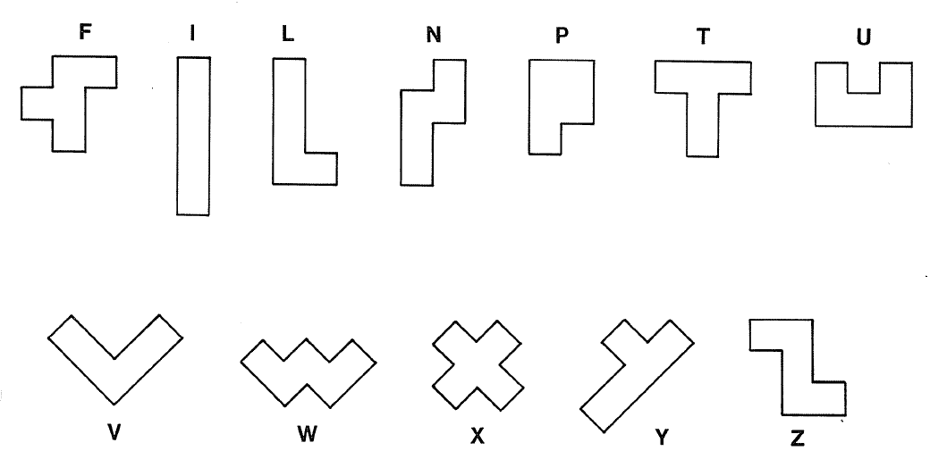
PENTOMINOES

Slide 2
Use 4 tiles to make this shape

Slide 3
DOUBLING
Work with your partner to make a shape like the “F” tile, but twice as big
Use colored pencils to record your answer on the back of the worksheet
Double as many other Pentominoes as you can. Use the grid paper if needed
Record all answers using colored pencils

Slide 4
4
2
4
6
3
2
1
2

Slide 5


Slide 6
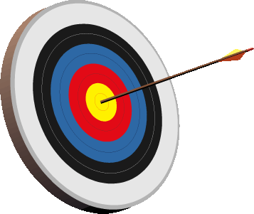
Lesson 7-1
I can determine whether a dilation is an enlargement, a reduction or congruence transformation
I can determine the scale factor for a given dilation

Slide 7
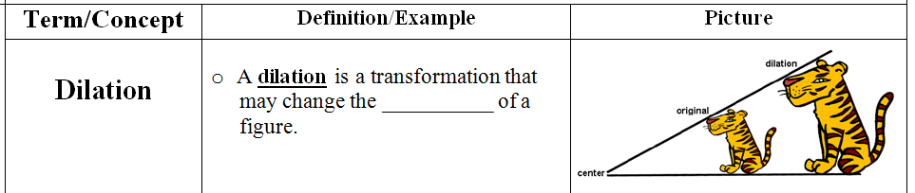
size

Slide 8
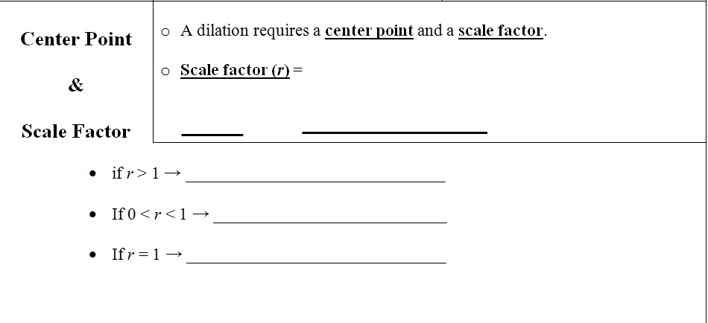
image
preimage
enlargement
reduction
congruent

Slide 9
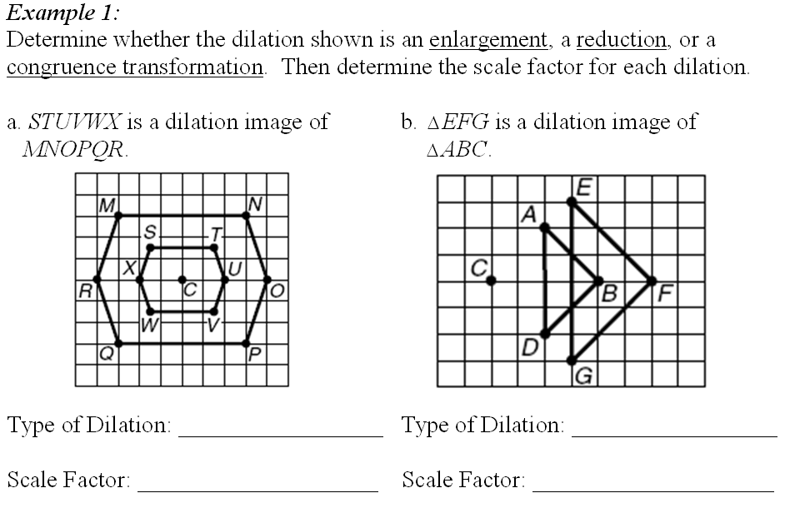
reduction
enlargement
3/6 or 0.5
6/4 or 1.5

Slide 10
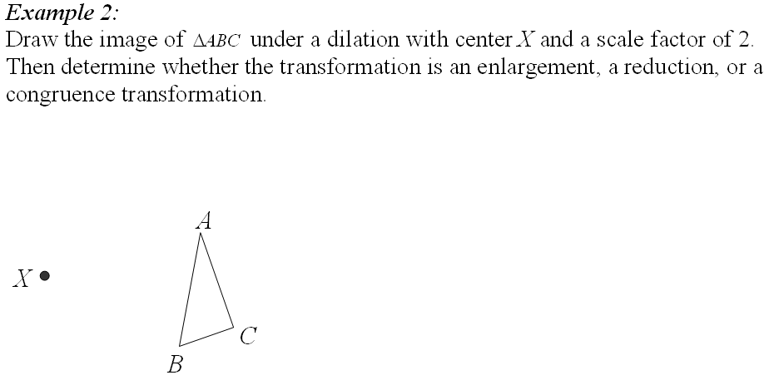
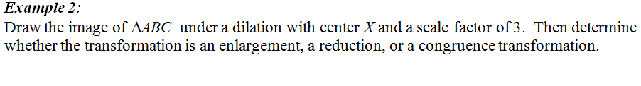
3
enlargement
A’
66 mm
22 mm
28 mm
22 mm
84 mm
66 mm
C’
B’

Slide 11
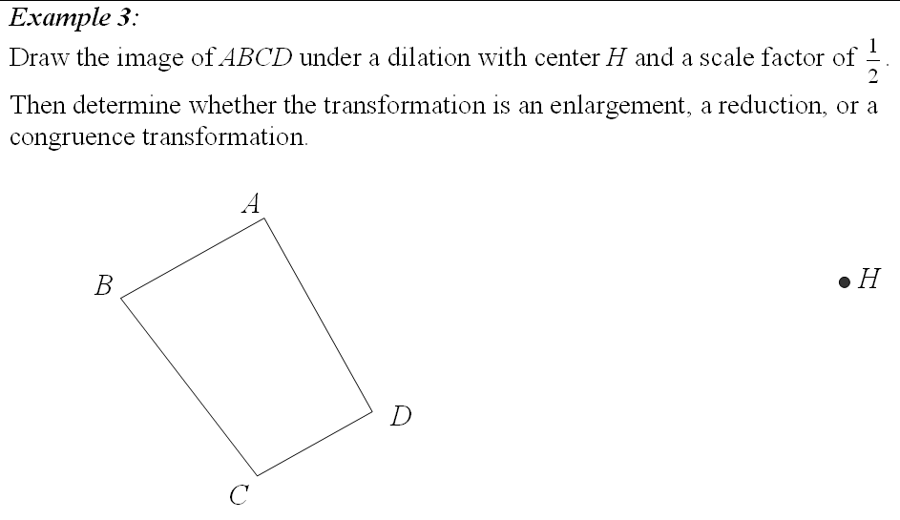
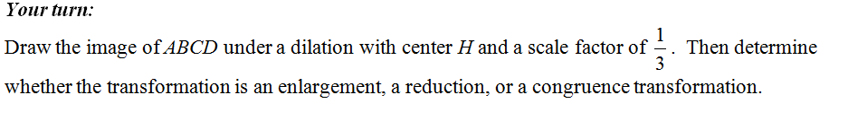
1/3
reduction
A’
B’
D’
C’

Slide 12
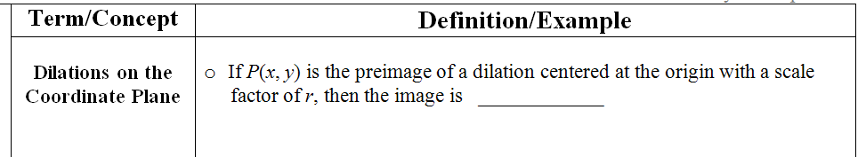
P’(rx, ry)

Slide 13
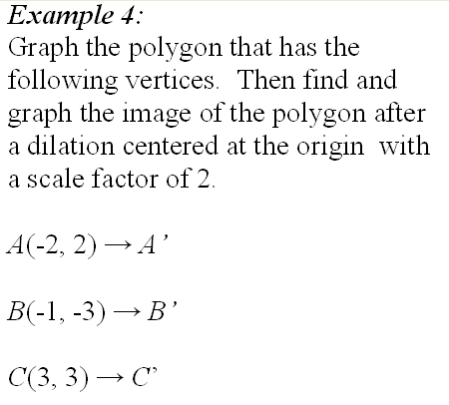
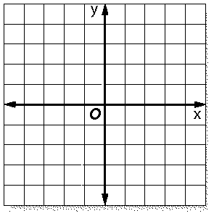
(-4, 4)
(-2, -6)
(6, 6)

Slide 14
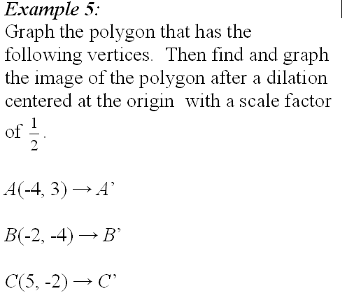
(-2, 1.5)
(-1, -2)
(2.5, -1)

Slide 15

image
r =
preimage
6
4 =
x
x = 1.5

Slide 16
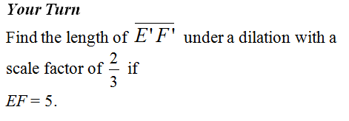
image
r =
preimage
2
x
=
3
5
x = 3.33

Slide 17
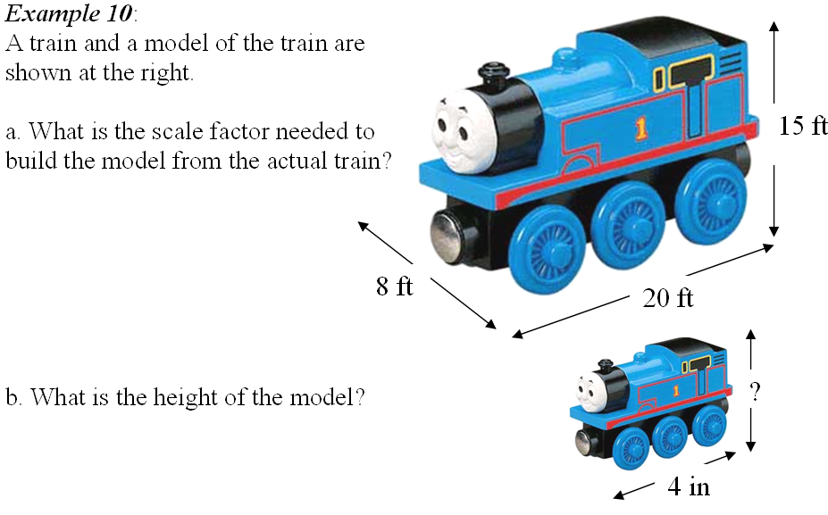
180 in
4
1
=
= 0.0167
240
60
96 in
240 in
4
x
=
x = 3 in
240
180

Slide 18
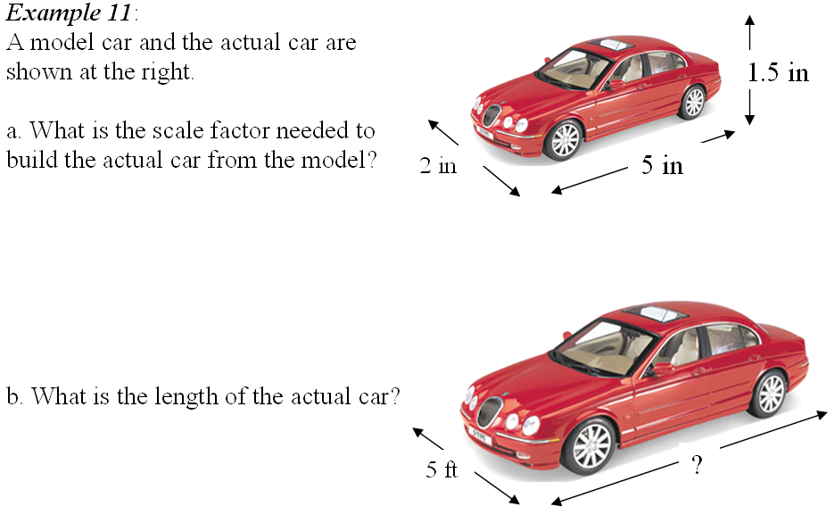
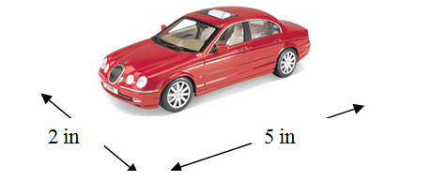
60
= 30
2
60
x
60 in
=
2
5
x = 150 in

Slide 19
ASSIGNMENT
7-1 worksheet

Slide 20
Lesson 7-2
I can write ratios.
I can use properties of proportions.

Slide 21
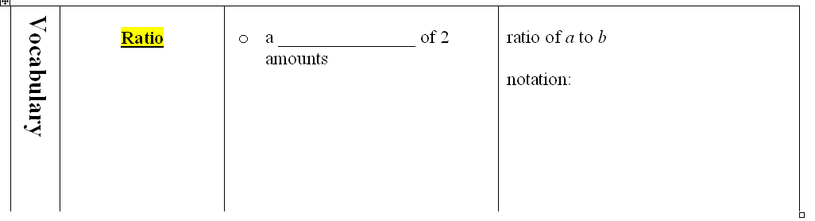
quotient
a : b
with the same units
Write with : or as a fraction, a/b

Slide 22

females : males

Slide 23
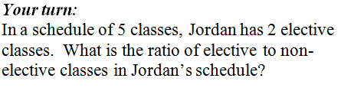
elective : non-elective
2 :
3

Slide 24
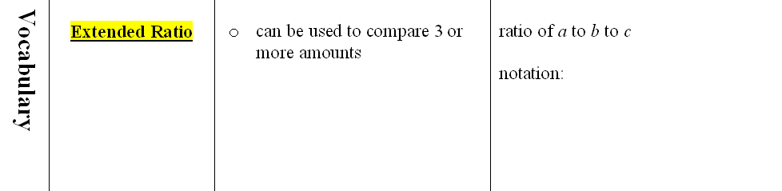
a : b : c
Ex: ratio of freshmen to sophomores to juniors
Cannot be written as a fraction

Slide 25
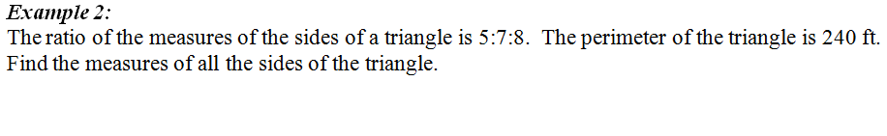
7
84
x
240
5x + 7x + 8x =
5
x
60
96
20x = 240
8
x
x = 12

Slide 26
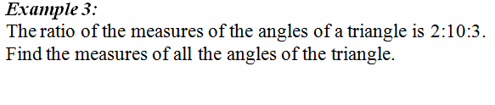
24°
2
x
2x + 10x + 3x =
180
3
x
10
x
36°
15x = 180
120°
x = 12

Slide 27
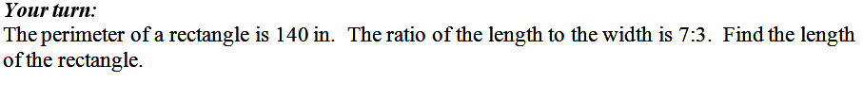
L
7x
W
3x
3x
20x =
140
7x
x = 7
L = 49

Slide 28
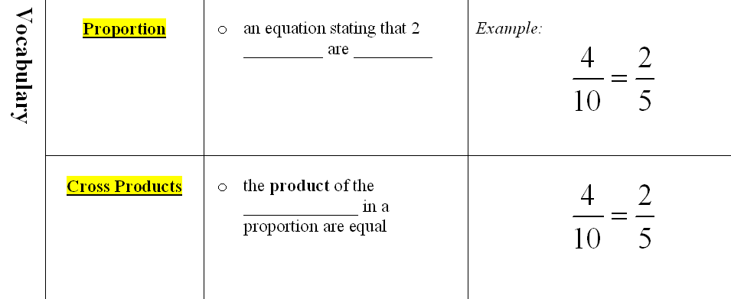
fractions
equal
diagonals
4(5) = 10(2)

Slide 29

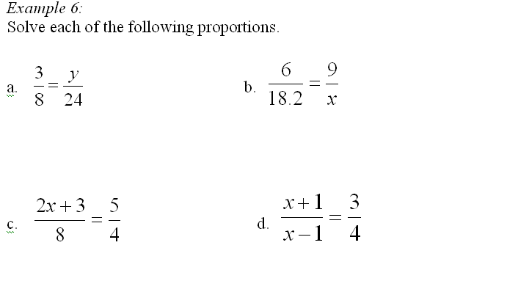
72
8y =
163.8
6x =
y = 9
x = 27.3

Slide 30
40
4(2x + 3) =
3(x – 1) =
4(x + 1)
8x + 12 = 40
3x – 3 =
4x + 4
x = 3.5
x = -7

Slide 31
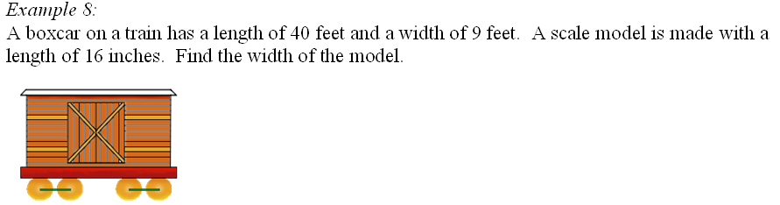
length
width
40
16
40x =
144
=
9
x
x = 3.6
3.6 inches

Slide 32
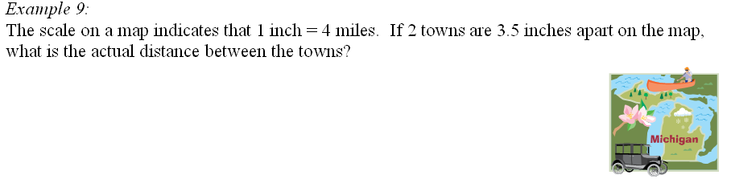
miles
inches
4
x
x = 14
=
1
3.5
14 miles

Slide 33
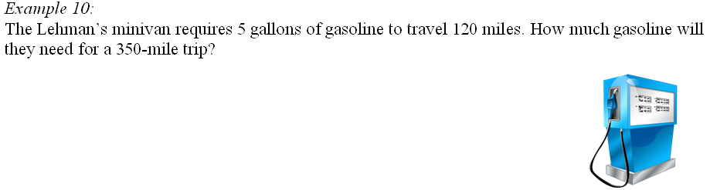
gal
miles
5
x
x = 14.58333
=
120
350
14.6 gallons

Slide 34

?
5
wide
3.5
18
tall
5
x
=
3.5
18
x = 25.7143
25.7 inches

Slide 35
ASSIGNMENT
7-2 worksheet

Slide 36
Lesson 7-3
I can identify similar figures.
I can find missing side lengths in similar figures.

Slide 37
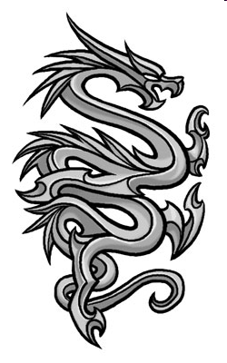

Slide 38
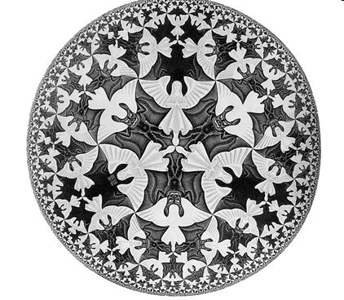

Slide 39
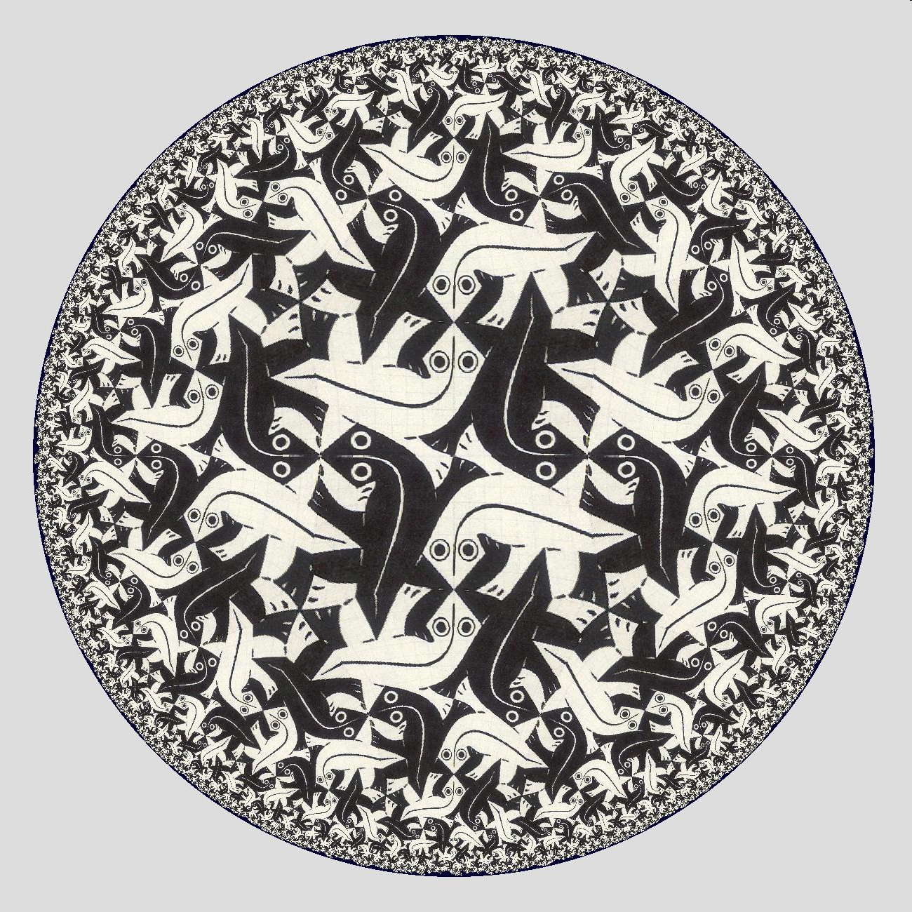

Slide 40
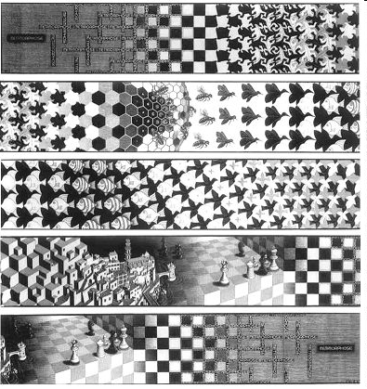

Slide 41
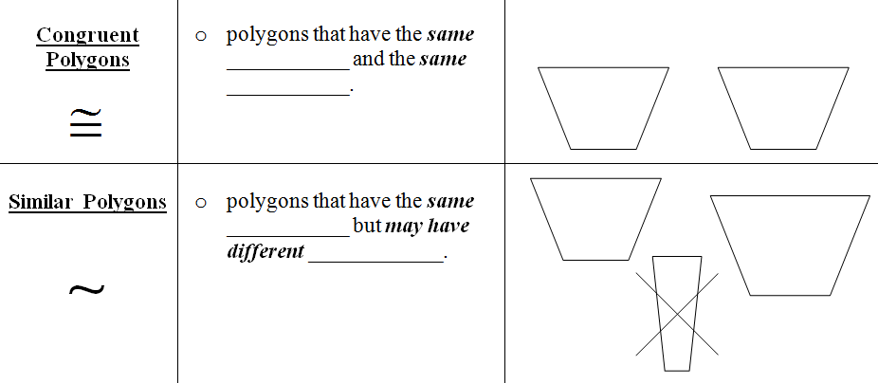
shape
size
shape
size

Slide 42
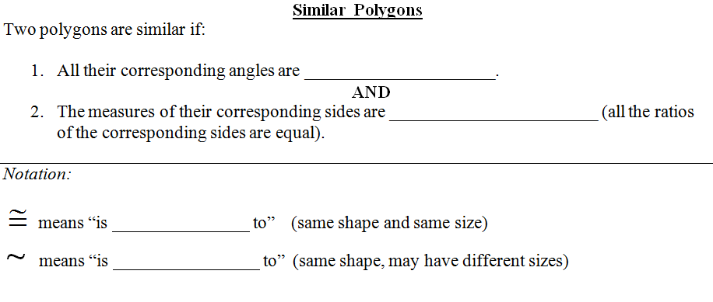
congruent
proportional
congruent
similar

Slide 43
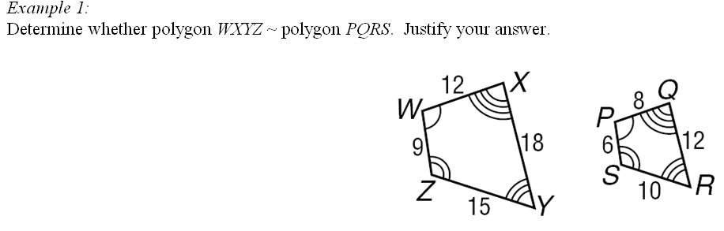
12
18
15
9
8
12
10
6
All = 1.5
Similar,
all angles congruent,
all sides proportional.

Slide 44
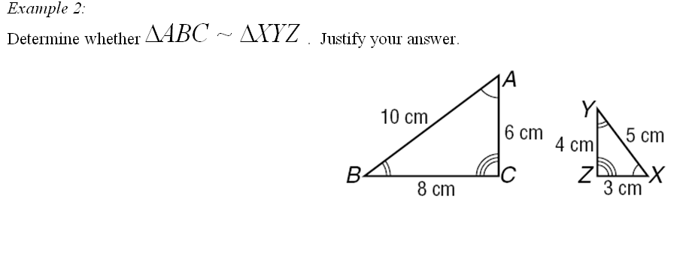
10
6
8
5
3
4
All = 2
X
5
3
Y
Z
Similar,
all angles congruent,
4
all sides proportional.

Slide 45
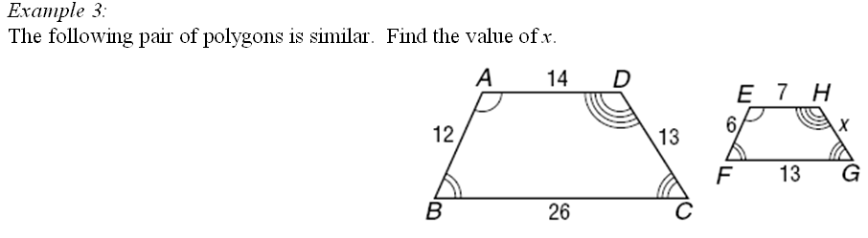
13
14
=
x
7
x = 6.5

Slide 46
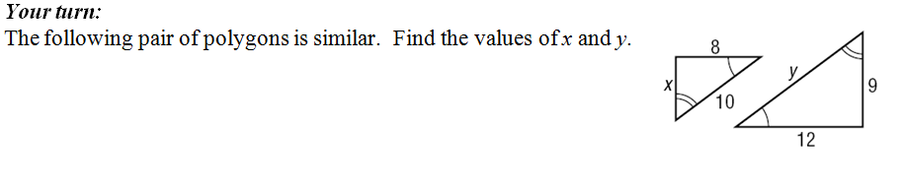
x
8
x = 6
=
9
12
10
8
y = 15
=
y
12

Slide 47
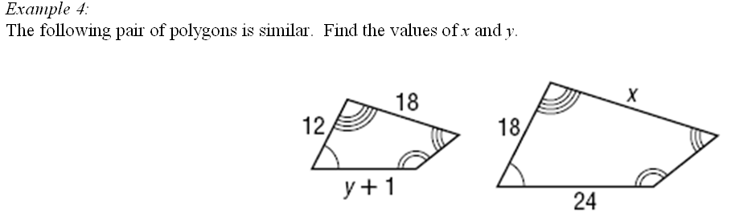
27
Find x first
18
12
=
x
18
x = 27

Slide 48
27
Find y next!
y + 1
12
=
24
18
18(y + 1) =
288
x = 27, y = 15
18y + 18 = 288
y = 15

Slide 49
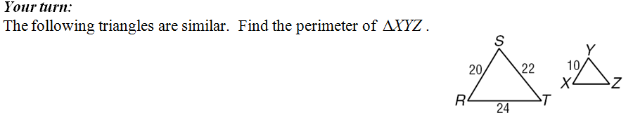
11
12
Perimeter = 10 + 11 + 12
= 33

Slide 50
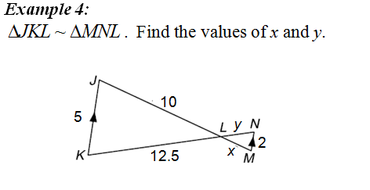
L
10
5
=
x
2
L
10
12.5
x = 4
x
y
12.5
5
M
N
2
=
J
K
y
2
5
y = 5

Slide 51
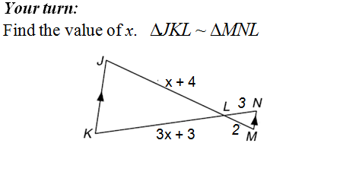
x + 4
3x + 3
=
2
3
2(3x + 3) =
3(x + 4)
6x + 6 = 3x + 12
x = 2

Slide 52
ASSIGNMENT
7-3 worksheet

Slide 53
Lesson 7-4
I can identify similar triangles.
I can use similar triangles to solve problems.

Slide 54
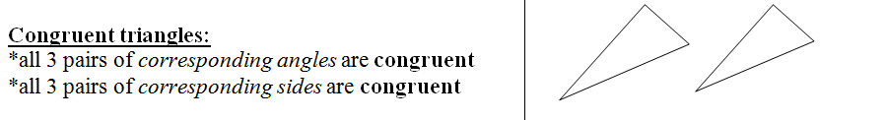

Slide 55
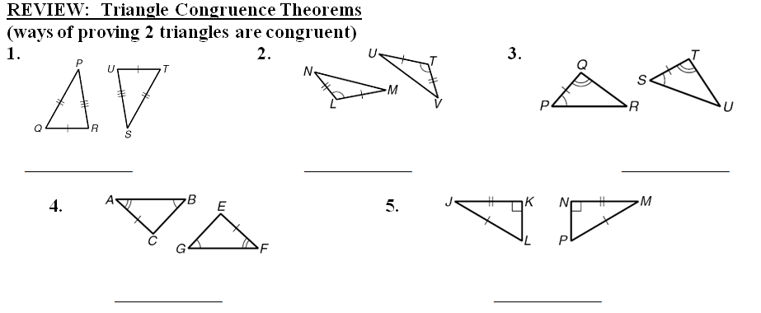
SSS
SAS
ASA
AAS
HL

Slide 56
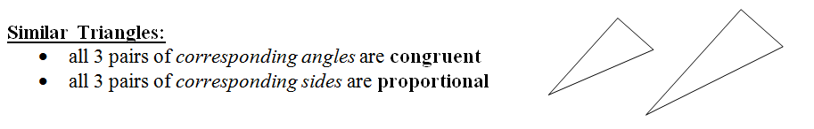

Slide 57
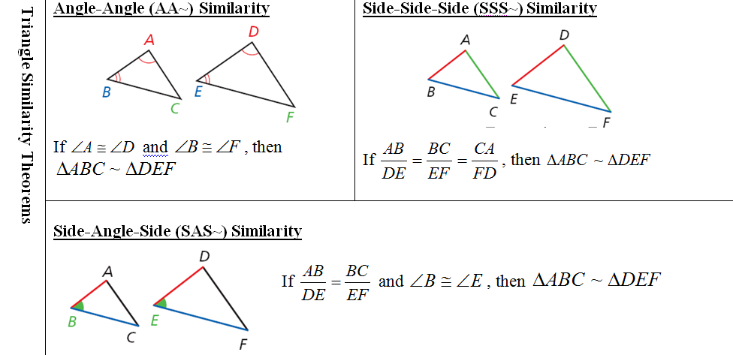

Slide 58
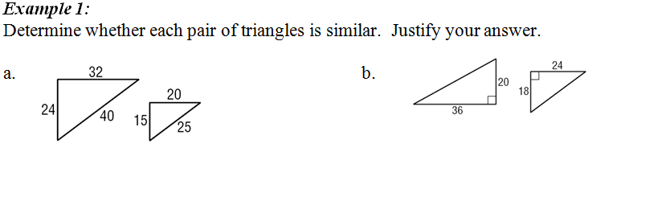
32
40
24
36
20
=
=
≠
20
25
15
24
18
similar by SSS~
Not similar

Slide 59
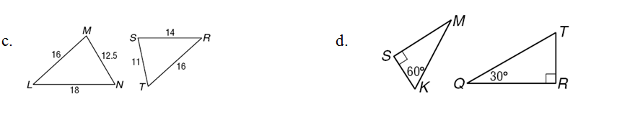
30°
60°
18
16
12.5
Similar by AA~
≠
≠
16
14
11
ΔMKS ~
ΔQTR
Not similar

Slide 60
ASSIGNMENT
7-4 worksheet

Slide 61
Lesson 7-5
I can use the Triangle Proportionality Theorem to find parts of triangles
I can use the Triangle Midsegment Theorem to find parts of triangles.
I can recognize and use proportions to find relationships between altitudes, angle bisectors and medians of similar triangles.

Slide 62
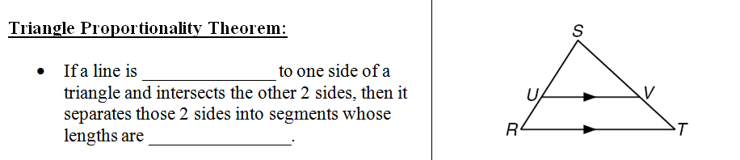
parallel
proportional

Slide 63
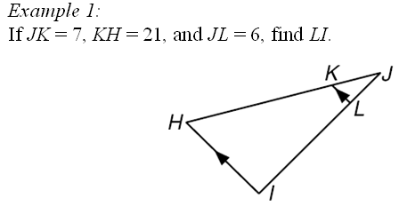
7
21
6
x
7
6
=
x = 18
21
x

Slide 64

x
14
x = 14
12
6
=
NQ = 26
x
7

Slide 65

22
x
11
=
x = 12
x + 12
22

Slide 66

x – 4
14
=
x = 7.5
x – 6
6

Slide 67

endpoints
midpoints
2 sides
parallel
half

Slide 68

35
X =
= 17.5
2

Slide 69

R
RS = 2(12)
X
= 24
12
S
T
Y

Slide 70

proportional

Slide 71

6
x
5
7
5
6
=
x = 8.4
7
x

Slide 72

24
14
x
10.5
14
24
=
x = 18
10.5
x

Slide 73


x + 2
2x + 1
=
x = 3
10
14

Slide 74

x
x + 2
=
x = 4
8
12

Slide 75
ASSIGNMENT
7-5 worksheet

Slide 76
Warm-up… please show work!
Suppose the triangles below are similar. Find x, y and z
y
14
17.5
5
6
x
3
4.5
z
x = 4
y = 7.5
z = 10.5

Slide 77
Lesson 7-6
I can solve problems involving relationships between parts of a right triangle and the altitude (height) to its hypotenuse (longest side).

Slide 78

D
D
A
C
C
B
ΔABC
ΔACD
ΔCBD

Slide 79



x
6
2
x
2
x
$$x^{2}=12$$
=
x
6
$$x=\sqrt{12 }$$
= 3.46

Slide 80





x
y
9
12
y
3
3
x
9
y
x
=
=
x
12
y
12
$$x^{2}=36$$
$$y^{2}=108$$
$$x=\sqrt{36 }$$
$$y=\sqrt{108 }$$
= 6
= 10.39

Slide 81

7
y
z
z
x
5
2
x
y
2
x
2
y
5
z
=
=
=
x
5
y
7
z
7
x = 3.16
y = 3.74
z = 5.92

Slide 82

2
x
2
y
4
z
=
=
=
x
6
y
4
z
6
x = 3.46
y = 2.83
z = 4.90

Slide 83
ASSIGNMENT
7-6 worksheet

