Slide 1
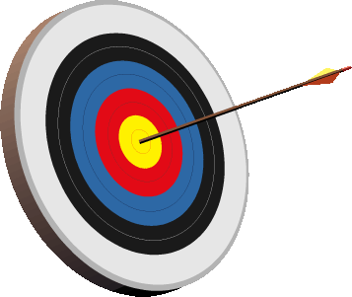
Lesson 9-1
I can identify and use parts of a circle
I can solve problems involving the circumference of a circle

Slide 2
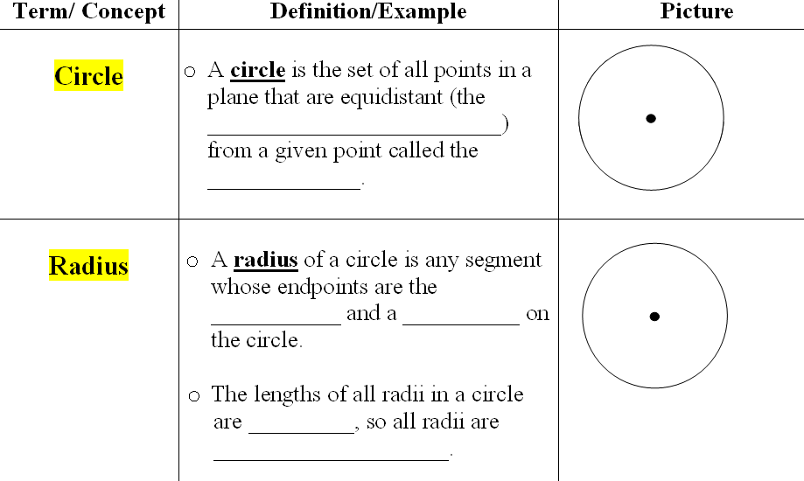
same distance
center
center
point
equal
congruent

Slide 3
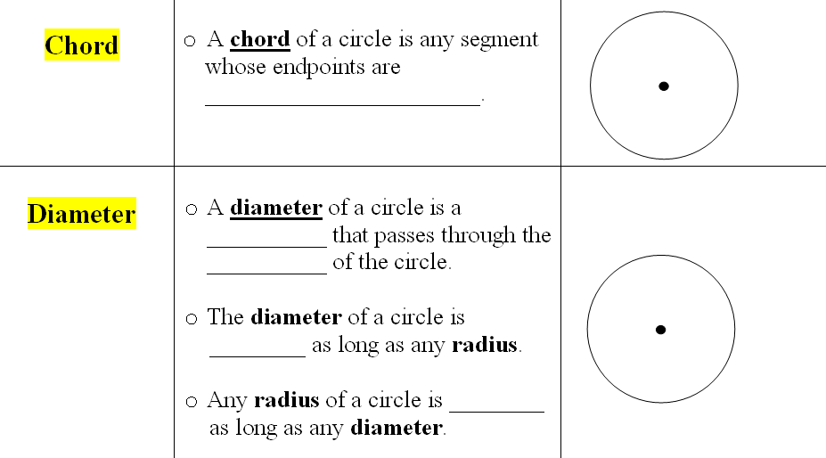
on the circle
chord
center
twice
half
no!
yes!

Slide 4
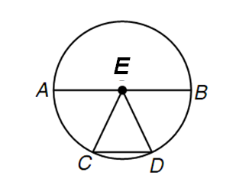
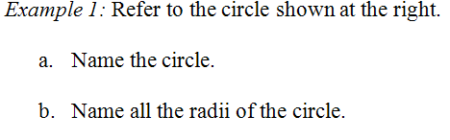




E
EA
EC
ED
EB
AB
CD
AB
4 mm
12 cm

Slide 5
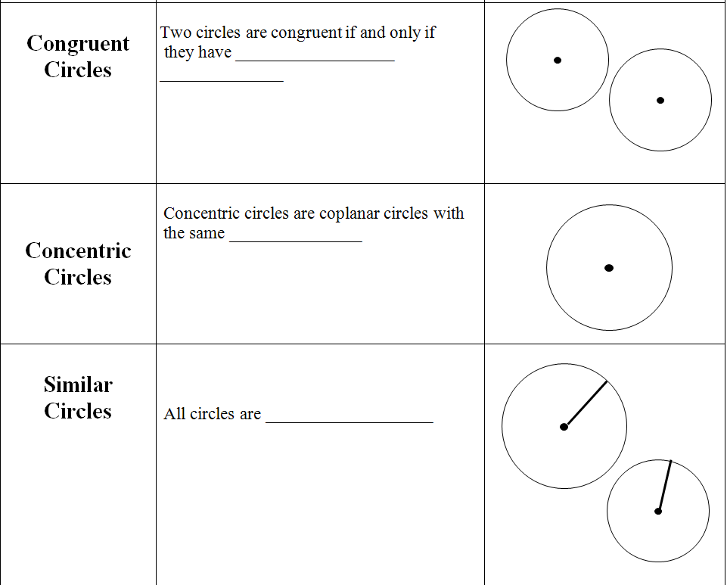
congruent
radii
center
similar

Slide 6
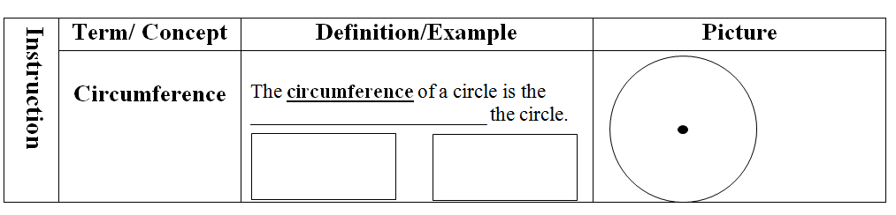
distance around
C = πd
C = 2πr

Slide 7
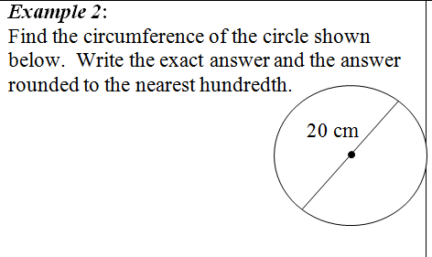
C = πd
= π(20)
= 20π cm
exact
= 62.83 cm

Slide 8
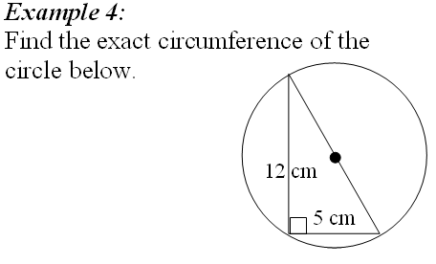
C = πd
d
= 13π cm
a² + b² = c²
5² + 12² = d²
25 + 144 = d²
169 = d²
13 = d

Slide 9
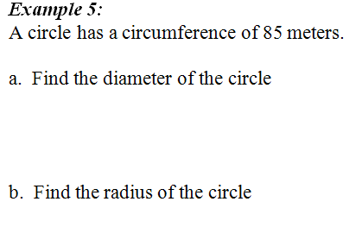
C = πd
85 =
πd
π π
d = 27.06 m
27.06
r =
2
r = 13.53 m

Slide 10
ASSIGNMENT
9-1 worksheet

Slide 11
Lesson 9-2
I can recognize major arcs, minor arcs, semicircles, central angles and their measures
I can find arc length

Slide 12
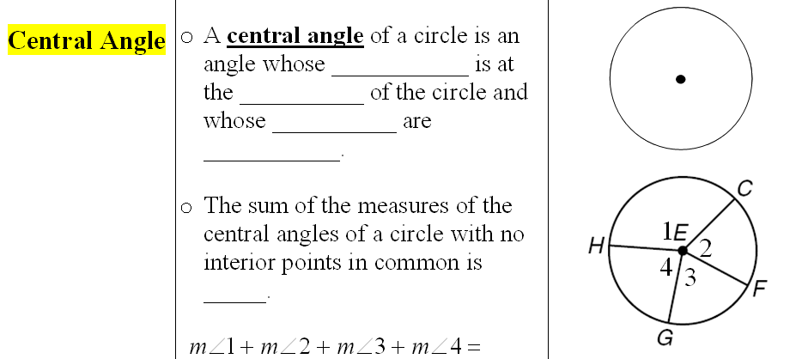
vertex
center
sides
radii
360°
360°

Slide 13
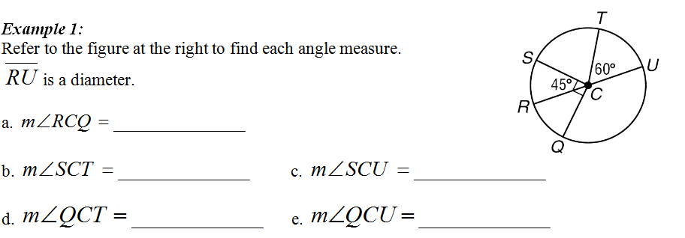
75°
135°
45°
45°
75°
135°
165°
135°

Slide 14
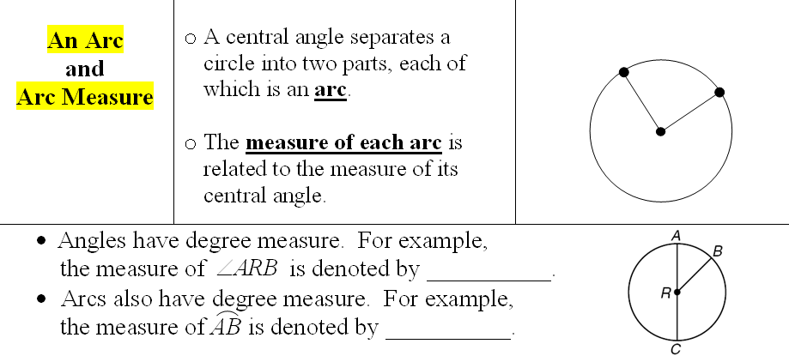

Slide 15
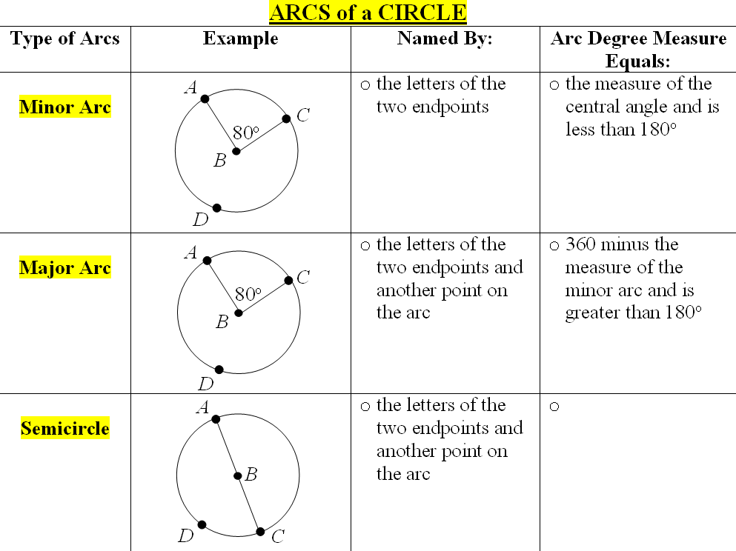
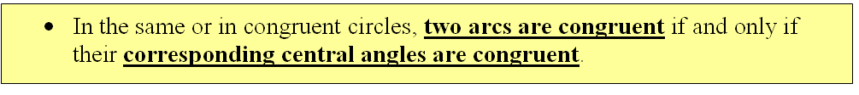
AC
m AC = 80°
ADC
m ADC = 280°
ADC
m ADC = 180°

Slide 16
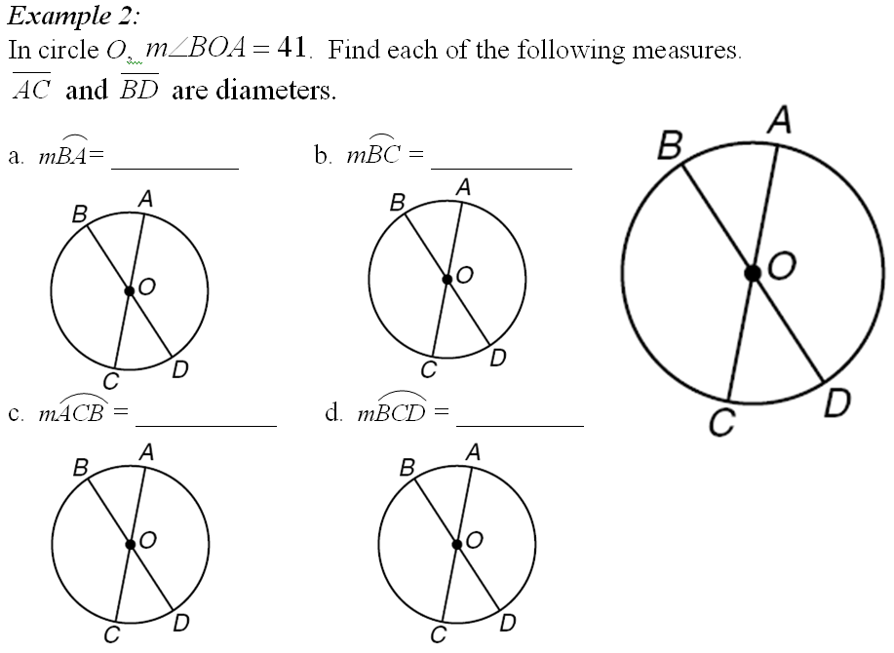
41°
139°
41°
139°
139°
41°
319°
180°

Slide 17
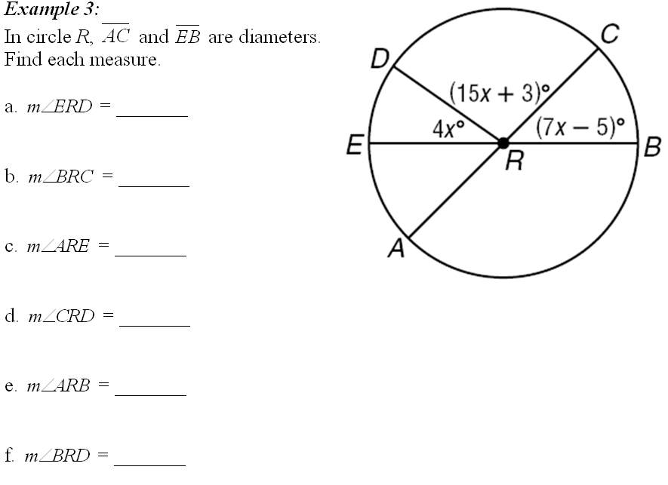
108°
28º
44°
28°
44º
44º
136º
44º
108º
26x – 2
= 180º
136º
26x = 182º
x = 7º
152º

Slide 18
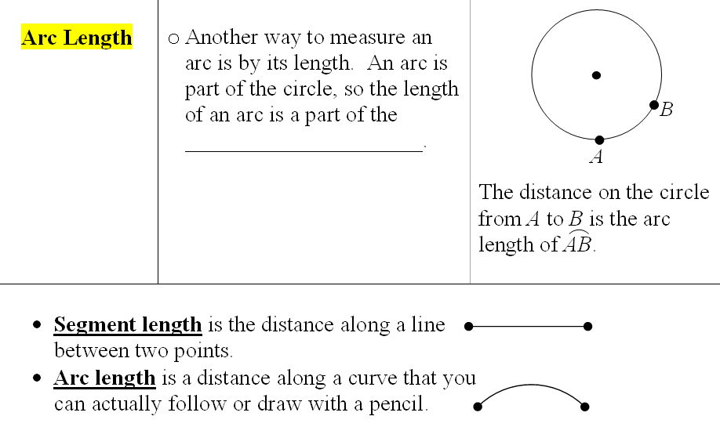
θ°
circumference
θ
πd
360

Slide 19
m XY = 90°
X
m AB = 90°
A
Y
B

Slide 20
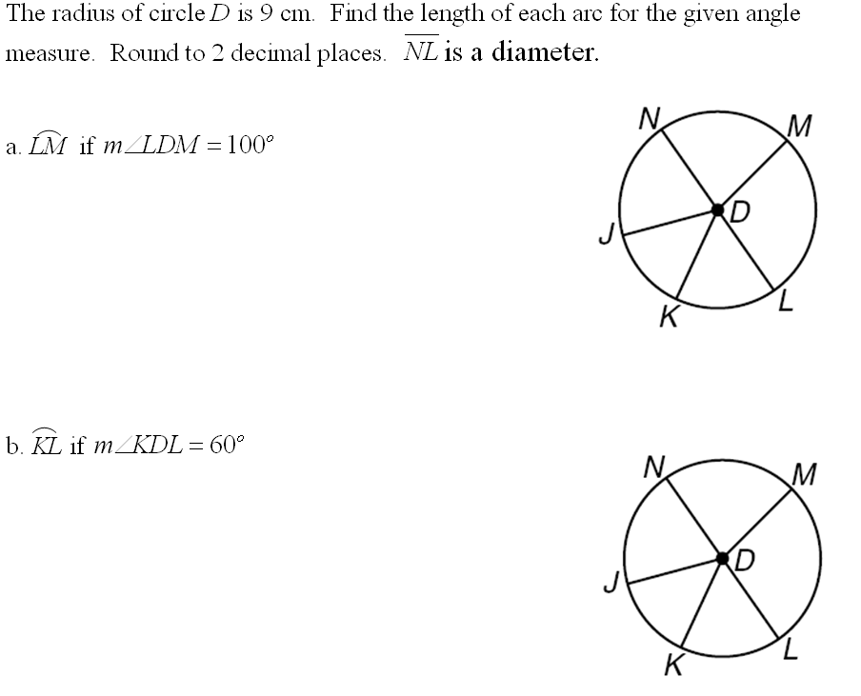
d = 18
100
π(18)
= 15.71
100°
360
60
π(18)
= 9.42
360
60°

Slide 21
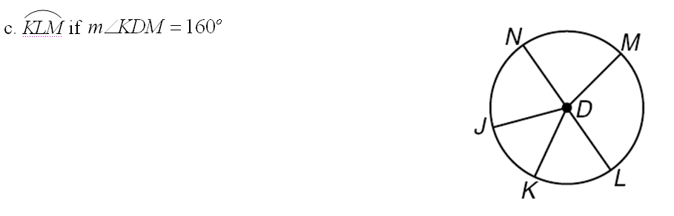
160
π(18)
= 25.13
160°
360

Slide 22
ASSIGNMENT
9-2 worksheet

Slide 23
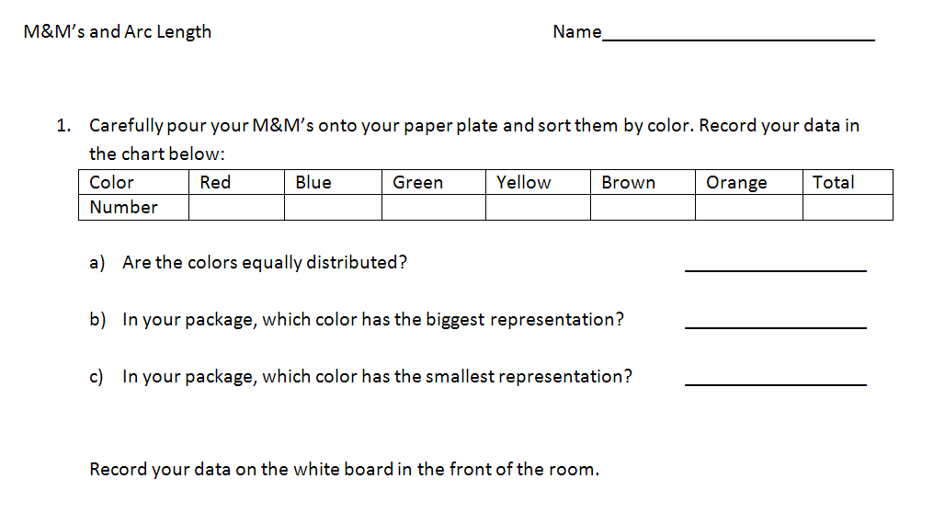

Slide 25
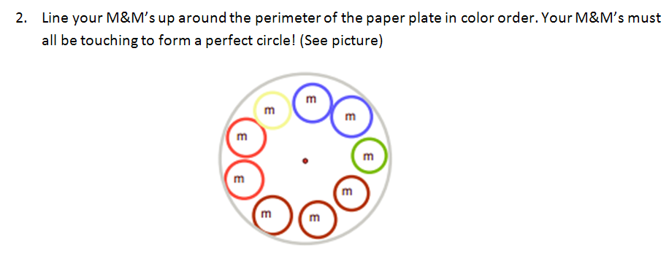

Slide 26
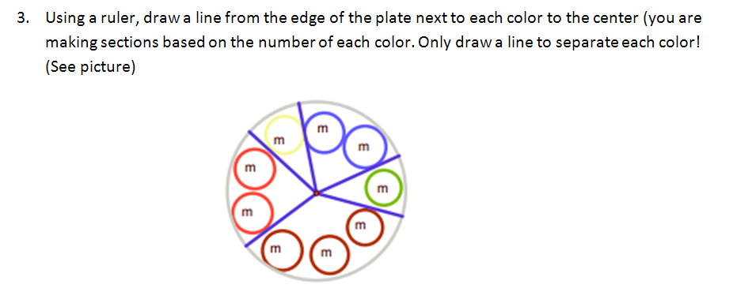

Slide 27
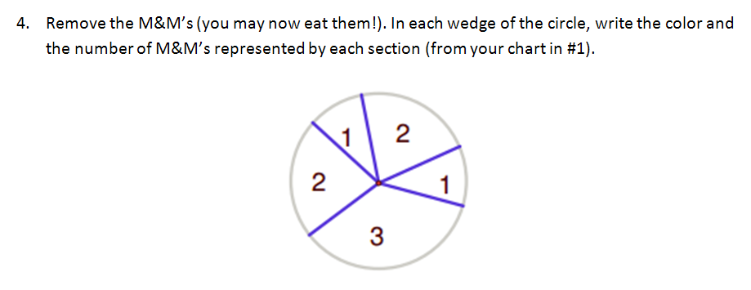

Slide 28
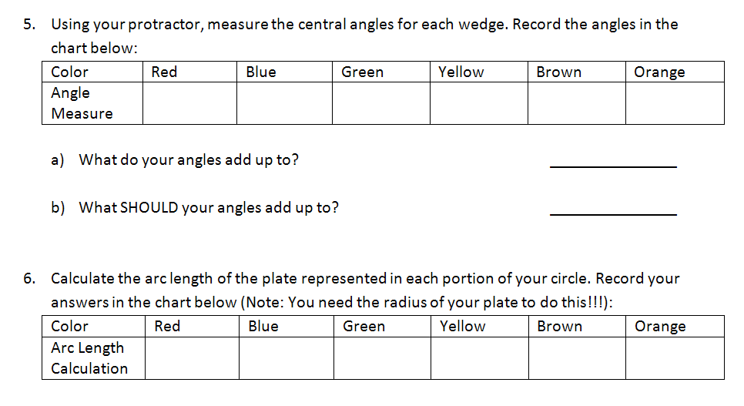

Slide 29
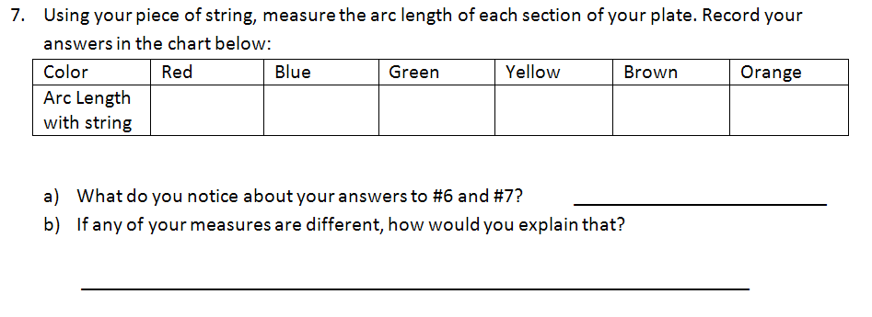

Slide 30
Lesson 9-3
I can recognize and use relationships between arcs are chords
I can recognize and use relationships between chords and diameters

Slide 31
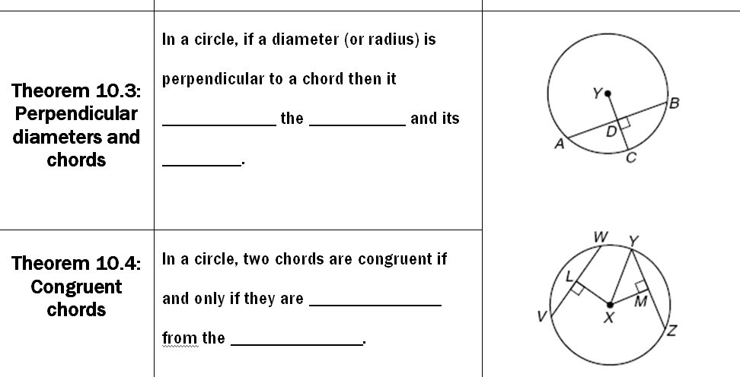
bisects
chord
arc
equidistant
center

Slide 32
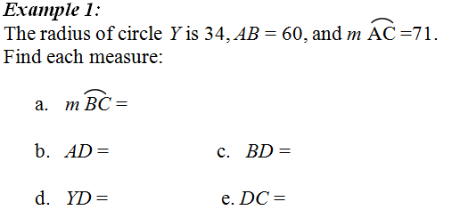
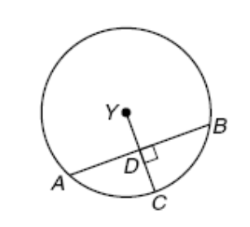
71°
30
30
16
18
34
60
x
x² + 30² = 34²
16
30
x² + 900 = 1156
30
18
71°
x² = 256
71°
x = 16

Slide 33
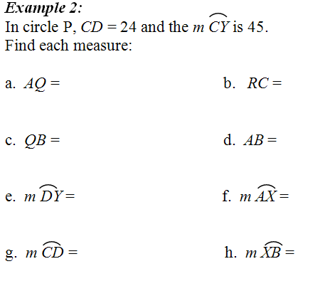
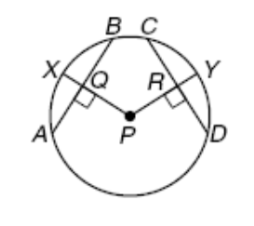
12
12
45º
24
12
24
45°
45°
90°
45°

Slide 34
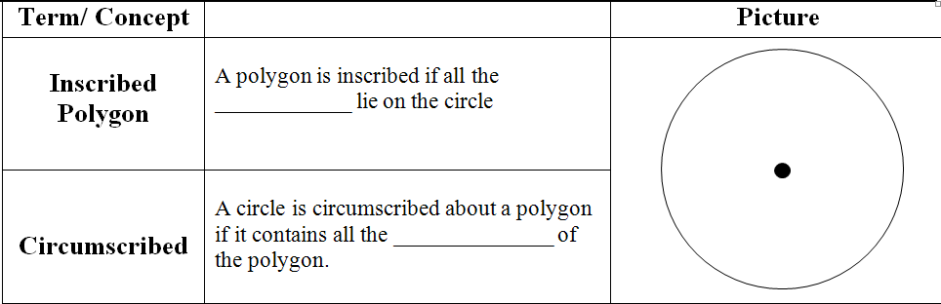
vertices
vertices
inscribed triangle

Slide 35
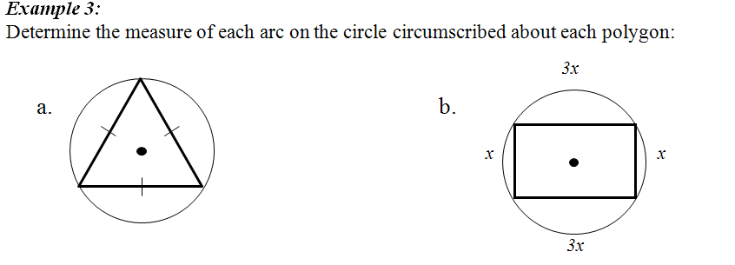
135º
x
120º
x
120º
45º
45º
x
120º
135º
8x = 360
3x =
360
x = 45º
x = 120º

Slide 36
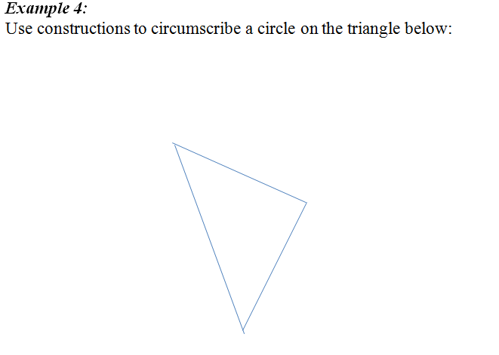

Slide 37
ASSIGNMENT
9-3 worksheet

Slide 38
Lesson 9-4
I can find the measure of inscribed angles
I can find measures of angles of inscribed triangles and quadrilaterals

Slide 39
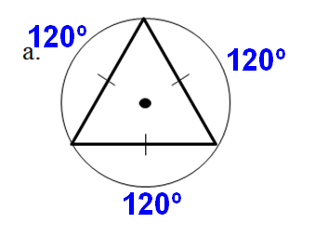
60º

Slide 40
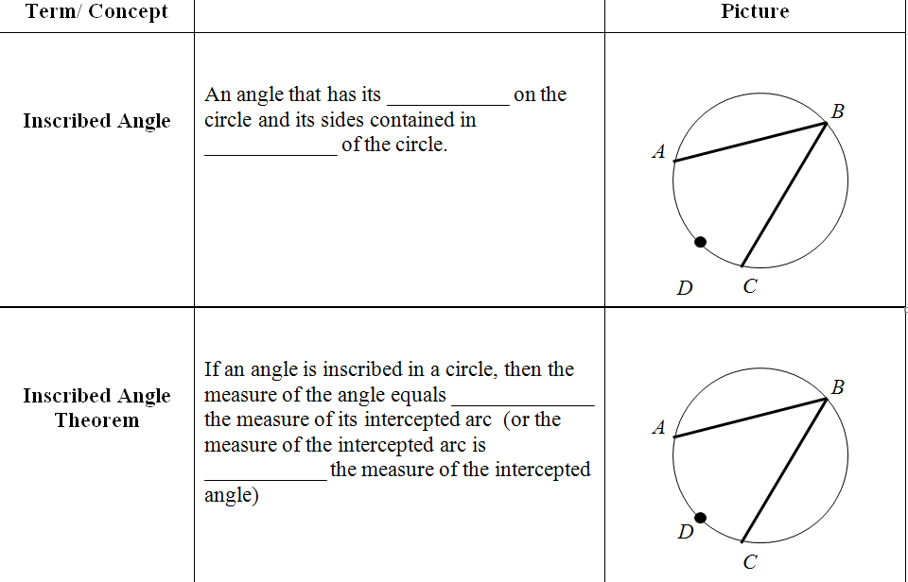
vertex
chords
half
xº
twice
2xº

Slide 41
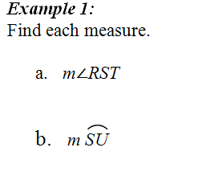
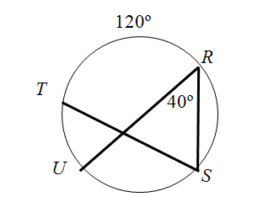
60º
80º

Slide 42
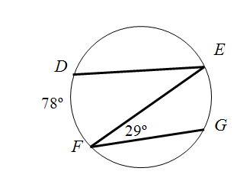
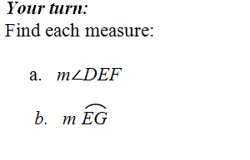
39º
58º

Slide 43
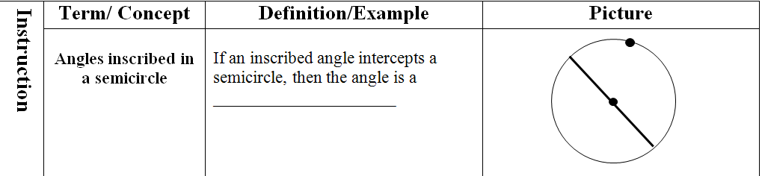
Right angle
180º

Slide 44
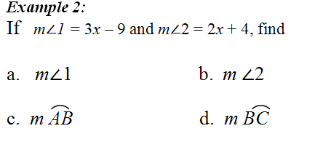
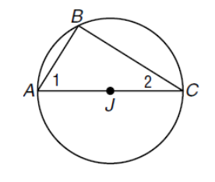
48º
42º
84º
96º
+ 90
3x – 9
+ 2x + 4
= 180
5x + 85 = 180
x = 19

Slide 45
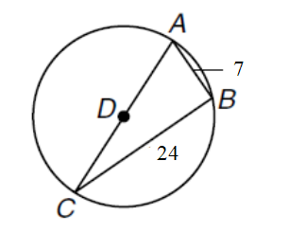

x
CD = 12.5
7² + 24² = x²
49 + 576 = x²
625 = x²
25 = x

Slide 46
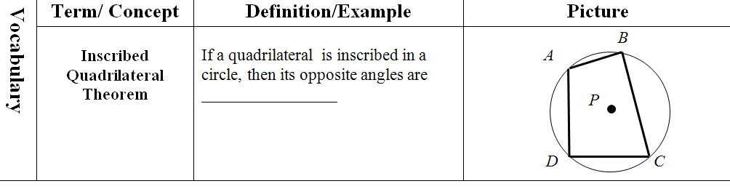
supplementary
(sum of 180º)

Slide 47
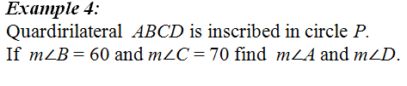
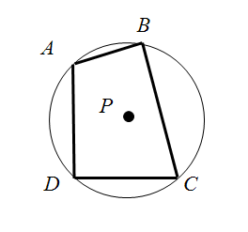
m∠A = 180 – 70
60º
= 110˚
m∠D = 180 – 60
= 120˚
70º

Slide 48
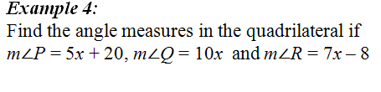
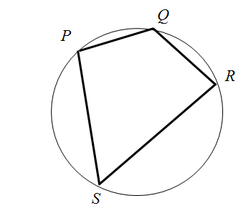
10x
140
= 180
5x + 20
+ 7x – 8
90
5x + 20
7x - 8
90
12x + 12 = 180
x = 14
40

Slide 49
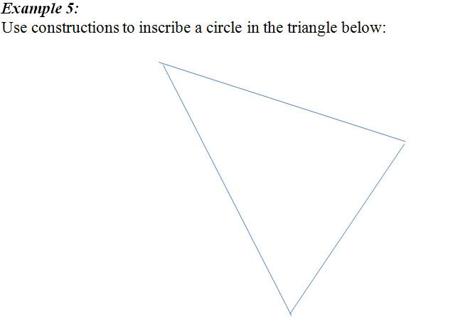

Slide 50
ASSIGNMENT
10-4 worksheet

Slide 51
WARM-UP: Chapter 10
Suppose YC = 29, AB = 42 and m AB = 92º.
1. Find AD.
21
20
2. Find YD.
3. Find DC.
9
4. Find m CB
46º

Slide 52
WARM-UP: Chapter 10
1. If the circumference of a circle is 100 feet, find the radius of the circle. Round to the nearest tenth.
15.9
2. Find m USQ.
230º
3. Find the length of UQ if
TA = 12 cm
27.23
40º
In circle A, TPQ is called a _____________________
semicircle

Slide 53
Lesson 9-5
I can use properties of tangents
I can solve problems involving circumscribed polygons

Slide 54

line
one point
point
intersects
tangent
perpendicular
radius

Slide 55

exterior
tangent
congruent

Slide 56

x
x² + 5² = 13²
5
8
x² + 25 = 169
x² = 144
x = 12

Slide 57

2x – 10
= x + 18
x = 28

Slide 58

sides
tangent

Slide 59

2
6
4
X = 10

Slide 60
ASSIGNMENT
9-5 worksheet

Slide 61
Lesson 9-6
I can write the equation of a circle
I can graph a circle on the coordinate plane

Slide 62

center
(h, k)
radius
r
(x – h)² + (y – k)² = r²

Slide 63


(x – h)² + (y – k)² = r²
(x – )² + (y – )² = ²
-2
4
5
(x + 2)² + (y – 4)² = 25

Slide 64

(x – h)² + (y – k)² = r²
(x – )² + (y – )² = ²
3
0
4
(x – 3)² + y² = 16

Slide 65

(x – h)² + (y – k)² = r²
(x – )² + (y – )² = ²
0
2
6
x² + (y – 2)² = 36

Slide 66

(5, 9)
9
(-7, 1)
10
(0, 4)
7

Slide 67

4
(-1, 4)
r = 3
(3, 0)
r = 5

Slide 68


5
x² + (y + 2)² = 25
(x – 5 )² + (y – 2)² = 16
(0, -2)
r = 5
(5, 2)
r = 4

Slide 69

r = 9
r = 20
d = 18
d = 40
C = 18π
C = 40π
= 56.55
= 125.66

Slide 70

r = 4
(3,1)
(x – 3)² + (y – 1)² = 16

Slide 71




Center: (-2, 3)
$$r=\sqrt{{(1−−2)}^{2}+{(5−3)}^{2}}$$
$$r=\sqrt{13}$$
(x – )² + (y – )² = ²
-2
3
$$\sqrt{13}$$
(x + 2)² + (y – 4)² = 13

Slide 72
ASSIGNMENT
9-6 worksheet

